Slide 1
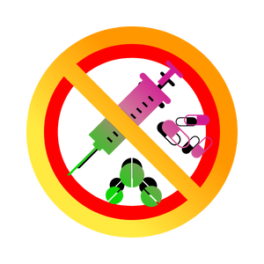
Substance Use, Addictions and Related Behaviours
Be Drug Free – Grade 6
Notes:
Trigger Warning: Explain to students that you will be discussing the topic of susbtance use, addictions and related behaviours, and that the topic may contain information that might be sensitive to them or bring up unwanted/ unprovoked trauma and/or emotion. Remind them that it is ok for them to take a break and leave the class if needed.
**The following slides (2-4) are for teacher use only**
Image from Canva

Slide 2
Presentation Format
Guiding Questions: Big idea questions that prompt students to brainstorm and share previous knowledge or new information.
Think, Pair, Share: Opportunity for students to work with partner or group and share ideas based on a prompt.
Notes:
Images from Canva

Slide 3
Presentation Format
Videos: Students can watch a short video clip that connects with topic. Discussion can follow before or after videos.
Final Activity: Activity that concludes the presentation.
Notes:
Images from Canva

Slide 4
Curriculum Expectations - Grade 6
D1.2 – Describe the range of effects associated with using cannabis, other drugs (e.g., prescription medications such as opioids; illicit opioids such as heroin, crack, cocaine, Ecstasy, crystal methamphetamine), and intoxicating substances (e.g., gas, glue).
D2.4 - Use decision-making strategies and skills and an understanding of factors influencing drug use to make safe personal choices about the use of drugs such as alcohol, tobacco and cannabis, and about activities such as vaping, including the choice to abstain.
Notes:
D1.4 - Identify people, resources, and services in the school and the community that can provide support when a person is dealing with mental health issues and choices or situations involving substance use and addictive behaviours, and describe how to access these support.
Image from Canva

Slide 5
Substance Use, Addictions and Related Behaviours
Be Drug Free – Grade 6
Notes:
**This is where the presentation officially begins**
Image from Canva

Slide 6
Guiding Question #1
Do you know of any types of drugs?
Notes:
Teacher Prompt: This could include prescription drugs, alcohol, tobacco, nicotine, etc. If students are struggling to come up with answers, you can always suggest “think about legal drugs and illegal drugs. If you don’t know what these are, that’s ok because we’re going to learn about them today.”
Image from Canva

Slide 7
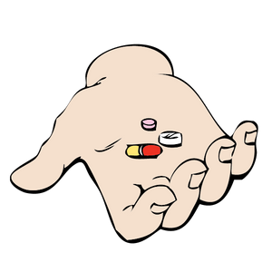
What is a Drug?
“A drug is a substance, other than food, which changes the way a person thinks, feels and acts.
Notes:
A drug can enter the body by being ingested, smoked, injected, inhaled or absorbed (e.g. under the tongue or through on the skin)
Canada. Department of Justice Canada. Controlled Drugs and Substances Act. Ottawa, ON:
Department of Justice, 1996. Available online at <http://laws.justice.gc.ca/en/C-38.8/>.
Definitions from https://www.edu.gov.mb.ca/k12/cur/physhlth/frame_found_gr11/rm/module_e_lesson_1.pdf
For different types of drugs, check out → Alcohol and Drug Foundation (ADF) https://adf.org.au/drug-facts/
Image from Canva

Slide 8
Video: What is a Drug?
Take notes about what you find interesting about this video.
Be prepared to share with the class.
Notes:
Only play the video until 3:17… If your students have learned about Neurons and you want to watch the entire video that is up to the teacher’s discretion.
Tell the students to pay attention to legal and illegal drugs, as well as the difference between stimulants and depressants, and their role.
Video link: https://www.youtube.com/watch?v=C3Na592f9oc
Also hyperlinked in the title. To access the video, click play on the video (make sure to be in present mode or the video won’t work)

Slide 9
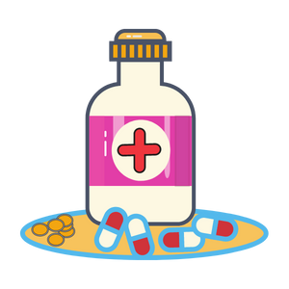
What are Legal and Illegal Drugs?
Legal drugs can be prescribed by doctors or health care providers and are sold in stores.
Illegal drugs refer to drugs that are not prescribed by a licensed medical professional, such as a doctor.
Notes:
Legal drugs: Are known as over-the-counter (OTC) and prescription (Rx) drugs. This can include alcohol, nicotine, and caffeine, which are all legal drugs.
Illegal drugs: The use of these drugs is considered illegal under the Controlled Drugs and Substances Act (Department of Justice Canada).
Canada. Department of Justice Canada. Controlled Drugs and Substances Act. Ottawa, ON: Department of Justice, 1996. Available online at <http://laws.justice.gc.ca/en/C-38.8/>.
Definitions from https://www.edu.gov.mb.ca/k12/cur/physhlth/frame_found_gr11/rm/module_e_lesson_1.pdf
Image from Canva

Slide 10
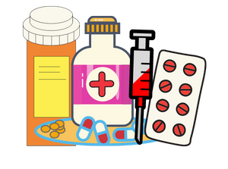
Drugs and Substances
The three main types of drugs affecting how a person thinks, feels and behaves are:
Depressants
Hallucinogens
Stimulants
Notes:
Depressants:
Slow down the functions of the central nervous system (CNS)
When this type of drug, the person is less aware of their environment.
These types of drug have a relaxing effect, can slow brain function and physical function.
Hallucinogens:
These drugs disrupt a person’s ability to think and communicate clearly, or to even recognize reality.
Person may experience distorted awareness and perception, which can result in dangerous behaviour.
Stimulants:
Speeds up the function of the central nervous system
Drug user is more aware of their environment
Drug use may cause changes in behaviour, such as restlessness and dizziness.
Reference: Better Health Channel. (2017, December 18). How drugs affect your body. https://www.betterhealth.vic.gov.au/health/healthyliving/How-drugs-affect-your-body
https://adf.org.au/drug-facts/
Image from Canva

Slide 11
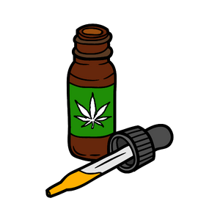
Legal Drugs
Prescription Medications – These are prescribed to you by a health care provider or doctor.
Over the Counter (OTC) medication, such as Tylenol or Advil.
Alcohol, Tobacco, and Cannabis – Must be over 19 years of age to purchase or use.
Notes:
*Government of Canada has now legalized recreational cannabis
Note that prescription drugs can be classified as either legal or illegal. This depends on whether or not the drug was prescribed to you by a doctor.
Over the Counter medication: Always talk to a parent or trusted adult before using to know if the product is right for you and to get help so that you are using it safely.
Remember all drugs (legal or not) can produce negative health outcomes.
Image from Canva

Slide 12
Tobacco
Tobacco products are most often smoked (cigarettes, cigars).
There are smokeless products like chewing tobacco.
Tobacco products contain nicotine.
Must be 19 years of age or older to purchase and use tobacco products.
Notes:
Tobacco can be smoked in the form of cigarettes, cigars, and other forms.
Tobacco also comes in smokeless tobacco products like chewing tobacco.
Chewing tobacco is shredded, twisted, or bricked loose leaf tobacco. It is places in the mouth, between the cheek and lower lip. It is occasionally chewed. The resulting tobacco juices/saliva is typically spit out.
Nicotine is the drug in tobacco that is addictive
Legal age to purchase tobacco products is 19 years of age and older
Image from Canva

Slide 13
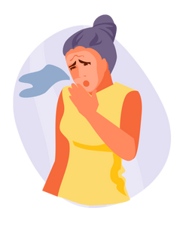
Potential Negative Effects of Tobacco Use
Yellow teeth
Bad breath
Coughing
Lung damage
Decreased exercise tolerance
Increased risk of heart attack and stroke
Addiction
Notes:
Using tobacco has many negative consequences that will affect your life, including:
Yellow teeth
Bad breath
Cough
Decreases exercise tolerance because of the decreased oxygen to the body (one cannot do sports as easily)
Among the negative consequences, there are some very serious health effects such as
Lung damage
Increased risk of heart attack, stroke, and addiction
Other things to consider are that your friends may not want to be around you if your use tobacco products and that it is a habit that costs a lot of money…
Image from Canva

Slide 14
Vaping Products
Also known as electronic cigarettes (e-cigs), vape pens, JUULs.
These battery-powered products turn a liquid substance into vapour.
Some liquids used to vape may contain nicotine.
The aerosol, or vapour from these devices contains other chemicals that can be extremely harmful.
Notes:
This should be a review from the vaping PowerPoint presentation, if already taught.
Electronic cigarettes – commonly referred to as e-cigarettes or “vapes”
Use a battery, heating element and liquid containing cartridge (e-liquid or e-juice) to create an aerosol or vapour.
The cartridges come in different flavours which may be appealing to young people.
In Canada, e-cigarettes without nicotine are considered legal; however, Health Canada warns that they have not been fully checked for safety or quality. In fact, some cartridges that have been labeled as nicotine-free actually contain nicotine. Different cartridges may contain different amounts of nicotine. E-cigarettes containing nicotine are readily available in Canada and online.
Electronic cigarettes may be perceived as being less harmful then cigarettes, but there are still risks. Many cartridges contain nicotine and the aerosol contains other chemicals that may be harmful.
Images from Canva

Slide 15
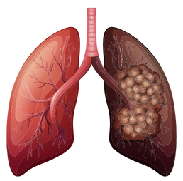
Potential Negative Effects of Vaping
Light headedness
Throat irritation
Dizziness
Coughing
Increased heart rate and blood pressure
Lung inflammation
Notes:
Research on the long-term health effects of frequent vapour (aerosol) exposure is unknown but some studies suggest possible lung damage.
Image from Canva

Slide 16
Cannabis
Cannabis, also known as weed (pot, marijuana), comes in many different forms.
Cannabis is smoked in joints and pipes, consumed in foods or beverages, and used in creams or oils.
Cannabis comes from a plant called a sativa plant and contains the chemicals THC and CBD.
Notes:
Cannabis comes in many forms, but it is most commonly known for dried flowers and leaves (in the form of a bud) or in extracts such as oils and edibles. Pther names for cannabis include marijuana, mary-jane, pot, weed.
Briefly explain that there is a chemical that is extracted from the plant called cannabinoids. The two most commonly known cannabinoids found in cannabis are THC (Tetrahydrocannabinol) and CBD (Cannabidiol).
THC = tetrahydrocannabinol – It is a mind changing/altering ingredient extracted from the plant. This chemical is responsible for giving people a “high”.
Cannabis can be consumed in many different forms including a pipe, joint, bong, in food, etc. It can also be smoked in a blunt which is a cigar that has been emptied of tobacco and refilled with a combination of tobacco and marijuana. This methods combines the dangerous chemicals of cannabis with nicotine and other harmful chemicals.
Recreational cannabis became legalized in Canada on October 17, 2018. You must be 19 years of age and older to buy, use, possess and grow cannabis.
Image from Canva

Slide 17
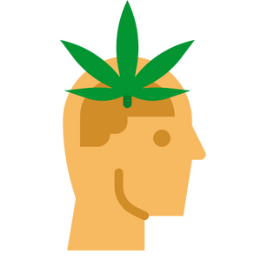
Potential Negative Effects of Cannabis Use
Increased hunger
Loss of coordination – difficulty walking, running, or balancing
Hallucinations – seeing things that aren’t real
Memory loss
Decreased concentration
Lung disease
Notes:
Cannabis increases heart rate which can lead to increased risk of heart attacks.
Cannabis smoke contains carcinogens (cancer causing agents)
Can negatively affect daily life or exacerbate existing problems. For example, decreased concentration can impact academic performance. It is dangerous to drive or operate heavy machinery after using cannabis.
Contrary to popular belief, marijuana is addictive. Research suggests that those who start using at a younger age are at increased risk for addiction.
Image from Canva

Slide 18
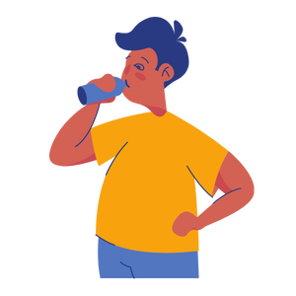
Alcohol and the Body
Alcohol is a product that slows down the brain and central nervous system (CNS), heart rate, and breathing rate.
Alcohol is a depressant.
Notes:
Image from Canva

Slide 19
What is “One Drink”?
One drink, as shown to the right, varies in size depending on the type of alcohol product.
Notes:
Alcohol content varies so “one drink” is a different size depending on the type of alcohol being consumed. The higher the alcohol content (indicated by the percentage), the smaller the volume of one serving.
Its important to know that everyone’s bodies will react differently to the consumption of alcohol.
NRPH Image

Slide 20
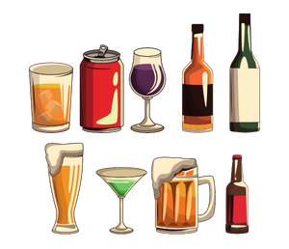
Potential Effects from Alcohol Use
When you drink alcohol it quickly enters the bloodstream and can affect the body. This can lead to:
Blurred vision
Slow reaction time
Poor coordination
Increased risk-taking behaviours
Slurred speech
Notes:
Increases risk taking behaviours and poor decision making (i.e. risky sexual activity, dangerous activities that may cause injury)
Decreased coordination, blurred vision and decreased reaction time increases risk of injury. These affects of alcohol are also what make it dangerous to drive after drinking.
Binge drinking may result in a “hangover” the follow day. Symptoms include shakiness, nausea, headache, etc.
Alcohol is addictive for some individuals.
Long term consequences may included damage to organs such as brain, liver, pancreas and stomach. The risk of cancer is also increased.
When a women is pregnant, drinking alcohol during the pregnancy can affect the unborn baby and can lead to challenges after the baby is born.
Image from Canva

Slide 21
Alcohol Poisoning
Signs of alcohol poisoning:
Cold/clammy, pale or bluish skin
Slow breathing
Could vomit
Confusion
Shakiness
Slow and weak pulse
Unconsciousness (passed out)
Notes:
A helpful acronym for remembering common symptoms of alcohol poisoning is CUPS:
Cold and sweaty skin
Unconscious
Puking
Slow or irregular breathing and heart rate
Binge drinking is defined as:
5 or more standard drinks on one occasion for males
4 or more standard drinks on one occasion for females
Alcohol poisoning is when you drink a large amount of alcohol in a short period of time. Alcohol Poisoning can be fatal. Alcohol decreases breathing and heart rate. If they slow down too much this can result in death. Alcohol poisoning can also lead to loss of consciousness and vomiting as the body tried to get rid of the excess alcohol. Choking on vomit (while “passed out”) can result in death. Alcohol poisoning is a medical emergency.
Reference: Government of Canada. (2021, September 3). How young adults can reduce risks related to alcohol use. https://www.canada.ca/en/health-canada/services/substance-use/alcohol/young-adults-reducing-risk.html
Image from Canva

Slide 22
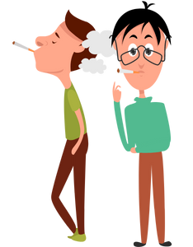
Think, Pair, Share
Your peers might influence your decisions about using drugs, drinking alcohol, smoking, or vaping.
How might you respond to those influences?
With a partner, discuss what you could say if someone were to offer you a drug, cigarette, alcoholic beverage, or vaping product.
Notes:
Teacher Prompt: After students have finished discussing the question, get them to role-play in groups a possible scenario that involves drugs, cigarettes, or vaping products. One person will be selling/offering the product, one student will be the one who is offered the product, and one or two students could be the bystander.
This is a great time to discuss peer pressure and influences, as well as address decision-making skills and refusal strategies.
Refusal Strategies:
Discuss different ways and tips for saying no (refusal skills):
Say “no”. Be assertive and clear.
Walk away
Broken record – You may be asked several times - keep repeating “no”.
Say “no” different ways. For example, “I’m not interested” or “I don’t want to”
Give an excuse or explanation if you want. For example, “I don’t want to smoke weed because I don’t want to become addicted.”
Offer an alternative activity. For example, “I don’t want to smoke weed; how about we go to the mall?”
Reverse the pressure. For example, “Why are you pressuring me?”
Some peers may try to influence you to do drugs, or to start smoking or vaping, by saying it’s cool to do them, or sometimes you may just want to be part of a crowd that’s into those things. To avoid this kind of influence, you have to be strong as an individual, think about what you really want and what you value, and make up your own mind about things. Even if someone tells you ‘everyone is doing it’, your decisions are your own, and so are the consequences. But peers can be a positive influence too. Hanging out with friends who don’t use drugs and don’t smoke or vape can keep you from starting.” – Ontario Health and Physical Education Curriculum, 2019,p.228
Images from Canva

Slide 23
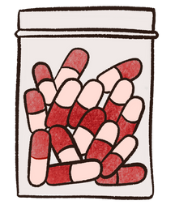
Illegal Drugs
Illegal drugs are often harmful and are drugs that are not prescribed to you by a health care provider.
Illegal drugs are also called “street drugs”.
Some illegal drugs are ecstasy (MDMA), heroin, cocaine, opioids, and methamphetamine (i.e., meth).
Notes:
Illegal drugs are often sold by people who do not have a license to sell them. This is why they are called “street drugs” because they are often sold by people who are not medical professionals.
Reference: Drug Free Kids (DFK). (2022). 60% of those who use illegal drugs are 15 to 24 years old. https://www.drugfreekidscanada.org/prevention/drug-spotlights/illegal-drugs/
https://www.canada.ca/en/health-canada/services/substance-use/controlled-illegal-drugs.html
Image from Canva

Slide 24
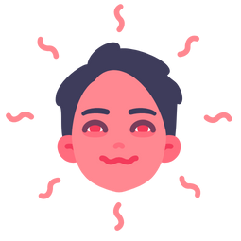
Possible Effects of Illegal Drug Use
Ecstasy (MDMA):
It might make you feel alert, warm and talkative.
It might make sounds and colours seem vibrant and intense.
Meth:
It might create feelings of pleasure and confidence, as well as might make you alert and energetic.
Notes:
Different drugs will have different effects on the body, specifically on the central nervous system (CNS).
Illegal drugs include ecstasy (MDMA), heroin, cocaine, opioids, and methamphetamine (i.e., meth).
Reference:
Better Health Channel. (2017, December 18). How drugs affect your body. https://www.betterhealth.vic.gov.au/health/healthyliving/How-drugs-affect-your-body
Drug Free Kids (DFK). (2022). 60% of those who use illegal drugs are 15 to 24 years old. https://www.drugfreekidscanada.org/prevention/drug-spotlights/illegal-drugs/
Image from Canva

Slide 25
Possible Effects of Illegal Drug Use
Cocaine:
It might increase your energy.
It might make you feel happy, awake, confident.
Psychedelics (“Magic Mushrooms”):
It might make you euphoric (feel high)
It might cause hallucinations (visual and auditory)
It might change your consciousness, mood, thought and perception (“trip”)
Notes:
Different drugs will have different effects on the body, specifically on the central nervous system (CNS).
Illegal drugs include ecstasy (MDMA), heroin, cocaine, opioids, and methamphetamine (i.e., meth).
Psychedelics or Psilocybin (magic mushrooms): can cause something called a “trip”. Some people have good “trips” and some people have “bad trips”. Other types of psychedelics are LSD, DMT, and
Reference:
Alcohol and Drug Foundation (ADF). (2021, November 10). Psilocybin (magic mushrooms). https://adf.org.au/drug-facts/psilocybin/
Better Health Channel. (2017, December 18). How drugs affect your body. https://www.betterhealth.vic.gov.au/health/healthyliving/How-drugs-affect-your-body
Drug Free Kids (DFK). (2022). 60% of those who use illegal drugs are 15 to 24 years old. https://www.drugfreekidscanada.org/prevention/drug-spotlights/illegal-drugs/
Image from Canva

Slide 26
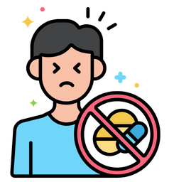
Possible Negative Effects of Illegal Drug Use
Ecstasy (MDMA):
It can lead to overheating and dehydration.
Long-term use causes memory loss, depression and anxiety.
Meth:
It can cause excessive sweating and grinding of your teeth.
It can increase your heart rate and breathing.
Notes:
Different drugs will have different effects on the body, specifically on the central nervous system (CNS).
Reference:
Better Health Channel. (2017, December 18). How drugs affect your body. https://www.betterhealth.vic.gov.au/health/healthyliving/How-drugs-affect-your-body
Image from Canva

Slide 27
Possible Negative Effects of Illegal Drug Use
Cocaine:
It can overstimulate the heart and nervous system.
It can increase the risk of mental health issues.
Psychedelics (“Magic Mushrooms”):
It can cause headaches, stomach discomfort and nausea, as well as vomiting.
It can lead to facial flushes, sweating and chills, as well as fast or irregular heartbeat.
It dilates pupils and can increase body temperature.
Notes:
Different drugs will have different effects on the body, specifically on the central nervous system (CNS).
Reference:
Alcohol and Drug Foundation (ADF). (2021, November 10). Psilocybin (magic mushrooms). https://adf.org.au/drug-facts/psilocybin/
Better Health Channel. (2017, December 18). How drugs affect your body. https://www.betterhealth.vic.gov.au/health/healthyliving/How-drugs-affect-your-body
Image from Canva

Slide 28
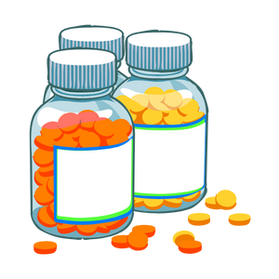
Prescription Drugs
The non-medical use of prescription drugs is taking and using someone else’s prescription medication.
Taking prescription drugs without a doctor’s supervision can be just as dangerous as using illegal drugs.
Notes:
The non-medical use of prescription drugs is taking other people’s prescription medication without guidance from a health care provider or doctor, to get high. You should never take someone else’s prescription medication.
Taking prescription drugs that are not prescribed to you can be just as dangerous as using illegal/illicit drugs. Drugs, including prescription drugs, have unwanted and potentially dangerous side effects (eg. Decreased breathing). Prescription pain killers (eg. Fentanyl, percocet, oxycontin, Tylenol #3,) are highly addictive.
It is illegal to take prescription medication that is not prescribed to you. This includes taking
Pain medications
ADHD medications
Sleeping pills
Image from Canva

Slide 29
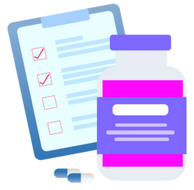
What are Opioids?
Opioids are drugs that are used to treat and relieve pain. They can be prescribed as medications such as:
Codeine
Fentanyl
Morphine
Oxycodone
Hydromorphone
Medical heroin
Notes:
Prescription opioid medications are available in various forms, such as syrups, tablets, capsules, nasal sprays, skin patches, suppositories, and liquids for injections.
If you have been prescribed an opioid medicine, it should:
Only be taken as prescribed
Never be used by someone for whom it was not prescribed
Never be taken with alcohol or other medications (except as prescribed by a doctor or health care provider)
Opioids can also be produced or obtained illegally.
Image from Canva
Reference: Government of Canada. (2022, January 14). Opioids. https://www.canada.ca/en/health-canada/services/opioids.html

Slide 30
Possible Effects of Opioid Use
Short-term effects:
Drowsiness
Constipation
Nausea and vomiting
Euphoria (feeling high)
Difficulty breathing
Headaches, dizziness and confusion
Long-term effects:
Increased tolerance
Liver damage
Infertility in women
Worsening pain (also known as “opioid-induced hyperalgesia”)
Substance use disorder, addiction, or dependence
Notes:
Reference: Government of Canada. (2022, January 14). Opioids. https://www.canada.ca/en/health-canada/services/opioids.html

Slide 31
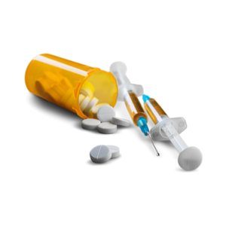
Problematic Opioid Use
Problems from opioid use can include:
Using opioid medicine incorrectly, such as taking more than prescribed by a medical professional.
Developing a substance use disorder, which may cause a physical effect called withdrawal.
Notes:
When someone is affected by substance use disorder, or addiction, they crave the drug and continue using it despite the harmful effects. The drug becomes the focus of their feelings, thoughts and activities.
Opioids affect the part of the brain that controls your breathing, so when you take in more opioids than your body can handle, your breathing starts to slow down. This can lead to unconsciousness and even death.
Physical withdrawal effects may include:
Chills
Diarrhea
Insomnia
Sweating
Body aches
Nervousness
Widespread or increased pain
Irritability and agitation
Nausea and stomach pain
Reference: Government of Canada. (2022, January 14). Opioids. https://www.canada.ca/en/health-canada/services/opioids.html

Slide 32
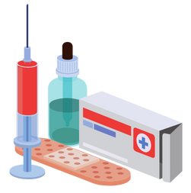
Naloxone
Naloxone is a type of harm reduction response to treat an opioid overdose.
Naloxone is a fast-acting drug used to temporarily reverse the effects if a person has opioids in their system.
Notes:
Naloxone only works if you have opioids in your system, such as:
fentanyl
heroin
morphine
codeine
In Canada, two types of take-home kits are available:
Naloxone nasal spray is sprayed directly into the nose, where it is absorbed. It starts to take effect in 2 to 3 minutes. Learn how to give naloxone spray (video) → https://www.youtube.com/watch?v=aR3qA63TrAI
Naloxone injectable is injected into any muscle in the body, such as the arm or thigh. It starts to take effect in 3 to 5 minutes. Learn how to give a naloxone injection (video) → https://www.youtube.com/watch?v=dPy168bpe6A
Reference:
Ontario Harm Reduction Network (HRN). (2021). Education & Training: Overdose Response with Naloxone. https://ohrn.org/naloxone/#introduction
Government of Canada. (2021, July 9). Naloxone. https://www.canada.ca/en/health-canada/services/opioids/naloxone.html
Image from Canva

Slide 33
Intoxicating Substances
These substances are products that are used everyday in your life, but when used incorrectly can act like a drug.
If these products are eaten or inhaled they can cause serious harm.
Notes:
Examples of intoxicating substance include: gasoline, glue, mouthwash, hairspray, bath salts, tide pods3.
Like other drugs, intoxicating substances can effect a number of different organs including the brain, heart, kidneys, and liver. The effects of these drugs can range but may include dizziness, hallucinations, nausea, loss of judgement, rapid heart rate, and others.
Image from Canva

Slide 34
Guiding Question #2
What do you think are some of the possible consequences from drug use?
Notes:
Decreased athletic, performance, Poor grades, more fights and more injuries, sexual assault/dating, violence, vehicle crashes, decreased decision making ability. Other examples might include:
Financial problems
Inability to make good decisions
Injury, death, or legal charges as a result of accidents or violence while impaired
Decreased Athletic Performance
Extra Weight
Hangovers
Decreased Motor Skills (eye, hand, brain coordination)
More Fights
Decreased Judgement
Decreased Sensitivity
Sexual Assault
Won’t take “no”
Won’t hear “no”
Passed out
More Injuries
Railroad
Pools
Falls
Vehicle Crashes
Motor Vehicle (i.e. bicycle, car, boat, ATV)
15% of all students (Gr 7-12) report being a passenger with driver who has been drinking (OSDUHS, 2015).
12% of students reported being a passenger with a driver who had been using drugs (OSDUHS, 2015)
Impairment, speed and driver error are the main reasons for vehicle crashes.
Images from Canva

Slide 35
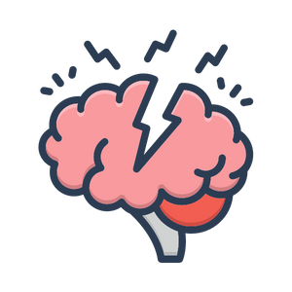
Mental Health and Substance Use
Substance use and mental health have shown to be connected.
Mental illnesses may lead to substance use and addiction.
Long-term drug use can lead to the development of mental illness.
Notes:
Suggest to students that they can look for these warning signs in a friend they may be concerned has mental health issues…
Frequently sad, depressed, anxious, or rebellious
Difficulty paying attention
Problems with eating, sleeping, or getting along at school
Being addicted to substances
Image from Canva

Slide 36
Addiction
An addiction is an urge to do something that is hard to control or stop.
People can have many different types of addictions, being addicted to drugs is only one type.
Notes:
Drug use can vary widely. Many people never try drugs, while some experiment with drugs and others use them regularly or even become addicted.
All drugs have negative effects – some of those effects are felt after trying a drug even once, while others occur as people use the drugs repeatedly. You never know how a drug is going to react with your body and so experimenting with any type of drug can be dangerous.
Some young people start off in the experimental stage and wind up using drugs regularly, which leads to dependency and addiction. Once a person develops an addiction to a drug, he or she feels controlled by the drug and needs the drug to function.
Addiction is characterized by the 4 C’s:
Craving the drug;
loss of Control of the amount of frequency of use;
a Compulsion to use the drug;
and continuing to use the drug despite the Consequences.
An addiction is a term used to describe a behaviour that is out of control in some way.
Image from Canva

Slide 37
Emergency Situation
If someone passes out from using drugs, try to wake them. If they do not respond, complete the following:
Check for a pulse
Make sure the person is breathing
Use the Bacchus Maneuver
Call 911
Stay with the person until help arrives
Notify parents or guardians as soon as possible
Notes:
If someone loses consciousness after drinking and/or using drugs there are some very important steps you should take to help keep the person safe.
Check for a pulse and make sure the person is breathing.
Position the person using the Bacchus maneuver shown in the diagram here.
Option: have students practice this skill on each other.
Stay with the person and call 9-1-1. If you don’t have a phone with you and you are alone, leave to call 9-1-1 but return immediately.
Notify the person’s parents or guardians or another responsible adult as soon as possible.
Make sure you DO NOT leave the person alone. Even if the person is conscious, but is impaired, they must not be left alone as the risk is high for injuries.
To prevent choking, DO NOT give the person anything by mouth (no coffee, food, etc).
DO NOT simply let the person sleep it off. They could be dead in the morning.
Above steps and procedures for an emergency situation applies to both alcohol poisoning and drug overdose.
Image from Canva

Slide 38
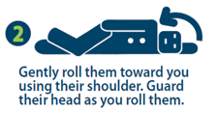
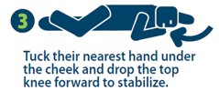
Bacchus Maneuver
If someone loses consciousness after drinking or using drugs, the Bacchus maneuver should be used.
Notes:
If someone loses consciousness after drinking and/or using drugs, the Bacchus maneuver should be used.
Option: students can practice this skill on each other.
NRPH Image

Slide 39
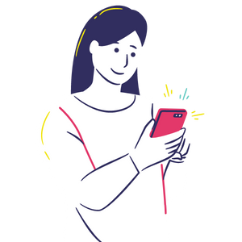
Community Supports
Community Addictions Services of Niagara (CASON) → (905-684-1183) or www.cason.ca
Kids Help Phone → (1-800-668-6868) or https://kidshelpphone.ca/
Mental Health Helpline → (1-866-531-2600) or https://www.connexontario.ca/en-ca/
Notes:
Services for Youth - Niagara Region, Ontario → https://www.niagararegion.ca/health/schools/youth-services.aspx
Drug Free Kids Canada → https://www.drugfreekidscanada.org/prevention/get-help-resources/
Pathstone Crisis Services (1-800-263-4944)
Al-Anon/Alateen (if you are bothered by someone else’s drinking) 905-328-1677 or 1-888-425-2666
CASON → 905-684-1183 or www.cason.ca
Kids Help Phone → (1-800-668-6868) or https://kidshelpphone.ca/
Mental Health Helpline → (1-866-531-2600) or https://www.connexontario.ca/en-ca/
Image from Canva

Slide 40
Final Activity: Staying Safe
What are some ways that you can be drug free?
With a partner or in a group, think of ways that you can help each other be safe and drug free.
Share as a class when finished.
Notes:
There are some things that can help you to stay drug-free.
Having a good friend can make you less likely to use drugs. What does it mean to be a good friend? (someone who accepts you/your decisions, looks out for you; does not pressure you to do something you don’t want to do; positive peer influence; can recommend people and places to go to for help when dealing with problems and difficult choices)
It can also help to have interests – especially those that you share with your friends – that you can do instead of using drugs or alcohol. What do you think some of those could be? (sports, starting a band, being in the school play/talent show, video games, etc)
Knowing how to say “no” is important to helping you stay drug-free. It can be very difficult to say “no” to friends or peers without offending them or feeling singled out. That’s why it helps to have some strategies to deal with those situations. If a friend offers you beer or a cigarette, how can you refuse it? Some strategies include: avoid the group, walk away, give a reason or excuse (e.g. training for track and field), suggest an alternative (e.g. going to the movies), say “Can you imagine if my parents found out? No way – I want to live until at least tomorrow”, say “respect my decision – I respect yours”, say “Look I’d rather not”, say “I’ll catch up with you tomorrow – I’ve got other things I’d like to do”.
You can also create a Safety agreement with your parents or guardians and plan to have them pick you up if you don’t have a safe ride home without asking questions about what happened or waiting to ask questions until the next day. The rules about this agreement would be decided together.
Another arrangement you could make with your parents/guardians is choosing a Code Word or symbol that you can text to them if you need to ask them for help. You would simply text the Code Word to your parents and they would call you back and make up an excuse for you to leave the situation and arrange a safe ride home.
It is also important to know where to go for help. For example, you might go to a trusted adult, like a parent, teacher, doctor, or coach, to ask them for help or advice. You might also consult one of the community resources that are available. [list on next slide]
Image from Canva

Slide 41
More Questions? Talk with Someone:
Teacher/Principal/Coach
Doctor or Health Care Provider
Parents/Guardians
School Health Nurse
Community Addictions Services of Niagara (CASON)
Kids Help Phone
Notes:
If you ever have questions/concerns, need help or know someone who needs help, you can always talk to someone. There are many options out there available to you. A young person is less likely to use drugs if they have one of the following support personnel mentioned above…
Image from Canva

Slide 42
Final Thoughts
Drugs have serious short- and long-term health effects.
Taking prescription medications that have not been prescribed by a health care provider can be just as dangerous as using illegal and illicit drugs.
Using any drugs for a long period of time may lead to substance use, addiction, and mental health problems.
Notes:
Remind students: It is illegal under the age of 19 to use, buy, or sell drugs such as alcohol, marijuana, tobacco, and other drugs.
If your in an uncomfortable situation, remember to use refusal skills or talk to someone you trust
Image from Canva

