Slide 1
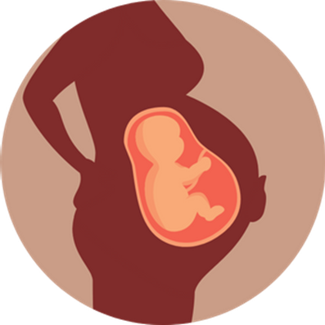
Part 2: Preventing Sexually Transmitted Infections and Unplanned Pregnancy
Grade 7
Notes:
**The following slides (1-6) are for teacher use only**
The speaker’s notes are also intended for teacher use only. The notes include general information, background knowledge, questions and/or prompts. The information included in these notes should not be read word for word. Teacher’s should review the notes before using the presentation to become familiar with the content, as it is to supplement what is on the slide.
There are two parts to this presentation: Part 1 is about Sexually Transmitted Infections (STIs) and Part 2 is about Unplanned Pregnancy. It is up to the discretion of the teacher on how they’d like to present this content. Due to the length of this presentation, it is recommended that you take two classes to teach this information.
Images from Canva
Last Updated: January 2023

Slide 2
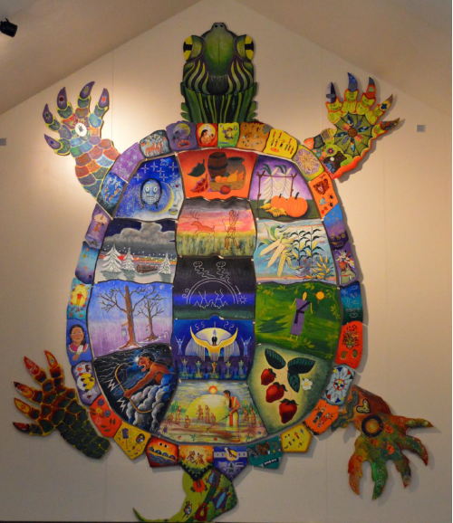
Land Acknowledgement
Notes:
Niagara Region is situated on treaty land. This land is steeped in the rich history of the First Nations such as the Hatiwendaronk (Hat-i-wen-DA-ronk), the Haudenosaunee (Hoe-den-no-SHOW-nee), and the Anishinaabe (Ah-nish-ih-NAH-bey), including the Mississauga's of the Credit First Nation. There are many First Nations, Métis, and Inuit peoples from across Turtle Island that live and work in Niagara today. The Regional Municipality of Niagara stands with all Indigenous peoples, past and present, in promoting the wise stewardship of the lands on which we live.
*Disclaimer: In the Spirit of Truth and Reconciliation, Niagara Region Public Health acknowledges that people are gathered on the customary and traditional lands of the Indigenous Peoples of this territory. We recognize that the land on which you are situated will vary depending on where you are located in Ontario. It is advised that you reach out to your school’s principal or school board for the school-specific treaty land. If you have already done a land acknowledgement on the same day you are presenting this lesson, you are welcome to skip this slide. However, it is always encouraged to complete a land acknowledgement before continuing on with this presentation.*
Information about the image on the left:
There are seven objects that have been purposely selected and included in the design of the artwork: an Inukshuk, an eagle feather, two drums, a Métis sash, an embroidered flower, and wampum belt. Each object reflects the diversity of First Nations, Métis and Inuit in North America. The iconic stone monument, the Inukshuk, is used as a marker identifying important sites and as a navigational tool to communicate direction. The eagle feather is significant to the spiritual beliefs of some Métis and First Nations peoples. Its symbolism includes honour, wisdom, and courage among many others. It is considered an honour to be given an eagle feather. The two drums include the Inuit drum and the Métis and First Nations drum. The drum is symbolic of the heartbeat of Mother Earth and is often played at various traditional gatherings and ceremonies. The embroidered flower is woven into many traditional garments and various objects through beadwork, painting, or etchings. It is also considered one of Canada’s first art forms. The Métis sash was once a tool of the voyageurs and fur traders. It is also a symbol of knowledge and the relationship between the Métis, the First Nations, and Europeans. At the top of the poster are four lines reminiscent of the traditional beaded wampum belt. There are many types of wampum belts with different significant meanings, including agreements made between two groups/nations, knowledge sharing, and storytelling. The four lines in this wampum belt represent the equality and diversity of the four peoples (First Nations, Metis, Inuit, and European settlers) and to acknowledge the journey of living together peacefully (ETFO, 2022).
For more information on Indigenous Education and First Nations, Metis and Inuit (FNMI), check out the following resources:
https://www.otffeo.on.ca/en/learning/indigenous-education
https://www.etfo.ca/socialjusticeunion/first-nation,-metis-and-inuit-(fnmi)
Photo References:
Image on the Left: Elementary Teacher Federation of Ontario (ETFO). (2022). ETFO Land Acnowledgements. https://www.etfo.ca/about-us/governance/etfo-land-acknowledgement
Image on the Right: Creating Our Way Forward: Recommendations for Improving Niagara Region Public Health & Emergency Services’ Indigenous Engagement (2019). https://www.niagararegion.ca/health/equity/pdf/indigenous-engagement-report.pdf
Mural of Turtle Island → Cover photo: Oneida nation artist, Sharon Sarnowski (deceased) This is a picture taken of the mural in the Boardroom of the Oneida Tribal Council office, Oneida, Wisconsin.

Slide 3
Presentation Format
Guiding Questions: Big idea questions that students can brainstorm and share previous knowledge or new information with.
Think, Pair, Share: Opportunity for students to work with partner or group and share ideas based on a prompt.
Notes:
Images from Canva

Slide 4
Presentation Format
Videos: Students can watch a short video clip that connects with topic. Discussion can follow before or after videos.
Final Activity: Activity that concludes the presentation.
Notes:
Images from Canva

Slide 5
Curriculum Expectations – Grade 7
D1.4 identify sexually transmitted infections (STIs) and blood-borne infections (STBBIs), and describe their symptoms.
D1.5 identify ways of preventing STBBIs and/or unplanned pregnancy, such as delaying first intercourse and other sexual activities until a person is older and using condoms and other forms of protection consistently.
Notes:
Images from Canva

Slide 6
Part 2: Preventing STIs and Unplanned Pregnancy
Grade 7
Notes:
Part 2: Preventing STIs and Unplanned Pregnancy (Covering Expectation D1.5)
Images from Canva

Slide 7
Learning Objectives
At the end of this presentation, you will understand what STIs are and how to prevent them. You will also:
Understand the importance of delaying sexual activity until you are older
Learn about the methods available to prevent pregnancy and STIs
Understand that everyone has differences and this makes them unique
Create an environment that is safe and inclusive for your peers
Notes:
General Information
The information we are going to talk about today is important for many reasons.
We want to ensure that you learn that everyone is unique and the things that make you unique is what makes you interesting and special.
We want you to feel good about your body, how it is changing, and how you approach different types of relationships you may have with people.
It is important that everyone feels safe, accepted and included at school and understand that differences are ok. This will help to reduce bullying and feelings of loneliness or isolation.
Background Knowledge
Students will learn and understand about themselves and their bodies as they grow and mature
Students need to understand that everyone has different qualities that make up their self-concept; this makes them unique
There needs to be an emphasis on feeling safe, included and accepted in the school community
Empathetic towards others…

Slide 8
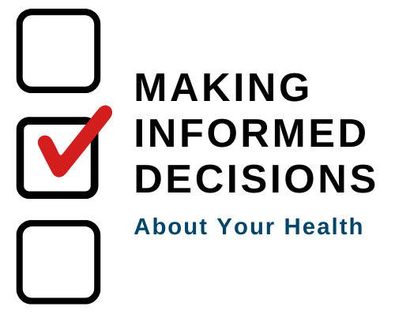
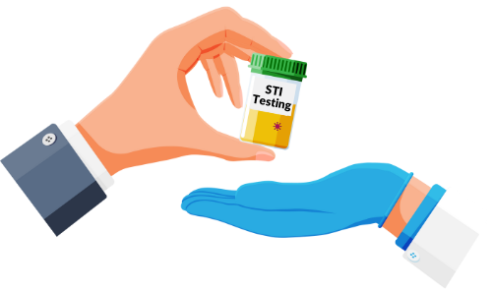
Making Decisions About Your Health
Notes:
General Information
When it comes to your health, there are many decisions you will have to make throughout your life as you mature and grow. Making decisions about your health is important because you need to know the different types of sexually transmitted infections, how they are passed between two people, and understand how they can impact your well-being.
When deciding what is best for you and your health, you should understand and be well informed about the choices available. It is important that information comes from a trusted source that is current and accurate.
There is a lot of great information available on the internet and social media, but sometimes there is a lot of misinformation as well, this is why we recommend talking to a trusted adult, as they can offer information to help you make the best decisions for you and your health.
Images from Canva

Slide 9
Feelings about Sexual Health
It’s Okay…
To feel embarrassed or uncomfortable
To ask questions
To not already know about this
For us to learn about sexually transmitted infections (STIs)
Notes:
General Information
Things to remember…
4 Okay’s
Today we’re going to be talking about what makes us different, and what makes us the same. We understand that for some of you, this may be the first time you’re learning about this topic, and for others this may be something you know a lot about. It may feel uncomfortable to talk about sexual health with your parents or friends, but it’s important we all understand sexual health so we can make safe decisions.
So let’s review the 4 OK’s. It is perfectly OK:
If you feel embarrassed or uncomfortable. The only way for us to overcome this uncomfortable feeling is to learn and grow. We can often feel uncomfortable about things we don’t fully understand. But if we take the time to learn about a topic and understand it, we become more educated and comfortable. Which creates a supportive environment for everyone!
It’s okay to be curious and to ask questions.
It’s okay if you don’t know this information already. We’re all going to learn this together.
And… It is okay for us to know about sexual health and each other’s experiences.
Images from Canva

Slide 10
Before We Begin…
Respect each other
Use inclusive language
Use the correct terms for sexually transmitted infections (STIs)
Respect personal boundaries
Notes:
Image from Canva

Slide 11
Think, Pair, Share
“Do you know of any ways that a person can prevent STIs or unplanned pregnancy?”
Notes:
Teacher Prompt:
Ask students the following question and answer as a class…
“Engaging in sexual activities like oral sex, vaginal intercourse, and anal intercourse means that you can contract an STI/STBBI or become pregnant. Do you know of/ What contraceptive methods are available that can be used to prevent STIs or unplanned pregnancy?”
“What methods of protection are available to people who decide to be sexually active and are trying to prevent STIs and unplanned pregnancy?”
“What can people do to protect themselves from STIs and/or unplanned pregnancy if they are sexually active?”.
Contraceptive methods that the students most likely know and suggest:
Abstinence
Condoms
Birth control pill (oral contraceptive)
Intrauterine device (IUD)
The Patch
The Pill
The Ring
Withdrawal (pulling out method)
Vasectomy or tubal ligation (tubes tied)
Dental dams (The only method that protects people against STIs during oral sex)
General Information
“As already discussed, STIs have visible symptoms and some do not, therefore it may be hard to self-identify an STI. All STIs can have a significant impact on a person’s health. Engaging in sexual activities like oral sex, vaginal intercourse, and anal intercourse without protection means that you can be infected with an STI. Even with the use of a condom or dental dam, there is still a small risk.”
The methods of contraceptive protection that are among the most effective at protecting against unplanned pregnancy are condoms, birth control, the ring, the patch, and the IUD. However, the most reliable, effective and safest way to avoid sexually transmitted infections and unplanned pregnancy is to not have sex (abstinence).
Everyone engaged in sexual activity bears an equal responsibility for contraception, safe sex, and consent, and this needs to be transparent, discussed, and understood by all partners in a sexual relationship.
Background Knowledge
This activity will be used to assess student’s prior knowledge about methods of protection. The examples provided above will be describe in further detail on the following slides.
Contraception (also commonly known as “birth control”), is a method of protection to prevent unplanned pregnancy.
Hormonal Contraception:
Oral contraceptive pill (“The Pill”) or Birth control pill
Injectable contraception (“The Shot”)
Vaginal ring (“The Ring”)
Transdermal contraceptive patch (“The Patch”)
Intrauterine contraception system (IUS)
Contraceptive implant
Non-Hormonal Contraception and Barrier Methods:
External (Male) condom (The only method that protects against STIs during vaginal intercourse)
Internal (Female) condom
Intrauterine Contraception (IUC)
The IUD
Vasectomy (Male Sterilization)
Tubal Ligation (Female Sterilization)
Salpingectomy
Dental dam (The only method that protects people against STIs during oral sex)
Sterilization
Diaphragm
Cervical cap
Spermicides
Sponge
Natural Methods:
Abstinence
Withdrawal (coitus interruptus) or the “pulling out” method
Fertility-awareness based methods (FAM)
Lactational amenorrhea method (LAM)
Emergency Contraception:
Morning after pills
Copper Intrauterine Device (IUD) – not as commonly used in Canada for emergency contraception (long wait lists to get into Doctor’s who do this procedure)
**Note: The methods that are crossed out above are still options and available in Canada; however, they are not an effective method of STI protection or pregnancy prevention.*
References:
Niagara Region Public Health (n.d.). Public Health: Sexual Health - Birth Control Options. https://www.niagararegion.ca/living/health_wellness/sexualhealth/birth-control.aspx
Sex & U (n.d.). Resource Library: Contraception – Contraception Methods. https://www.sexandu.ca/resources/resource-library/#tc5 and https://www.sexandu.ca/wp-content/uploads/2021/05/SOGC_14372_Contraception_DownloadablePDF_ENG_WEB.pdf
The Society of Obstetricians and Gynaecologists of Canada (SOGC) (n.d.). It’s a plan – Types of Contraception. https://www.itsaplan.ca/
Shore Centre (n.d.). Birth Control Options Available in Canada. https://www.shorecentre.ca/wp-content/uploads/Birth-Control-Options-Available-In-Canada.pdf
Image from Canva

Slide 12
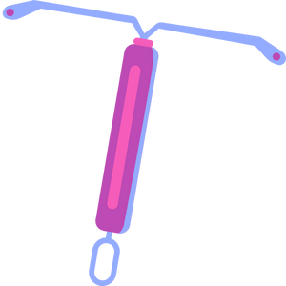
Hormonal Contraception
Hormonal contraception is a type of birth control that uses hormones to prevent pregnancy.
Common methods include:
Birth Control Pill
Patch
Ring
Injection
Notes:
General Information
Hormonal birth control regulates the change in hormone levels during a woman’s cycle by using different forms of synthetic hormones that mimic the estrogen and progesterone that is naturally produced in the female body.
Background Knowledge
Methods:
Oral contraceptive pill (Birth control pill)
There are two kinds of oral contraceptives:
Combined oral contraceptive (COC), which contains both estrogen and progestin
Progestin-only contraceptive (POP)
Must be taken at the same time every day
Hormones stop ovulation (monthly egg release)
Changes cervical mucous, making it difficult for sperm to get into the uterus
Can regulate period, reduce bleeding and cramping
When use properly, it’s over 99% effective
Vaginal ring (i.e., NuvaRing)
Flexible plastic ring inserted into the vagina (by you) for three weeks, and then removed for one week
Hormones are released from the ring into the walls of the vagina
Works to prevent pregnancy like the pill and the patch
99% effective
Injectable contraception/shot (i.e., Depo-Provera)
Hormone injection given by a health care professional in the arm or buttocks
Stops the ovaries from releasing an egg and thins the lining of the uterus
99.7% effective
Contraceptive patch (“The Patch”)
Patch is placed on the buttocks, upper outer arms, lower stomach, or upper body (not breasts)
Applied once a week for three weeks, then removed for one week
Hormones are released into the skin, and it works like the pill
99% effective
Contraceptive implant
A 4cm long and 2mm wide flexible rod that sits just below the skin
Continuously releases a progestin hormone into the bloodstream
The progestin hormone prevents the ovaries from releasing an egg. It also thickens the cervical mucus making it difficult for sperm to reach the egg
Intrauterine contraceptive systems (IUS)
T-shaped device inserted into the uterus by a health care professional
Contains the hormone progestin, which thins the lining of the uterus and thick cervical mucous
99.9% effective
Options:
IUD: the Copper intrauterine device (Cu-IUD)
IUS: levonorgestrel-releasing intrauterine system (LNG-IUS), which contains a progestin
Note: This option is typically recommended to young adults, not usually children and adolescents.
References:
Gordon, L. P. (2022, January). Nemours TeensHealth: Birth Control Pill. https://kidshealth.org/en/teens/contraception-birth.html
Niagara Region Public Health (n.d.). Public Health: Sexual Health - Birth Control Options. https://www.niagararegion.ca/living/health_wellness/sexualhealth/birth-control.aspx
Sex & U (n.d.). Resource Library: Contraception – Hormonal Contraception. https://www.sexandu.ca/wp-content/uploads/2021/05/SOGC_14372_Contraception_DownloadablePDF_ENG_WEB.pdf
Image from Canva

Slide 13
Non-Hormonal Contraception
Non-hormonal birth control is when a blockage is created between sperm and the egg during sexual activity.
Common methods include:
Condoms*
External
Insertive
Dental Dams
Vasectomy / Tubal Ligation (Tubes Tied)
Notes:
General Information
Non-hormonal birth control can involves creating a barrier between sperm and the egg, changing the chemistry in the reproductive tract or a combination of both methods. Non-hormonal birth control prevents pregnancy without affecting your hormones.
Background Knowledge
Non-Hormonal Contraception:
*Condoms (internal and external; female and male) (The only method that protects against most STIs*)
Condoms for the Penis: On/ Outside/ External/ Male condom
Fits over the penis
Prevents sperm from entering the vagina
97% effective if used correctly
Condoms for the Vagina: In/ Inside/ Internal/ Insertive/ Female condom
Inserted into the vagina by you
Lines the inside of the vagina and covers the woman’s genitals
95% effective if used correctly
Vasectomy (known as “male sterilization” for a person with a penis)
Tubal Ligation & Salpingectomy (known as “female sterilization” for a person with a vagina)
Dental dam (protects a person against STIs during oral sex only)
Intrauterine Device (copper IUD)
Diaphragm
Cervical cap
Spermicides
Sponge
**Note: The methods that are crossed out above are still options and available in Canada; however, they are not an effective method of STI protection or pregnancy prevention.*
References:
Niagara Region Public Health (n.d.). Public Health: Sexual Health - Birth Control Options. https://www.niagararegion.ca/living/health_wellness/sexualhealth/birth-control.aspx
Sex & U (n.d.). Resource Library: Contraception – Non-Hormonal Contraception. https://www.sexandu.ca/contraception/non-hormonal-contraception/ and https://www.sexandu.ca/wp-content/uploads/2021/05/SOGC_14372_Contraception_DownloadablePDF_ENG_WEB.pdf
Image from Canva

Slide 14
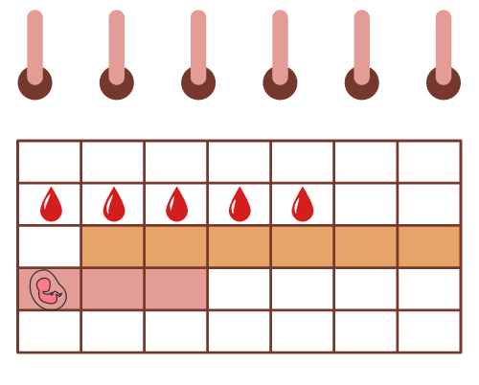
Natural Methods to Prevent Pregnancy
These methods do not use any devices to prevent pregnancy or STIs, which might poses more risks of pregnancy.
Common methods include:
Rhythm method
Fertility-awareness based method (FAM)
Lactational amenorrhea method (LAM)
Notes:
Background Knowledge
*Note: The teacher can choose what to expand upon for the following natural methods. These might be too in-depth and high level for Grade 7 students, but this will depend on your class.
Natural Methods:
Rhythm
The belief is that sexual activity can occur on “SAFE” days
It is based on ovulation and understanding your menstrual cycle
It is not recommended for young people because it is extremely difficult to do correct
This method requires careful planning and keeping track of your menstrual cycle
Not a good method as most teens/young women do not have a consistent and regular menstrual cycle
BUT… Periods do not always come as expected.
Important to have an idea of how the cycle works but calculations could be wrong. There is no time during the menstrual cycle that is 100% safe for pregnancy prevention
Menstruation lasts approximately the first 5 to 7 days of a cycle.
Ovulation occurs approximately 14 days before the next menstrual period.
Ovulation occurs on approximately the 16th day of a 30 day cycle. One should add a day or two on either side to allow for individual variations (e.g. 14th to 18th day). The egg lives for 24 to 48 hours after ovulation
Sperm can live as long as 5 days after ejaculation. Therefore, add 2 days on after ovulation and 5 days before. This gives you a rough estimate of the fertile time if the body worked in the way it technically should (e.g. 9th to 20th).
Fertility-awareness based methods (FAM)
Fertility awareness-based (FAB) methods of family planning involve identifying the fertile days of the menstrual cycle, whether by observing fertility signs such as cervical secretions and basal body temperature or by monitoring cycle days (Box F1) (Table F1). (CDC, 2017)
Ovulation is the time during a woman’s menstrual cycle when she is most likely to get pregnant
Conception can occur when sexual intercourse takes place during the fertile window (5 days before to 1 day following ovulation)
FAM relies upon avoiding unprotected sex during this fertile window
Lactational amenorrhea method (LAM)
The Lactation Amenorrhea Method is a natural, short term birth control method in which a woman relies on exclusive breastfeeding after birth to prevent pregnancy.
L = Lactational means breastfeeding
A = Amenorrhea means having no monthly period
M = Method
How does LAM work?
When a baby suckles frequently at the breast, hormones are released that interrupts a women’s normal ovulation cycle by stopping the ovaries from releasing an egg. This prevents mom from becoming pregnant. As the baby grows and starts to eat other foods (around six months of age), the time suckling at the breast decreases. When this happens the woman’s body begins to return to its regular cycling and ovulation and menstrual periods.
Practicing LAM – Breastfeeding can be used as a method of contraception by following these four conditions:
1. Your baby is less than 6 months old
2. Your monthly periods have not returned
3. Your baby is fully or nearly fully breastfed*
4. Your baby should be breastfed at least every 4 hours and not have more than one 6 hour stretch between breastfeeding in 24 hrs.
When all of the conditions above are followed (and exist), LAM provides 98% protection from pregnancy in the first six months.
Note: People are still encouraged to use another method of birth control when any of the four conditions change, as the change of pregnancy increases.
References:
Centers for Disease Control and Prevention (CDC). (2017, February 1). Classifications for Fertility Awareness–Based Methods. https://www.cdc.gov/reproductivehealth/contraception/mmwr/mec/appendixf.html#:~:text=Fertility%20awareness%2Dbased%20(FAB),F1)%20(Table%20F1).
Niagara Region Public Health (n.d.). Public Health: Sexual Health - Birth Control Options. https://www.niagararegion.ca/living/health_wellness/sexualhealth/birth-control.aspx
Peel Public Health. (2018, April 20). Healthy sexuality: Birth Control Methods – LAM (Lactation Amenorrhea Method). https://www.peelregion.ca/health/sexuality/birth-control/methods-lam.htm#:~:text=What%20is%20LAM%3F,after%20birth%20to%20prevent%20pregnancy.
Sex & U (n.d.). Resource Library: Contraception – Natural Methods. https://www.sexandu.ca/wp-content/uploads/2021/05/SOGC_14372_Contraception_DownloadablePDF_ENG_WEB.pdf
Image from Canva

Slide 15
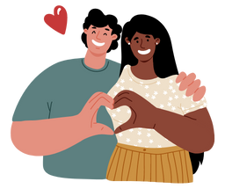
Abstinence
Abstinence means different things to different people
It usually means no sexual contact or intercourse
For some people, it may allow certain types of sexual activity, such as kissing
Abstaining from all sexual activities means that you can not get pregnant or get an STI
Notes:
Teacher Prompt
Why do you think people choose to abstain from engaging in sexual activity, including intercourse?
Abstinence:
Abstinence refers to not having sex. There are many forms of sexual abstinence, but in terms of using this as a method of contraception, it means avoiding vaginal intercourse.
Abstinence means different things to different people. It may mean making the choice not to have any sexual contact including:
self-touch (masturbation)
direct touching of your partner’s genitals (i.e., sexual touching)
vaginal sex (penis to vagina)
anal sex (penis to anus)
oral sex (mouth to penis or mouth to vagina)
kissing
For some people, abstinence may include certain types of sexual contact. Abstinence prevents pregnancy and the spread of sexually transmitted infections (STIs). If a person chooses not to partake in any of the sexual activity listed above, it means they’re protected from STIs and pregnancy and don’t need to use birth control.’
*Remind students that abstaining from all sexual activities eliminates the need for birth control, is effective at preventing pregnancy and the spread of sexually transmitted infections
*Note for the teacher: It is still possible to get an STBBI if a person uses or shares needles, personal care articles (i.e., razors, nail files, toothbrushes, etc.). This is because STBBIs are infections that are transmitted from one person to another in the blood stream by exposure to the blood and body fluids of another (ie: getting infected by someone’s blood through open skin).*

Slide 16
Withdrawal Method
The withdrawal method is when a person with a penis pulls out before ejaculation occurs
It is diffcult to determine when ejaculation will occur
Semen can leave the penis before ejaculation happens
This method does not prevent pregnancy
Notes:
General Information
The following is not effective and is unreliable/risky when engaging in sexual activity.
Withdrawal (Pulling Out In Time/ Before ejaculation occurs or coitus interruptus): When a person with a penis removes their penis from a vagina during sexual intercourse before ejaculation can occur. Remember pre-ejaculation is still a possibility, so the withdrawal method is risky and not safe. Pregnancy can still occur due to pre-ejaculation.
Once the penis becomes erect, it gives off a small amount of semen which contains many sperm. It only takes 1 sperm + 1 ovum (egg) = baby.
Not always able to pull out before ejaculation occurs as this method requires a lot of self-control.
Ejaculation near vaginal opening is risky as sperm can travel into the vagina.
Pre-ejaculation can happen during sex and the person will be unaware when this happens… This is why it is extremely important to use condoms and other forms of contraception when engaging in sex (i.e., birth control)
Myth Methods
Saran wrap or sheets are not an effective way to prevent pregnancy and they cannot replace a condom.
Sexual intercourse while standing up or in water is not effective to prevent pregnancy, sperm will still move upwards towards the egg.
Sexual intercourse during menstruation is not effective to prevent pregnancy, since the egg could have been released early that cycle.
Anal sex can still result in pregnancy (due to leakage of semen) and increases the risk of contracting a STI.
Resource:
Niagara Region Public Health (n.d.). Public Health: Sexual Health - Birth Control Options. https://www.niagararegion.ca/living/health_wellness/sexualhealth/birth-control.aspx
Image from Canva

Slide 17
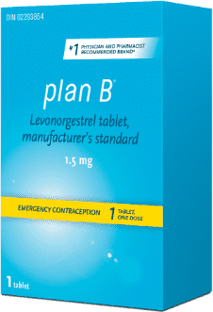
Emergency Contraception
Emergency contraception:
Can help prevent unplanned pregnancy
Option: Morning after pill – Plan B
This is a pill that should be taken soon after unprotected sexual intercourse happens
Should not be used as a regular method of protection
Notes:
General Information
Emergency contraceptive is intended for occasional use only, not as a regular method of birth control.
If you have had unprotected sex and you already know that you do not want to get pregnant, emergency contraception is a safe option that can help prevent unplanned pregnancies if used as soon as possible.
Some of the reasons that you may consider using emergency contraception include:
No contraception was used
Missed birth control pill, patch, or injection
The condom slipped, broke, or leaked
Error in the calculation of the fertility period
Non-consensual sexual intercourse (Sexual assault… rape)
Background Knowledge
Options:
Morning After Pill – Plan B
Delays or prevents ovulation (temporarily stops the release of an egg from the ovary)
Each Plan B tablet contains 1.5 mg of levonorgestrel
Prevents fertilization
Use within five days of unprotected sex
When used in the first 48 hours after unprotected sex, it’s 85% effective in preventing pregnancy
Intrauterine Device (IUD) – Copper (Teacher does not need to explain this, but if asked about it they can say it is not as commonly used for emergency contraception because it can be difficult to get in to see a Doctor right away for this specific procedure)
This method is not as common or recommended, as it is usually only referred to individuals who are sex workers.
For more information about Plan B, check out the following resource: https://planb.ca/en/
Reference:
Sex & U (n.d.). Resource Library: Contraception – Emergency Contraception. https://www.sexandu.ca/wp-content/uploads/2021/05/SOGC_14372_Contraception_DownloadablePDF_ENG_WEB.pdf
Image from: https://planb.ca/en/how-plan-b-works/

Slide 18
Guiding Question #1
If a person is thinking of having sex, what steps can they take to make safe and informed decisions?
Notes:
As a class, try to answer the following question…
Teacher Prompt
“If a person is thinking of having sex, what steps can they take to make safe and informed decisions, to protect themselves from STIs or pregnancy?”
**Although this question is similar to the think, pair, share, I want students to think critically about ways to make informed decisions to protect themselves, not only by using methods of contraception, but other ways as well.**
Options:
Abstain
Use protection
Decrease the number of partners you are intimate with
Get a health check up with a health care provider
Get tested
Get vaccinated
Elicit:
People should go to a health clinic or see a nurse or doctor who can provide important information about protection and HPV vaccination. People who think they will be having sex sometime soon should keep a condom or other effective and suitable form of protection with them so they will have it when they need it.
People should also talk with their partner about being emotionally ready to have sex and about using protection before they have sex, so both partners will know that protection will be used. If a partner says they do not want to use a condom, for example, a person should say, ‘I will not have sex without a condom.’
If someone does have sex, it is important that you use protection every time, to help prevent contracting an STBBI or becoming a parent before you are ready.
Reference:
OPHEA (n.d.). Identifying Sexually Transmitted Infections. https://teachingtools.ophea.net/lesson-plans/hpe/grade-7/understanding-sexual-health-and-decision-making/identifying-sexually-transmitted-infections
Image from Canva

Slide 19
STI’s are Preventable: Informed Decisions
Abstain
Get regular health check ups
Use protection every time you are sexually active
Decrease the number of sexual partners you have
Get tested regularly for STIs
Get vaccinated for HPV and Hepatitis B
Oral sex is still a sexual activity; you are still at risk of an STI
Notes:
General Information
You can prevent STIs by getting regular health check ups when you are sexually active
Both partners should get a health check first (and discuss their history if they’ve been sexually active before): You may know your partner on a social level but do you know your partners’ health history? By both of you going for a health check up to see if you have an STI infection you can rest assured that neither one of you will infect the other with an STI. Remember: Even if you don’t have any symptoms, doesn’t mean you don’t have an STI. If more people got a health check up before they were sexually active there would be a decrease in the number of people spreading the infections to others and therefore less numbers of the infections in the community. A sexual health clinic or nurse/doctor can provide important information about protection.
Reduce number of partners:
The more partners a person has sex with the greater the chance of being infected with an STI. Therefore, if one reduces the number or has one uninfected partner in their life, the risk is less for getting an STI.
Condoms:
Yes, it is important to use a condom every time as it can help protect you from STIs and pregnancy but this method is still not 100% effective.
Do not use the same condom twice or double the condom as this is ineffective and increases the chances of the condom ripping.
*Note: Remember, condoms are the only form of contraception that protects against STIs through sexual intercourse*
However, dental dams can be used when trying to prevent STIs through oral sex only.
Get vaccinated:
There are vaccinations to protect you from STIs (i.e., Hepatitis B, HPV) and they are recommended by Niagara Region Public Health and other health care professionals.
Image from Canva

Slide 20
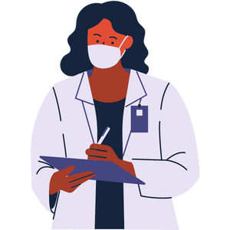
Please Remember…
Be aware of your own body and any changes you may experience
If you develop symptoms, go see a health care provider
You cannot tell by looking at someone if they have an STI
Even if you have no symptoms, an STI can still cause damage to your body
Notes:
General Information
You are not expected to remember all the “symptoms” for an STI. What is important is that you know your body and if there are any bumps, pain when peeing, itching/tingling in the genital area or other changes that are not normal, get checked.
You may not have an STI but you will not know unless you get checked out.
Remember that some STIs have no visible symptoms so you may not know you have an STI or the symptoms could show up years later.
Talk with your partner and get tested regularly if you are sexually active
**For the teacher only → If you are looking for more important about Canada Immunizations, here is a guide that provides information about vaccines. For ones related to STIs, refer to Hepatitis B and Human papillomavirus:
Government of Canada (2021, December 23). Canada Immunization Guide: Part 4 – Active Vaccines. https://www.canada.ca/en/public-health/services/publications/healthy-living/canadian-immunization-guide-part-4-active-vaccines.html
Image from Canva

Slide 21
Final Activity: Risks and Consequences
One afternoon you are hanging out with a friend who tells you that they’re thinking about having sex.
You want to inform your friend about the risks and consequences of being sexually active. What could you tell them?
Who could your friend talk to if they have any questions?
Notes:
General Information
As you grow up there are many influences that affect the choices you make (i.e., friends, parents, teachers, religion-faith, culture-beliefs and country laws etc.). Personal values, family values, and religious beliefs can influence how you think about sex and sexual activity.
As an adolescent you will be making many decisions on your own.
There are many pressures particularly from friends or a partner. The choice you make may have risks/consequences that YOU have to deal with – not your peers or partner.
A person should not have sex if: he or she is not ready; their partner is not ready; they or their partner have not given consent; they are feeling pressured; and they are feeling unsure or if under the influence of drugs or alcohol.
Being able to talk to your partner about how you feel and how to protect against STI’s/pregnancy is an important part of sexual health. It is important to wait to have sex until you are comfortable talking to your partner.
You need to make the choices that are best for YOU! not your partner, peers or friends.
As per the questions above:
Risks and consequences: STIs, pregnancy, unprepared, emotional/physical readiness
The friend is not a doctor or professional, so they should refer their friend to someone who is qualified in the subject → Refer to the next slide for “More Questions? Talk to Someone”
Image from Canva

Slide 22
More Questions? Talk to Someone:
Parents/ Guardian
Teacher/ Principal
Doctor or Health Care Professional
School Health Nurse
Child and Youth Worker
Niagara Sexual Assault Centres (905-682-4584)
Niagara Region Public Health – Sexual Health Live Chat (Ask questions anonymously)
Notes:
General Information
There are many people and places that you can reach out to in order to get help or ask questions about relationships and sexual health. If you ever have questions/concerns, need help or know someone who needs help, you can always talk to someone. There are many options out there available to you.
Among these are:
A trusted adult (such as a parent or teacher)
A health care provider (such as a doctor or nurse)
A child and youth worker
The school health nurse
The school social worker
Any of the Niagara Region Sexual Health Centres
Kids Help Phone
Services for Youth - Niagara Region, Ontario → https://www.niagararegion.ca/health/schools/youth-services.aspx
Other community resources:
Kids Help Phone: Call 1-800-668-6868 or https://kidshelpphone.ca/
Niagara Sexual Assault Centre (CARSA) (http://niagarasexualassaultcentre.com/)
24 HOUR CRISIS & INFORMATION LINE: 905-682-4584
Niagara Region Public Health – Sexual Health Live Chat
https://vue.comm100.com/chatWindow.aspx?siteId=232657&planId=0066c5f6-364e-4017-9799-c08a1ef44d6b
Niagara Sexual Health Centre (https://www.niagararegion.ca/living/health_wellness/sexualhealth/sexual-health-centres.aspx)
905-688-3817
Sexual Heath Ontario – Live Chat: https://sexualhealthontario.ca/en/chat
Image from Canva

Slide 23
Sexual Health Centre Information
Our Locations
Phone: 905-688-3817
Or call toll free: 1-800-263-5757
Niagara Falls Sexual Health Centre
7835 McLeod Road, Niagara Falls
St. Catharines Sexual Health Centre
277 Welland Avenue, St. Catharines
Welland Sexual Health Centre
200 Division Street, Welland
Hours of Sexual Health Centres vary.
Some of the confidential services offered are:
Birth control information
STI testing and treatment
Pregnancy testing
Birth Control at a lower cost (with doctor’s prescription)
Plan B (emergency contraceptive pills)
Free Condoms
Three Sexual Health Centres in the Niagara Region
Provide free, non-judgmental, and confidential services
Aim to enhance the sexual health of our community
Notes:
Niagara Sexual Health Centre: 905-688-3817
The hours for each of the sexual health centres are different and change depending on the times of the year. It is recommended that students call to inquire about the services offered and what they need so they can be directed to the closest and most appropriate centre.
For more information about the sexual health centres in the Niagara Region, use the following link: Sexual Health Centres - Niagara Region, Ontario → https://www.niagararegion.ca/living/health_wellness/sexualhealth/sexual-health-centres.aspx
https://www.niagararegion.ca/living/health_wellness/sexualhealth/sti.aspx

Slide 24
Final Thoughts
Most STIs have no visible signs or symptoms
Abstaining from all sexual activities is the most effective way to prevent STIs and pregnancy
There are ways to protect yourself if you choose to become sexually active
If you have any questions, reach out to a trusted adult
Notes:
General Information
STIs are preventable…
There are many methods of protection available that can be used to prevent pregnancy, and condoms can protect against STIs
For more information on STIs, check out the following resources:
http://www.phac-aspc.gc.ca/std-mts/sti-its/index-eng.php → Canadian Guidelines on Sexually Transmitted Infections (PHAC)
http://www.phac-aspc.gc.ca/std-mts/faq-eng.php → Sexually Transmitted Infections (STI), Sexual Health Facts and Information for the public (PHAC)
Image from Canva

Slide 25
Questions?
Notes:
Image from Canva

