Slide 1
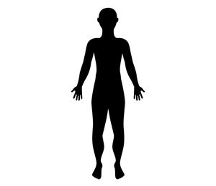
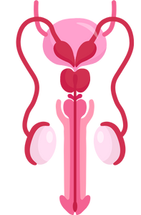
The Reproductive Systems
Grade 5
Notes:
**The following slides (1-6) are for teacher use only**
The speaker’s notes are also intended for teacher use only. The notes include general information, background knowledge, questions and/or prompts. The information included in these notes should not be read word for word. Teacher’s should review the notes before using the presentation to become familiar with the content, as it is to supplement what is on the slide.
**Important** The language of “boys” and “girls” or “male” and “female” is gender interpreted, and often assigned based on a person’s biological sex at birth. It excludes individuals who are intersexed and/or whose gender identity does not align with their assigned biological sex. It is more accurate to talk about anatomy rather than gender and use “bodies with” or “people with” language when referring to developments and changes in puberty. Using this language supports an inclusive classroom in which diversity is recognized and provides a strong model to help students understand that bodies are unique, come in all shapes, sizes, types, and all bodies are good bodies.
This presentation will use the term people assigned female at birth/ people assigned male at birth to refer to individuals who are born with certain sex organs, hormones and/or chromosomes. However, it’s important to note that some people may have a different gender identity than the sex assigned to them at birth.
Language is complex, evolving, and powerful. In these lessons, gender-neutral language is used to be inclusive of all students, including those with diverse gender identities and sexual orientations. This includes the use of ‘they’ as a singular gender-neutral pronoun. The lesson plans use the terms ‘male’ and ‘female’ when referring to biological sex (sex assigned at birth), such as when discussing reproductive anatomy. A person’s reproductive system can be male, female or intersex (not clearly defined as either male or female).
People are assigned a sex at birth based on their reproductive anatomy. Sex assigned at birth is independent of gender identity. Gender identity is a person’s internal sense of identity as female, male, both or neither, regardless of their biological sex assigned at birth.
For many people, their gender matches the sex they were assigned at birth (cisgender). Others may identify as being transgender or gender diverse if their gender identity does not match the sex they were assigned at birth. A person’s gender identity can be girl, woman, boy, man, transgender, gender fluid, gender queer, agender or others. The intention in this material is to use language that reflects these many possibilities.
Reference:
Teaching Sexual Health (n.d.). Grade 6 Growing a Baby Lesson. https://teachingsexualhealth.ca/app/uploads/sites/4/Grade-6-LP2-Growing-Baby-Oct11.pdf
Image from Canva
Last Updated: December 7th, 2022

Slide 2
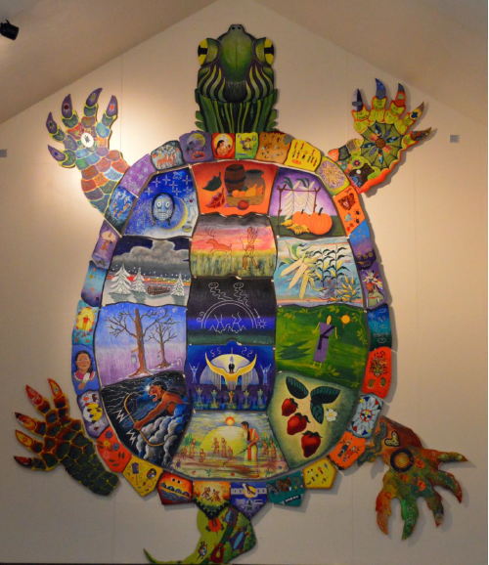
Land Acknowledgement
Notes:
Niagara Region is situated on treaty land. This land is steeped in the rich history of the First Nations such as the Hatiwendaronk (Hat-i-wen-DA-ronk), the Haudenosaunee (Hoe-den-no-SHOW-nee), and the Anishinaabe (Ah-nish-ih-NAH-bey), including the Mississauga's of the Credit First Nation. There are many First Nations, Métis, and Inuit peoples from across Turtle Island that live and work in Niagara today. The Regional Municipality of Niagara stands with all Indigenous peoples, past and present, in promoting the wise stewardship of the lands on which we live.
*Disclaimer: In the Spirit of Truth and Reconciliation, Niagara Region Public Health acknowledges that people are gathered on the customary and traditional lands of the Indigenous Peoples of this territory. We recognize that the land on which you are situated will vary depending on where you are located in Ontario. It is advised that you reach out to your school’s principal or school board for the school-specific treaty land. If you have already done a land acknowledgement on the same day you are presenting this lesson, you are welcome to skip this slide. However, it is always encouraged to complete a land acknowledgement before continuing on with this presentation.*
Information about the image on the left:
There are seven objects that have been purposely selected and included in the design of the artwork: an Inukshuk, an eagle feather, two drums, a Métis sash, an embroidered flower, and wampum belt. Each object reflects the diversity of First Nations, Métis and Inuit in North America. The iconic stone monument, the Inukshuk, is used as a marker identifying important sites and as a navigational tool to communicate direction. The eagle feather is significant to the spiritual beliefs of some Métis and First Nations peoples. Its symbolism includes honour, wisdom, and courage among many others. It is considered an honour to be given an eagle feather. The two drums include the Inuit drum and the Métis and First Nations drum. The drum is symbolic of the heartbeat of Mother Earth and is often played at various traditional gatherings and ceremonies. The embroidered flower is woven into many traditional garments and various objects through beadwork, painting, or etchings. It is also considered one of Canada’s first art forms. The Métis sash was once a tool of the voyageurs and fur traders. It is also a symbol of knowledge and the relationship between the Métis, the First Nations, and Europeans. At the top of the poster are four lines reminiscent of the traditional beaded wampum belt. There are many types of wampum belts with different significant meanings, including agreements made between two groups/nations, knowledge sharing, and storytelling. The four lines in this wampum belt represent the equality and diversity of the four peoples (First Nations, Metis, Inuit, and European settlers) and to acknowledge the journey of living together peacefully (ETFO, 2022).
For more information on Indigenous Education and First Nations, Metis and Inuit (FNMI), check out the following resources:
https://www.otffeo.on.ca/en/learning/indigenous-education
https://www.etfo.ca/socialjusticeunion/first-nation,-metis-and-inuit-(fnmi)
Photo References:
Image on the Left: Elementary Teacher Federation of Ontario (ETFO). (2022). ETFO Land Acnowledgements. https://www.etfo.ca/about-us/governance/etfo-land-acknowledgement
Image on the Right: Creating Our Way Forward: Recommendations for Improving Niagara Region Public Health & Emergency Services’ Indigenous Engagement (2019). https://www.niagararegion.ca/health/equity/pdf/indigenous-engagement-report.pdf
Mural of Turtle Island → Cover photo: Oneida nation artist, Sharon Sarnowski (deceased) This is a picture taken of the mural in the Boardroom of the Oneida Tribal Council office, Oneida, Wisconsin.

Slide 3
Presentation Format
Guiding Questions: Big idea questions that students can brainstorm and share previous knowledge or new information with.
Think, Pair, Share: Opportunity for students to work with partner or group and share ideas based on a prompt.
Notes:
Images from Canva

Slide 4
Presentation Format
Videos: Students will watch a short video clip that connects with topic. Discussion can follow before or after videos.
Final Activity: Activity that concludes the presentation.
Notes:
Images from Canva

Slide 5
Curriculum Expectations – Grade 5
D1.3 - Identify the parts of the reproductive systems, and describe how the body changes during puberty.
Notes:
Image from Canva

Slide 6
The Reproductive Systems
Grade 5
Notes:
The presentation begins here.
This presentation should be taught before the pregnancy presentation.
**Note: The reproductive system has been divided into two lessons: The content for a person with a penis (person assigned male at birth) (part 1) and then the content for a person with a vagina (person assigned female at birth) (part 2)**. Learning about the reproductive system for a person assigned female at birth second might help ease the students into talking about menstruation, conception and fertilization.
Reproductive and sexual anatomy includes your genitals and your internal sex and reproductive organs. Everyone’s reproductive and sexual anatomy looks a little different.
Image from Canva

Slide 7
Learning Objectives
At the end of this presentation, you will be able to identify the parts of the reproductive system. You will also:
Learn how the body changes during puberty
Understand the changes you might be going through
Learn that everyone has differences and this makes us unique
Understand how to support your classmates as they grow and change
Learn how to create a safe space for your peers
Notes:
General Information
The information we are going to talk about today is important for many reasons.
We want to ensure that you learn that everyone is unique and the things that make you unique is what makes you interesting and special.
We want you to feel good about your body, how it is changing, and how you approach different types of relationships you may have with people.
It is important that everyone feels safe, accepted and included at school and understand that differences are ok. This will help to reduce bullying and feelings of loneliness or isolation.
Background Knowledge
Students will learn and understand about themselves and their bodies as they grow and mature
Students need to understand that everyone has different qualities that make up their self-concept; this makes them unique
There needs to be an emphasis on feeling safe, included and accepted in the school community
Empathetic towards others…

Slide 8
Making Decisions About Your Health
Notes:
General Information
When it comes to your health, there are many decisions you will have to make throughout your life as you mature and grow. Making decisions about your health is important because you need to know the different parts of the reproductive system and how you will experience changes to your body during puberty that might impact your well-being.
When deciding what is best for you and your health, you should understand and be well informed about the choices available. It is important that information comes from a trusted source that is current and accurate.
There is a lot of great information available on the internet and social media, but sometimes there is a lot of misinformation as well, this is why we recommend talking to a trusted adult, as they can offer information to help you make the best decisions for you and your health.
Images from Canva

Slide 9
Feelings about the Reproductive Systems
It’s Okay…
To feel embarrassed or uncomfortable
To ask questions
To not already know about this
For us to learn about each others bodies
Notes:
General Information
Things to remember…
4 Okays
Today we’re going to be talking about what makes us different and what makes us the same. We understand that for some of you, this may be the first time you’re learning about this topic, and for others this may be something you know a lot about. It may feel uncomfortable to talk about your body and puberty with your parents or friends, but it’s important we all understand puberty so we can be supportive and respectful of others.
So let’s review the 4 OKs. It is perfectly OK:
If you feel embarrassed or uncomfortable. The only way for us to overcome this uncomfortable feeling is to learn and grow. We can often feel uncomfortable about things we don’t fully understand. But if we take the time to learn about a topic and understand it, we become more educated and comfortable. Which creates a supportive environment for everyone!
It’s okay to be curious and to ask questions.
It’s okay if you don’t know this information already. We’re all going to learn this together.
And… It is okay for us to know about each other’s bodies and experiences. This helps us to understand one another better, and be respectful of each individual person regardless of our similarities and differences.
Background Knowledge
Instead of male and female reproductive systems, we use the terms “person with a penis” and “person with a vagina” and/or “person assigned female at birth” and “person assigned male at birth”
Explore why students might find this topic difficult to discuss
Discuss why parents or other trusted adults might also feel embarrassment (think children are too young, no one ever talked to them, it is a private topic, not used to discussing it, or think they should have all the answers)
General Comments for the Topic of Puberty:
Embarrassment
Embarrassment is common; giggling or blushing, and wiggling in chairs is expected (the topic can also be uncomfortable for some students)
Most people want to know about their bodies and those of the opposite assigned sex
Knowing the information helps youth to feel more comfortable and prepared as they go through puberty
Knowing/Not Knowing
Is important to learn about puberty; helps to understand the changes that are/will happen
Some students have very limited knowledge and others might know more
For some, this may be the first opportunity to explore the changes of puberty
For those with some knowledge, it is important to continue talking about puberty and to make sure that the information they have is correct
Students may have learned about these topics from friends or the media. However, those sources are not always accurate
It is important that everyone gets to know and learn about each other (and everyone)
Discuss respect of each other and of the topic
We spend a lot of our lives relating to people of the opposite assigned sex (fathers, brothers, sons, mothers, sisters, daughters). If we learn about them and their concerns, perhaps we can understand them better and can improve our relationships with them
It may be more difficult to discuss these topics in the co-ed setting, but it is a good introduction to understanding and communicating in a respectful way
Asking questions…
If a student has a question, it’s likely other students have the same question
Introduce the question box (if using)
Images from Canva

Slide 10
Guiding Question #1
What do you know about the human reproductive systems?
Notes:
Teacher Prompt
What do you know about the human reproductive systems? What role does it play in puberty? This is an open-ended question because it gives students the opportunity to expand on their answer, rather than only provide a yes or no answer.
Image from Canva

Slide 11
What is Reproduction?
All living things reproduce or create offspring (a baby)
In human reproduction there are two kinds of sex cells: sperm and eggs (ovum)
Human reproduction is when an egg cell and a sperm cell join to create a fetus
As pregnancy continues the fetus will become a baby
Notes:
General Information
“We will be talking about how our bodies change as we grow. It is important that we all learn about these changes, so we know what's happening with our bodies as we grow. Some of you may be very familiar with these changes and talk about them at home and for some of you, this may be new, and you may feel a little shy or uncomfortable. These are normal feelings. We are going to come up with some rules together to make everyone more comfortable.”
Background Knowledge
All living things reproduce or create offspring
Human reproduction is the ability to create a baby
The organs, glands, and other structures enable humans and animals to reproduce are known as the reproductive systems
In the human reproductive process there are two kinds of sex cells, or gametes (pronounced: GAH-meetz) involved.
Ovum means more than one egg cell
Ova means one egg cell
The sperm (for a person with a penis) and the egg or ovum (for a person with a vagina), meet in the uterus of an assigned female’s reproductive system.
When sperm fertilizes (meets) an egg, this fertilized egg is called a zygote (pronounced: ZYE-goat). The fertilized egg goes through steps to become an embryo and then develop into a fetus (Britannica Kids).
“Humans, pass some characteristics of themselves to the next generation. We do this through our genes, the special carriers of human traits. The genes that parents pass along are what make their children similar to others in their family, but also what make each child unique. These genes come from the male's (assigned sex at birth) sperm and the female's (assigned sex at birth) egg.”
The reproductive systems are needed for human reproduction
Reference:
Hirsch, L. (2019, July). Nemours TeensHealth: Male Reproductive System. https://kidshealth.org/en/teens/male-repro.html
Gregg, Daphna (n.d.). Britannica Kids: Reproductive System. https://kids.britannica.com/students/article/reproductive-system/276695 (student version - grade 6 to 8) and https://kids.britannica.com/kids/article/reproductive-system/353707 (kids version - up to grade 5)

Slide 12
Reproductive System for a Person Assigned Male at Birth
Testicles
Scrotum
Epididymis
Vas Deferens
Seminal Vesicles
Prostate gland
Urethra
Penis
Spermatogensis
Anus*
Notes:
General Information
The reproductive system has organs, or genitals, that are both inside and outside the pelvis of a person assigned male at birth.
The body parts that develop may include the penis, scrotum, testicles, urethra, prostate gland, seminal vesicles, and vas deferens. They may also become more muscular, get deeper voices, grow facial and body hair, and their penis and testicles may grow larger.” (Adapted from: Region of Peel, Healthy Sexuality Program. (2011). Growing Up! A handbook on puberty and maturing.) (OPHEA – Grade 5 Lesson 1: Our Changing Bodies)
Although the anus is near the internal reproductive parts, it is not actually a part of the reproductive system, it is part of the digestive system.
Reference:
Hirsch, L. (2019, July). Nemours TeensHealth: Male Reproductive System. https://kidshealth.org/en/teens/male-repro.html
Sex & U. (2022). The Human Body: Male Body. https://www.sexandu.ca/your-body/the-human-body/#tc1
Image from Shutterstock: Shutterstock_264739313 (https://www.shutterstock.com/image-vector/man-woman-reproductive-system-vector-illustration-264739313)

Slide 13
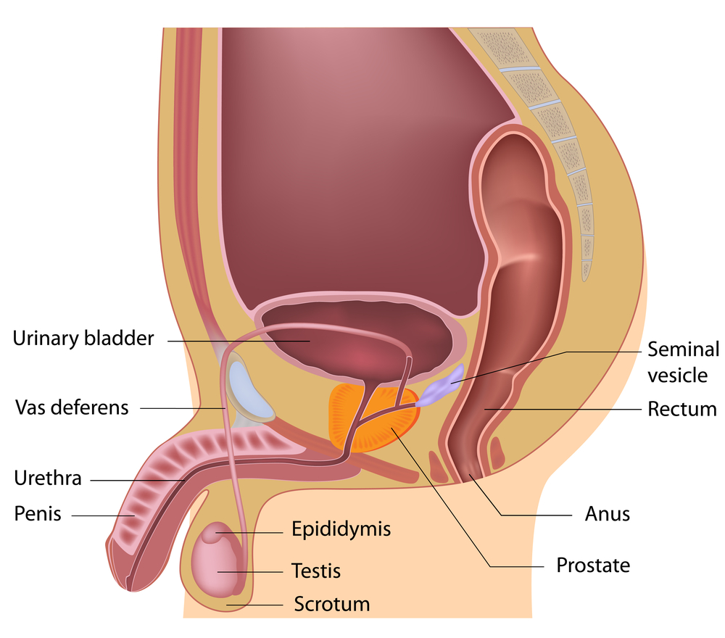
Reproductive System – Side View
Urinary Bladder
Seminal Vesicle
Vas Deferens
Rectum
Urethra
Penis
Epididymis
Anus*
Testicle
Prostate
Scrotum
Notes:
General Information
The genitals for a person assigned male at birth include: testicles, the duct system (epididymis and vas deferens), the accessory glands (seminal vesicles and prostate gland), and the penis…
Background Knowledge
**If you’d prefer to show the Male Reproductive System Video that was created by our team at Niagara Region Public Health, please use the following link: https://youtu.be/Los_XRRRngg
Image from Shutterstock: Shutterstock_127210829 (https://www.shutterstock.com/image-illustration/male-reproductive-system-127210829) → Labels were created/added by a school health nurse on the team
Reference:
Sex & U. (2022). The Human Body: Male Body. https://www.sexandu.ca/your-body/the-human-body/#tc1

Slide 14
Reproductive System – Front View
Urinary bladder
Seminal vesicle*
Vas deferens
Prostate gland
Scrotum
Testicle
Penis
Urethra
Notes:
Teacher Prompt
Where do you think all of the reproductive organs are for a person with a penis?
Using an overhead projector or smart board, ask students to try and label the image on the left-side. When finished, click the enter button on the keyboard to move forward, which will start to show the correct terms overtop of the areas on the right side image for the reproductive system for a person with a penis.
Reference:
Sex & U. (2022). The Human Body: Male Body. https://www.sexandu.ca/your-body/the-human-body/#tc1
SickKids staff. (2009, September). SickKids: Reproduction. https://www.aboutkidshealth.ca/Article?contentid=310&language=English
Image from Shutterstock: Shutterstock_1525692728 (https://www.shutterstock.com/image-vector/male-female-reproductive-system-organs-realistic-1525692728) → Labels were created/added by a school health nurse on the team

Slide 15
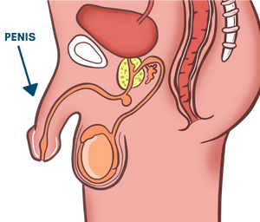
Reproductive System – Penis
The penis is a tube-like organ located on the outside of the body
It is made up of spongy tissue, nerves, and blood vessels
It varies in size from person to person
Notes:
General Information
Penis
The penis is a tube-like organ of spongy tissue, nerves and blood vessels; and varies in size
It is made up of two parts, the shaft and the glans
It takes a while for the penis to grow and it will grow as the rest of the body grows. Testicles grow first
The foreskin is the name given to the skin on the end of the penis that pulls back when the penis gets hard (erection)
The penis delivers sperm through the urethra. It is made up of two parts, the shaft and the glans
Reference:
Hirsch, L. (2019, July). Nemours TeensHealth: Male Reproductive System. https://kidshealth.org/en/teens/male-repro.html
The Society of Obstetricians and Gynaecologists of Canada. (2022). Sex & U: The Human Body. https://www.sexandu.ca/your-body/the-human-body/
Image from Canva

Slide 16
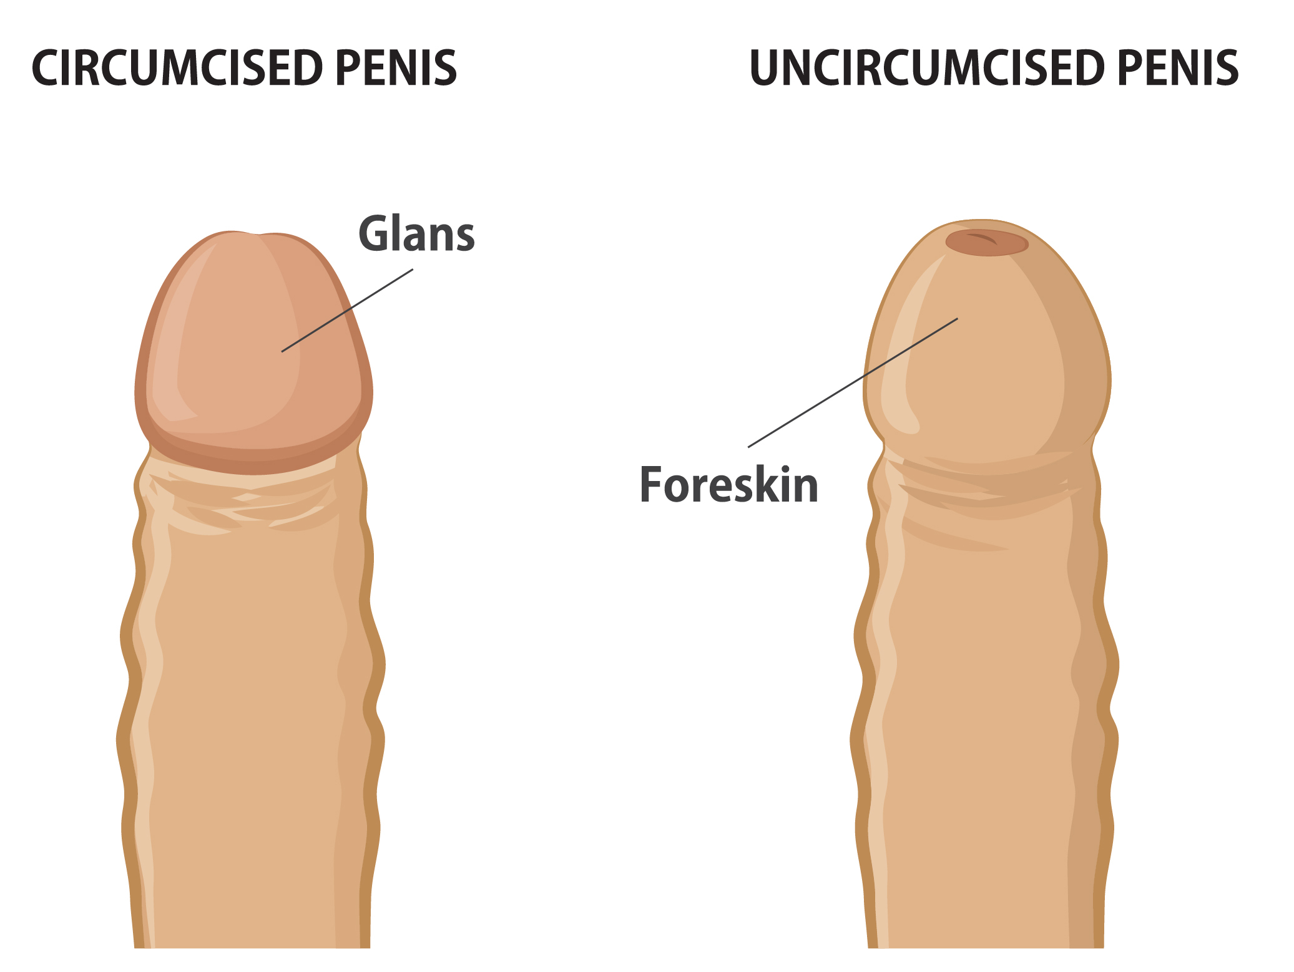
Circumcised and Uncircumcised Penis
Sometimes the skin on the penis is removed
This is called circumcision and is usually done soon after a baby is born
Not every person with a penis will have this procedure
Notes:
General Information
Circumcised and Uncircumcised Penis
Sometimes this skin is removed in a procedure called circumcision, usually done soon after birth
It is important to note that not every child receives the procedure of circumcision.
Some of the factors that play into parent’s decision include: religious reasons, personal and cultural beliefs and parents want their baby to “look like” the father. It is normal either way!
Used to be routinely done – now is more common to be based on a person’s choice
People who have not been circumcised should cleanse beneath the foreskin of the penis regularly by gently pulling it back from the glans, rinsing the glans and inside of the foreskin with warm water, then pulling the foreskin back over the head of the penis
It is important to gently pull back the foreskin to clean and prevent infection
Reference:
Hirsch, L. (2019, July). Nemours TeensHealth: Male Reproductive System. https://kidshealth.org/en/teens/male-repro.html
Hirsch, L. (2022, January). Nemours KidsHealth: Circumcision. https://kidshealth.org/en/parents/circumcision.html
The Society of Obstetricians and Gynaecologists of Canada. (2022). Sex & U: The Human Body. https://www.sexandu.ca/your-body/the-human-body/
Image from Shutterstock:
Shutterstock_360675518
https://www.shutterstock.com/image-vector/circumcised-uncircumcised-penis-vector-illustration-360675518

Slide 17
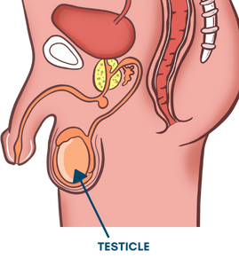
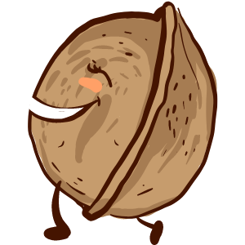
Reproductive System – Testicles
Each testicles is about the size of a walnut
Testicles have two functions: they produce the hormone testosterone and sperm
Fun Fact: you only need one testicle to be able to reproduce
Notes:
General Information
Testicles (or testes)
Reproductive glands of which there are usually two, about the size of walnuts
Two functions- production of testosterone, which causes the changes of puberty, and the production of sperm (stores millions of tiny sperm cells)
People assigned male at birth only need one testicle in order to be able to reproduce
If a person with a penis only has one testis (born that way, sometimes in an accident, or cancer caused the testicle to be damaged and removed) the remaining testis doubles its sperm production
Sometimes one can grow faster than the other; normal for one to hang lower
Because the testicles sit outside the body, they are fragile and sensitive
Do not purposely hit or kick someone in this area, as this can cause damage to the testicle(s)
Some people who participate in sports wear sports protected gear/equipment in this area to avoid injury
In a person who has a penis and has hit puberty (or reached sexual maturity), the two oval-shaped testicles (or testes) make and store millions of tiny sperm cells. The testicles are also part of the endocrine system because they make hormones, including testosterone.
Reference:
Hirsch, L. (2019, July). Nemours TeensHealth: Male Reproductive System. https://kidshealth.org/en/teens/male-repro.html
Images from Canva

Slide 18
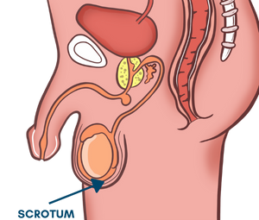
Reproductive System – Scrotum
The scrotum is the sac of skin on the outside of the body that holds and protects the testicles
Each testicle is held in the scrotum by a cord. It contains the vas deferens, blood vessels, lymph vessels and nerves
Notes:
General Information
Scrotum
The sac of skin that holds the testicles
Fun Fact: It pulls the testicles closer to the body if it is cold and lowers away from the body if it is hot
The testicles have to be kept at a certain temperature just below body temperature in order to produce healthy sperm
The lowering and raising of the scrotum is to help keep the sperm healthy and at proper temperature.
During puberty the scrotum will grow and turn darker in colour
Each testicle is held in the scrotum by a spermatic cord. Each spermatic cord is made of tough connective tissue and muscle. It contains the vas deferens, blood vessels, lymph vessels and nerves.
It is a very sensitive area – can be easily damaged – important to protect during sports activities by wearing sports protected gear/equipment
Never deliberately hit/kick anyone there
Reference:
Hirsch, L. (2019, July). Nemours TeensHealth: Male Reproductive System. https://kidshealth.org/en/teens/male-repro.html
Canadian Cancer Society. (2022). The testicles. https://cancer.ca/en/cancer-information/cancer-types/testicular/what-is-testicular-cancer/the-testicles
Image from Canva

Slide 19
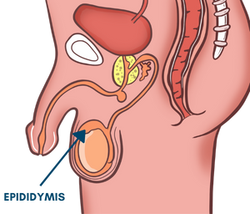
Reproductive System – Epididymis
The epididymis is a coiled tube that is attached to each of the testicles
It holds and carriers sperm
This is where sperm matures
Notes:
General Information
Epididymis
The coiled tube that is located behind the testes and attached to each of the testicles
It holds and carries sperm
Sperm cells move from the testicles into the epididymis, where they finish maturing and are stored
Reference:
Hirsch, L. (2019, July). Nemours TeensHealth: Male Reproductive System. https://kidshealth.org/en/teens/male-repro.html
The Society of Obstetricians and Gynaecologists of Canada. (2022). Sex & U: The Human Body. https://www.sexandu.ca/your-body/the-human-body/
Image from Canva

Slide 20
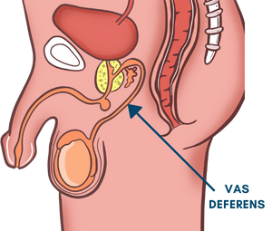
Reproductive System – Vas Deferens
The vas deferens are long tubes that go from the epididymis, up the bladder and connects to the urethra
The vas deferens carries sperm to the prostate gland
Notes:
General Information
Vas Deferens
The tube which carries sperm out of the testicles (also known as the sperm duct)
Since there are 2 testicles, there are 2 vas deferens
Both join with the urethra, which is the tube located under the bladder
When sperm are going to leave the body, they travel through the vas deferens to the prostate gland, where they mix with a fluid to produce a white sticky substance called semen.
The vas deferens carries mature sperm from the epididymis to the urethra for ejaculation
Transports sperm from the epididymis to the urethra
*Note: It is important to remember that sperm and urine never mix. This will be discussed further on the next slide.*
Reference:
Hirsch, L. (2019, July). Nemours TeensHealth: Male Reproductive System. https://kidshealth.org/en/teens/male-repro.html
Canadian Cancer Society. (2022). The testicles. https://cancer.ca/en/cancer-information/cancer-types/testicular/what-is-testicular-cancer/the-testicles
Image from Canva

Slide 21
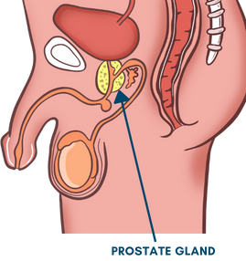
Reproductive System – Prostate Gland
The prostate gland is a donut shaped gland under the bladder
In the prostate gland, sperm cells mix with fluid to create a white sticky substance called semen
Notes:
General Information
Prostate gland
Donut shaped gland under the bladder which is the size of a chestnut
Surrounds the urethra
The testicles produce sperm and the vas deferens carries this sperm to the prostate gland, where it mixes with fluid from the prostate and seminal vesicles
In the prostate gland, sperm cells mix with fluid created by the seminal vesicles to create semen
The purpose of these fluids which start to be produced at puberty is to nourish the sperm and keep them alive
Sperm + fluid = substance called semen
It is important to note that sperm and urine never mix…
The prostate gland enlarges to block urine from leaving the bladder when sperm is ejaculated
The bladder is blocked when ejaculation occurs…
Urine and semen cannot come out (or exit the body) at the same time as the acidity of the urine would destroy the sperm cells in the semen.
When a person is going to ejaculate, it stops semen and urine from mixing.
Therefore, a person with a penis cannot pee and ejaculate at the same time.
Reference:
Hirsch, L. (2019, July). Nemours TeensHealth: Male Reproductive System. https://kidshealth.org/en/teens/male-repro.html
The Society of Obstetricians and Gynaecologists of Canada. (2022). Sex & U: The Human Body. https://www.sexandu.ca/your-body/the-human-body/
Image from Canva

Slide 22
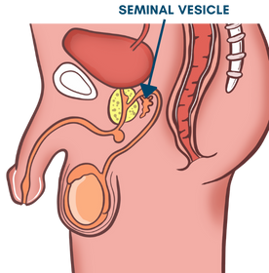
Reproductive System – Seminal Vesicles
The seminal vesicles are two small pouches behind the bladder and above the prostate gland
They create fluid that protects and nourishes the sperm
They join with the vas deferens so that semen can pass through the urethra
Notes:
General Information
Seminal Vesicles
Two small pouches behind the bladder and above the prostate gland that produce the majority of the fluid in semen
This fluid is made by two small pouches called the seminal vesicles. The purpose of this fluid is to protect and nourish the sperm, and ultimately keep them alive.
This fluid mixes with sperm and other fluid to produce semen
They make most of the fluid in semen. The seminal vesicles fuse with the vas deferens to empty into the urethra.
Reference:
Hirsch, L. (2019, July). Nemours TeensHealth: Male Reproductive System. https://kidshealth.org/en/teens/male-repro.html
Canadian Cancer Society. (2022). The testicles. https://cancer.ca/en/cancer-information/cancer-types/testicular/what-is-testicular-cancer/the-testicles
Image from Canva

Slide 23
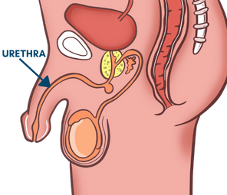
Reproductive System – Urethra
The urethra is a tube that runs the length of the penis
It has two branches: one connects to the bladder and one connects to the vas deferens
It carries semen (containing sperm) out of the body through an opening during ejaculation
It helps urine (pee) and semen exit the body
Notes:
General Information
Urethra
The urethra is the tube that runs the length of the penis
It has 2 branches – one to bladder, one to vas deferens
Provides a passageway for both urine and semen to leave the body
It is important to note that sperm and urine never mix…
The prostate gland enlarges to block urine from leaving the bladder when sperm is ejaculated
The bladder is blocked when ejaculation occurs…
Urine and semen cannot come out (or exit the body) at the same time as the acidity of the urine would destroy the sperm cells in the semen.
When a person is going to ejaculate, it stops semen and urine from mixing.
Therefore, a person with a penis cannot pee and ejaculate at the same time.
When the penis is ready to release semen, the bladder’s sphincter contracts so urine cannot escape
The urethra carries urine (pee) from the bladder to the outside of the body. It also carries sperm out of the body through the meatus (opening of the urethra out of the body) during ejaculation.
Reference:
Hirsch, L. (2019, July). Nemours TeensHealth: Male Reproductive System. https://kidshealth.org/en/teens/male-repro.html
Canadian Cancer Society. (2022). The testicles. https://cancer.ca/en/cancer-information/cancer-types/testicular/what-is-testicular-cancer/the-testicles
Image from Canva

Slide 24
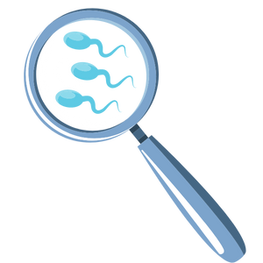
Reproductive System – Spermatogenesis
Spermatogenesis is the creation of sperm
Sperm are produced by the testicles after the start of puberty
Sperm builds up in the tubes around the testicles called the epididymis
When a sperm cell joins an egg cell, this is called fertilization and can create a fetus
Notes:
General Information
Spermatogenesis
There are special cells produced in the testicles after the onset of puberty called sperm cells
One cell, the tiniest cell in the body, can reproduce when united with the special egg cell (ovum)
They are very small – need a microscope to see them
Once a person with a penis starts to make sperm they will continue to make about 400 million each day for the rest of their life
Sperm are shaped like tadpoles and are able to swim by lashing their tails
Sperm build up in tubes around the testicles called the epididymis
As sperm is being produced the older ones die off and will be reabsorbed by the body
Fun fact: People born with a penis are not born with sperm. Sperm starts to develop once puberty begins.
When sperm is going to leave the body, in a process called ejaculation they travel through the vas deferens and mix with fluids released from both the seminal vesicles and prostate gland to form a white sticky fluid called semen.
When a sperm cell joins an egg cell, this is fertilization and can create a fetus. As pregnancy continues the fetus will become a baby. This will be expanded on in the Pregnancy PowerPoint Presentation.
Reference:
Hirsch, L. (2019, July). Nemours TeensHealth: Male Reproductive System. https://kidshealth.org/en/teens/male-repro.html

Slide 25
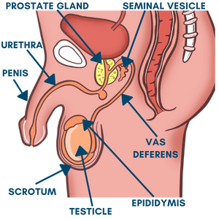
Changes in the Reproductive System
Erections
Ejaculations
Wet dreams
Jock itch (infection)
Notes:
General Information
“Things like ejaculating when you are asleep (wet dreams) or experiencing vaginal lubrication are normal and happen as a result of physical changes that come with puberty. Exploring one’s body by touching or masturbating is something that many people do because it feels good. It is common and is not harmful and is one way of learning about your body” (Taken directly from the Ontario 2019 HPE Curriculum, pg. 228).
Changes during puberty in the reproductive organs for a person assigned male at birth:
Erections
The tissue that makes up the penis is called spongy tissue
Under a microscope this tissue has many tiny holes in it
These tiny holes fill up with extra blood which causes the penis to get bigger, harder and stand out from the body, called an erection
Erections happen for physical reasons before puberty, even before birth
They can also happen when the penis is touched or when excited
Sexual thoughts send message to penis – hardens and sticks out from body
Can happen when it is least expected or wanted (e.g. first thing in the morning when you have a full bladder, during sleep, when you are anxious or frightened, no reason at all), not always related to sexual thoughts
Erections can be frightening and embarrassing, but this is a normal process of growing up.
An erection does not mean that sperm will be released (ejaculation).
Erections will eventually go away on their own.
People with a penis can cope with an unwanted erection by:
Trying to focus on something else until it goes away
Teachers should normalize that erections will happen, it is a part of puberty and the reproductive system as a result of the hormone testosterone.
Ejaculations
Ejaculation is the release of semen from penis
The penis must be erect before an ejaculation occurs
Muscles push the semen into the urethra and out the penis
There are millions of sperm in one ejaculation
Ejaculations may also happen during sleep (nocturnal emission or “wet dream”)
Wet dreams (Nocturnal Emissions)
Wet dreams are ejaculation of semen during sleep
This is one time that semen comes out without any extra touching of the penis
If a person wakes up and finds a wet, sticky spot on their pajamas, it is possible to assume that semen came out when they was sleeping
A person may be concerned that they wet (urinated) the bed but this is not always the case
Some people have wet dreams, some don’t. Whatever happens is OK
A person should change their PJ’s and sheets as needed and then put them in the laundry
It is important to remember that this is a normal part of growing up
Jock itch (infection)
There is increased perspiration during puberty, including in the pubic area
Sweaty underwear, sweaty jock straps (sweaty sports equipment), a bathing suit that is wet and worn for a long time – these can lead to a scaly, itchy rash in the genital area
It is important to keep clean, and keep the skin dry (e.g. dry well after bathing or showering; use of corn starch)
It can be treated with anti-fungal preparations available at the drugstore without a prescription
If the problem persists, see your health care professional
References
Anzilotti, A. W. (2019, October). Nemours TeensHealth: What Are Wet Dreams? https://kidshealth.org/en/teens/expert-wet-dreams.html
Dowshen, S. (2017, November). Nemours TeensHealth: Is It Normal to Get Erections? https://kidshealth.org/en/teens/normal-erections.html
Image from Canva

Slide 26
Video: Every Body Curious – Genitals
What is something you learned in this video that you didn’t know before?
Notes:
Background Knowledge
The teacher should watch the video before playing it for their class, to determine if it is appropriate for their students.
To access video you must be in present mode to play OR open the hyperlink in a separate Internet browser.
Video link: Every Body Curious – Genitals → https://youtu.be/pWSUR2hSECM
Also hyperlinked in the title.
Video Length: 9:16 → I suggest ending the video at 4:43; After this is begins to discuss the internal reproductive organs for a person with a uterus, as well as briefly touches on menstruation (which won’t be covered in this presentation)
Note: The teacher should review the video before attempting to play it in their class. They can decide what parts of the video they find relevant and pertinent to share with the students.
Another Everybody Curious video that might be of interest and talks about the Penis can be found here: https://youtu.be/9GLPOwM9yiQ (please review before deciding to share with the class)
Image from Canva

Slide 27
Think, Pair, Share
Turn to a classmate and talk about…
3 things you learned today
2 things you already knew
1 question you still have
Notes:
Teacher Prompt
Consolidate: Reaching Out About Puberty and the Reproductive Systems
Remind them to reflect on the conversation, for example:
Think about how you feel while you are having that conversation with an adult you trust…
Variation:
If students feel uncomfortable about some of the concepts that were discussed, the teacher can give out cue cards or a piece of paper to the students and they can write the 3-2-1 there. The teacher can then collect them and read them out loud. The students name DOES NOT have to go on their piece of paper/cue card, unless the teacher is assessing the students.
**Note: The final activity for the reproductive systems will be covered in Part 2 of the Reproductive Systems PowerPoint Presentations**
Image from Canva

Slide 28
More Questions? Talk to Someone:
Parents/ Guardians
Teacher/ Principal
Doctor or Health Care Professional
School Health Nurse
Child and Youth Worker
Kids Help Phone
Notes:
Teacher Prompt
Where or who do you reach out to if you need help or have questions regarding puberty and/or reproductive systems?
General Information
There are many people and places that you can reach out to in order to get help or ask questions about your health and/or relationships. Some types of supports include: social supports (family, friends); school supports (counselors, teachers); and community supports (school nurses, health care providers, doctors, faith leaders, kids help phone, etc.) If you ever have questions/concerns, need help or know someone who needs help, you can always talk to someone. There are many options out there available to you.
*Note: Students might reach out for support through social media… Be aware that this may not always provide the most accurate information, so remind students that it is important to reach out to adults*
Among these are:
A trusted adult (such as a parent or teacher)
A health care provider (such as a doctor or nurse)
A child and youth worker
The school health nurse
The school social worker
Any of the Niagara Region Sexual Health Centres
Kids Help Phone
Services for Youth - Niagara Region, Ontario → https://www.niagararegion.ca/health/schools/youth-services.aspx
Other community resources:
Kids Help Phone: Call 1-800-668-6868 or https://kidshelpphone.ca/
Image from Canva

Slide 29
Final Thoughts
For a person assigned male at birth, their reproductive system includes:
The penis, testicles, scrotum, epididymis, vas deferens, prostate gland, and seminal vesicles
Notes:
General Information
For people assigned male at birth, the body parts that develop may include the testicles, scrotum, epididymis, vas deferens, seminal vesicles, prostate gland, urethra, and penis. In Part 2 (or next class), we will discuss the reproductive parts for people assigned female at birth (ovaries, ovum, fallopian tubes, uterus, cervix, and vagina).

Slide 30
Questions?
Notes:
Ask students if they have any questions. Inform students that they will continue learning about puberty in subsequent lessons.
Optional: If a question box or envelope has been created, close the lesson by reading and responding to/discussing some of the questions submitted by students. ***It is very important to review the questions prior to reading them to the class. Do not read any questions aloud that are inappropriate. If inappropriate questions have been submitted, inform the class that if a student submitted a question that is not answered during this period, that they are welcome to discuss it directly with the teacher another time.
Image from Canva

