Slide 1
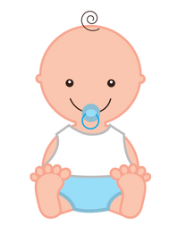
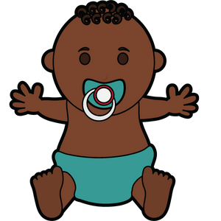
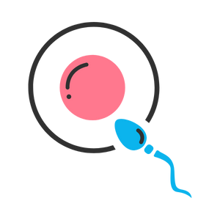
Pregnancy
Grade 5
Notes:
**The following slides (1-6) are for teacher use only**
The speaker’s notes are also intended for teacher use only. The notes include general information, background knowledge, questions and/or prompts. The information included in these notes should not be read word for word. Teacher’s should review the notes before using the presentation to become familiar with the content, as it is to supplement what is on the slide.
The title for this PowerPoint is called “Pregnancy” to reduce the literacy level for students. However, this presentation will cover menstruation, spermatogenesis, conception, fertilization, and implantation.
**Important** The language of “boys” and “girls” or “male” and “female” is gender interpreted, and often assigned based on a person’s biological sex at birth. It excludes individuals who are intersexed and/or whose gender identity does not align with their assigned biological sex. It is more accurate to talk about anatomy rather than gender and use “bodies with” or “people with” language when referring to developments and changes in puberty. Using this language supports an inclusive classroom in which diversity is recognized and provides a strong model to help students understand that bodies are unique, come in all shapes, sizes, types, and all bodies are good bodies.
Language is complex, evolving, and powerful. In these lessons, gender-neutral language is used to be inclusive of all students, including those with diverse gender identities and sexual orientations. This includes the use of ‘they’ as a singular gender-neutral pronoun. The lesson plans use the terms ‘male’ and ‘female’ when referring to biological sex (sex assigned at birth), such as when discussing reproductive anatomy. A person’s reproductive system can be male, female or intersex (not clearly defined as either male or female).
People are assigned a sex at birth based on their reproductive anatomy. Sex assigned at birth is independent of gender identity. Gender identity is a person’s internal sense of identity as female, male, both or neither, regardless of their biological sex assigned at birth.
For many people, their gender matches the sex they were assigned at birth (cisgender). Others may identify as being transgender or gender diverse if their gender identity does not match the sex they were assigned at birth. A person’s gender identity can be girl, woman, boy, man, transgender, gender fluid, gender queer, agender or others. The intention in this material is to use language that reflects these many possibilities.
Reference:
Teaching Sexual Health (n.d.). Grade 6 Growing a Baby Lesson. https://teachingsexualhealth.ca/app/uploads/sites/4/Grade-6-LP2-Growing-Baby-Oct11.pdf
Images from Canva
Last Updated: December 7th, 2022

Slide 2
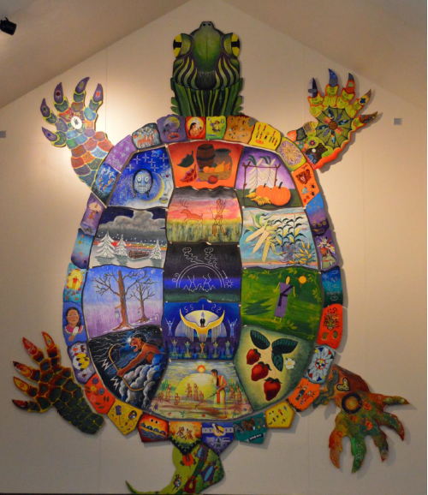
Land Acknowledgement
Notes:
Niagara Region is situated on treaty land. This land is steeped in the rich history of the First Nations such as the Hatiwendaronk (Hat-i-wen-DA-ronk), the Haudenosaunee (Hoe-den-no-SHOW-nee), and the Anishinaabe (Ah-nish-ih-NAH-bey), including the Mississauga's of the Credit First Nation. There are many First Nations, Métis, and Inuit peoples from across Turtle Island that live and work in Niagara today. The Regional Municipality of Niagara stands with all Indigenous peoples, past and present, in promoting the wise stewardship of the lands on which we live.
*Disclaimer: In the Spirit of Truth and Reconciliation, Niagara Region Public Health acknowledges that people are gathered on the customary and traditional lands of the Indigenous Peoples of this territory. We recognize that the land on which you are situated will vary depending on where you are located in Ontario. It is advised that you reach out to your school’s principal or school board for the school-specific treaty land. If you have already done a land acknowledgement on the same day you are presenting this lesson, you are welcome to skip this slide. However, it is always encouraged to complete a land acknowledgement before continuing on with this presentation.*
Information about the image on the left:
There are seven objects that have been purposely selected and included in the design of the artwork: an Inukshuk, an eagle feather, two drums, a Métis sash, an embroidered flower, and wampum belt. Each object reflects the diversity of First Nations, Métis and Inuit in North America. The iconic stone monument, the Inukshuk, is used as a marker identifying important sites and as a navigational tool to communicate direction. The eagle feather is significant to the spiritual beliefs of some Métis and First Nations peoples. Its symbolism includes honour, wisdom, and courage among many others. It is considered an honour to be given an eagle feather. The two drums include the Inuit drum and the Métis and First Nations drum. The drum is symbolic of the heartbeat of Mother Earth and is often played at various traditional gatherings and ceremonies. The embroidered flower is woven into many traditional garments and various objects through beadwork, painting, or etchings. It is also considered one of Canada’s first art forms. The Métis sash was once a tool of the voyageurs and fur traders. It is also a symbol of knowledge and the relationship between the Métis, the First Nations, and Europeans. At the top of the poster are four lines reminiscent of the traditional beaded wampum belt. There are many types of wampum belts with different significant meanings, including agreements made between two groups/nations, knowledge sharing, and storytelling. The four lines in this wampum belt represent the equality and diversity of the four peoples (First Nations, Metis, Inuit, and European settlers) and to acknowledge the journey of living together peacefully (ETFO, 2022).
For more information on Indigenous Education and First Nations, Metis and Inuit (FNMI), check out the following resources:
https://www.otffeo.on.ca/en/learning/indigenous-education
https://www.etfo.ca/socialjusticeunion/first-nation,-metis-and-inuit-(fnmi)
Photo References:
Image on the Left: Elementary Teacher Federation of Ontario (ETFO). (2022). ETFO Land Acnowledgements. https://www.etfo.ca/about-us/governance/etfo-land-acknowledgement
Image on the Right: Creating Our Way Forward: Recommendations for Improving Niagara Region Public Health & Emergency Services’ Indigenous Engagement (2019). https://www.niagararegion.ca/health/equity/pdf/indigenous-engagement-report.pdf
Mural of Turtle Island → Cover photo: Oneida nation artist, Sharon Sarnowski (deceased) This is a picture taken of the mural in the Boardroom of the Oneida Tribal Council office, Oneida, Wisconsin.

Slide 3
Presentation Format
Guiding Questions: Big idea questions that students can brainstorm and share previous knowledge or new information with.
Think, Pair, Share: Opportunity for students to work with partner or group and share ideas based on a prompt.
Notes:
Images from Canva

Slide 4
Presentation Format
Videos: Students will watch a short video clip that connects with topic. Discussion can follow before or after videos.
Final Activity: Activity that concludes the presentation.
Notes:
Images from Canva

Slide 5
Curriculum Expectations – Grade 5
D1.4 - Describe the processes of menstruation and spermatogenesis, and explain how these processes relate to reproduction and overall development.
Notes:
Image from Canva

Slide 6
Pregnancy
Grade 5
Notes:
The presentation begins here.
This presentation should be introduced after the reproductive systems are taught.
The title for this PowerPoint is called “Pregnancy” to reduce the literacy level for students. However, this presentation will cover menstruation, spermatogenesis, conception, fertilization, and implantation.
Note: Parents are the primary sexual health educators of their children. The school functions as a partner in their education.
Images from Canva

Slide 7
Learning Objectives
At the end of this presentation, you will understand how a person can get pregnant and have a baby. You will also:
Learn about how “having a period” can prepare a person for pregnancy
Understand the changes people might go through during puberty
Learn that everyone has differences and this makes us unique
Understand how to support your classmates as they grow and change
Learn how to create a safe and inclusive space for your peers
Notes:
General Information
The information we are going to talk about today is important for many reasons.
We want to ensure that you learn that everyone is unique and the things that make you unique are what make you interesting and special.
We want you to feel good about your body, how it is changing, and how you approach different types of relationships you may have with people.
It is important that everyone feels safe, accepted, and included at school and understand that differences are ok. This will help to reduce bulling and feelings of loneliness or isolation.
Background Knowledge
Students will learn and understand about themselves and their bodies as they grow and mature
Students need to understand that everyone has different qualities that make up their self-concept; this makes them unique
There needs to be an emphasis on feeling safe, included and accepted in the school community
Empathetic towards others…

Slide 8
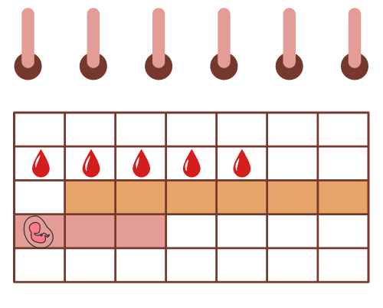
Making Decisions About Your Health
Notes:
General Information
When it comes to health, there are many decisions that a person will make throughout their life as they mature and grow. Making informed decisions regarding your health is important because you need to understand how reproduction, conception, and fertilization can impact a person’s well-being.
When deciding what is best for you and your health, it is important to understand and be well informed about the choices available. It is important that information comes from a trusted source that is current and accurate.
There is a lot of great information available on the internet and social media, but sometimes there is a lot of misinformation as well, this is why we recommend talking to a trusted adult, as they can offer information to help you make the best decisions for you and your health.
At this stage of development, children should have access to appropriate information about their bodies, health and life skills.
Images from Canva

Slide 9
Think, Pair, Share: KWL Activity
K: What do you know about the topic of conception?
W: What do you want to know about the topic?
L: What have you learned about the topic of conception recently? (We will come back to this one)
Notes:
Teacher Prompt:
Give students a sheet of paper that you will collect at the end of the class. Depending on the teacher, you may already have KWL sheets laying around. If not, you can always print one off from the internet. On the sheet of paper ask the students to write under the K something they know about the topic of conception, under the W write something that they want to know about the topic, and then L at the end of the lesson, tell them to write something that they learned about for the topic/concept.
Background Knowledge
KWL Chart
KWL charts are graphic organizers that help students organize information throughout the cycle of learning about a concept. They can be used to engage students in setting their direction for learning, engage them in a new topic, or determine what they already know about a topic.
Students begin by writing…
what they Know about a topic or concept before they begin their exploration and
What they want to know about the topic. Throughout the learning and/or at the conclusion of their exploration,
Students record what they have Learned about the concept.
The completed chart may then be used to generate further learning or as an assessment of student learning.
At the end of class, ask the students to turn to a friend and/or classmate and discuss what they wrote (think, pair, share)
Variation:
The teacher can then collect them and read them out loud. The students name DOES NOT have to go on their piece of paper/cue card, unless the teacher is assessing the students.
Image from Canva

Slide 10
Feelings about Conception and Fertilization
It’s Okay…
To feel embarrassed or uncomfortable
To ask questions
To not already know about this
For us to learn about each others bodies
Notes:
General Information
Things to remember…
4 Okays
Today we’re going to be talking about what makes us different and what makes us the same. We understand that for some of you, this may be the first time you’re learning about this topic, and for others this may be something you know a lot about. It may feel uncomfortable to talk about your body and puberty with your parents or friends, but it’s important we all understand puberty so we can be supportive and respectful of others.
So let’s review the 4 OKs. It is perfectly OK:
If you feel embarrassed or uncomfortable. The only way for us to overcome this uncomfortable feeling is to learn and grow. We can often feel uncomfortable about things we don’t fully understand. But if we take the time to learn about a topic and understand it, we become more educated and comfortable. Which creates a supportive environment for everyone!
It’s okay to be curious and to ask questions.
It’s okay if you don’t know this information already. We’re all going to learn this together.
And… It is okay for us to know about each other’s bodies and experiences. This helps us to understand one another better, and be respectful of each individual person regardless of our similarities and differences.
Today we are going to talk about menstruation (or better known as “a period”). This might be a tough topic for some because you might not understand what this process is since some of you will not experience it.
With menstruation comes the ability to conceive a baby, which is known as fertilization and conception.
Background Knowledge:
Embarrassment
Embarrassment is common; giggling or blushing, and wiggling in chairs is expected (the topic can also be uncomfortable for some students)
Most people want to know about their bodies and those of the opposite assigned sex
Knowing the information helps youth to feel more comfortable and prepared as they go through puberty
Knowing/Not Knowing
It is important to learn about puberty; it helps to understand the changes that are happening and that will happen
Some students have very limited knowledge and others might know more
For some, this may be the first opportunity to explore the changes of puberty
For those with some knowledge, it is important to continue talking about puberty and to make sure that the information they have is correct
Students may have learned about these topics from friends or the media. However, those sources are not always accurate
It is important that everyone gets to know and learn about each other (and everyone)
Discuss respect of each other and of the topic
We spend a lot of our lives relating to people of the opposite assigned sex (fathers, brothers, sons, mothers, sisters, daughters). If we learn about them and their concerns, perhaps we can understand them better and can improve our relationships with them
It may be more difficult to discuss these topics in the co-ed setting, but it is a good introduction to understanding and communicating in a respectful way
Asking questions…
If a student has a question, it’s likely other students have the same question
Introduce the question box (if using)
Optional:
The Giggle Minute: Students (and teachers!) may be uncomfortable with the medically-accurate words contained within this lesson. Acknowledge this discomfort with students and affirm that it’s ok to feel that way. However, it is important to learn the correct words for all body parts and functions so that they can talk about their bodies with confidence. Give students a “giggle minute”, or the chance to get laughter out at the beginning of the lesson.
Images from Canva

Slide 11
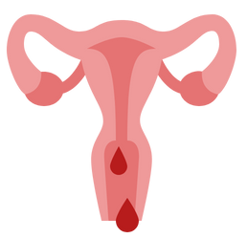
Guiding Question #1
What do you know about menstruation (also known as “a period”)?
Notes:
General Information
“Menstruation is the medical term for having a ‘period’ and is the monthly flow of blood from the uterus. This begins at puberty. Not all female bodies begin menstruation at the same age. Generally, every month, an egg leaves one of the ovaries and travels down one of the fallopian tubes towards the uterus. In preparation, the walls of the uterus develop a lining of extra blood and tissue to act as a cushion for the egg in case fertilization occurs. When an egg is fertilized, it attaches itself to the lining of the uterus and begins to develop into an embryo. If fertilization does not occur, the lining of the uterus is no longer needed and is discharged through the vagina. This is the monthly flow of blood. The whole process is called the menstrual cycle.”
People who have uteruses often menstruate. A number of factors can prevent menstruation from happening including: body weight, medications, illnesses, medical conditions etc. It is important to remember that not all of your students who will menstruate will identify as girls. To avoid making generalizations you can use phrases like “people who get periods” or “people with uteruses” or even more fun - “menstruators”! (Shore Centre – Talking About Menstruation in the Classroom: A Guide for Teachers → https://www.shorecentre.ca/talking-about-menstruation-in-the-classroom-compressed/)
Image from Canva

Slide 12
Menstruation (A Period)
A period usually happens to people who have a uterus
A period is when blood and tissue comes out through the vagina
A person might get their first period between the ages of 10 and 15, but every body is on their own schedule
Having a period is a normal change that happens during puberty
Notes:
General Information
Getting your period is a normal change that happens during puberty
A period is the release of blood and tissues that comes out through the vagina
When Do People (with a uterus) Get Their Period?
Most people with a uterus get their first period when they're around 12. But it can happen usually anytime between the ages of 10 and 15, and this is OK. Every body has its own schedule.
There isn't one right age for a person to get their period. But there are some clues that it will start soon:
No one can tell exactly when menstruation will start but usually acne, pubic hair, breast development and vaginal discharge tend to happen before menstruation begins
vaginal discharge is fluid (sort of like mucus) that a person might see or feel on their underwear. This discharge usually begins about 6 months to a year before a person gets their first period.
What is normal?
A period can be red, rusty, pink or brownish coloured spot on your underwear or pad.
Depending on the heaviness of a persons flow, the colour might be brighter red and might change from one day to the next
Websites about Periods:
Diva Cup: https://divacup.com/
Hello Flo: https://helloflo.com/
Scarlet Teen: https://www.scarleteen.com/
References:
The Society of Obstetricians and Gynaecologists of Canada (2022). Normal Periods: Menstrual Cycle Basics. https://www.yourperiod.ca/normal-periods/menstrual-cycle-basics/
Wood White, K. (2018, October). Nemours TeensHealth – All About Periods. https://kidshealth.org/en/teens/menstruation.html

Slide 13
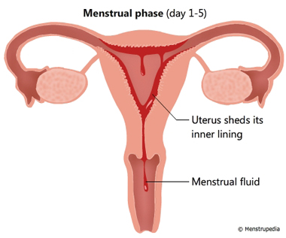
Menstrual Cycle
A period can last approximately 5-7 days, sometimes more or less
Periods can happen every 4 weeks, but it can be different for everyone
Periods will usually stop between the ages of 45 and 60
Notes:
Remind students that menstruation or the menstrual cycle is also called “having a period”.
Background Knowledge
the menstrual cycle is the time from the first day of bleeding in one cycle to the first day of bleeding in your next cycle.
At first there may not be any pattern to when you get your next period (e.g. may even skip a month or two between periods)
Each person is different so some people might have a period every 23 days, some every 28 days and some every 35 days
Some people who get their period like to keep a calendar to help them keep track of when they will have it each month and how long it lasts
A period usually lasts about 5-7 days– a hormonal message from the ovary tells the uterus to shed the lining, flowing through the cervix and then out of the body through the vagina
The average length of a menstrual cycle in the first few years is 21-45 days. After that, the normal length becomes 21-35 days, with an average length of a menstrual cycle being 28 days.
Once the lining is completely shed, a new one begins to grow
Next month another ovum is released and if fertilization does not occur, the egg dissolves and that lining is shed. This process continues to happen over and over again.
If a student still has information about their period, check out the following resource: https://www.yourperiod.ca/normal-periods/your-first-period/
Reference:
Menstrupedia (2022). Phases of Menstrual cycle. https://www.menstrupedia.com/articles/physiology/cycle-phases
The Society of Obstetricians and Gynaecologists of Canada (2022). Normal Periods: Menstrual Cycle Basics. https://www.yourperiod.ca/normal-periods/menstrual-cycle-basics/

Slide 14
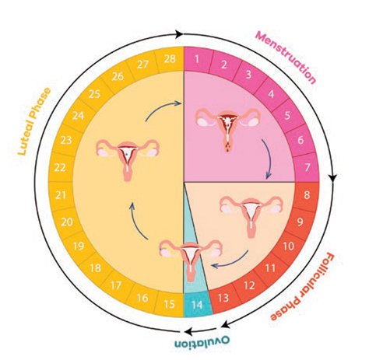
Phases of the Menstrual Cycle
There are four phases of the menstrual cycle.
1. Menstruation Phase (shown in pink)
2. Pre-ovulation Phase (shown in red)
3. Ovulation Phase (shown in blue)
4. Pre-menstrual Phase (shown in yellow)
Notes:
Note: Now that students have been introduced to all the anatomy, the process of menstruation can be explained.
General Information
Phases of the Menstrual Cycle:
Menstruation (or Menstrual Phase): Your menstrual period, which is made of endometrial tissue, blood, and other fluids, exits the uterus through the cervix and vagina.
Menstrual phase begins on the first day of menstruation and lasts till the 5th day of the menstrual cycle. The following events occur during this phase:
The uterus sheds its inner lining of soft tissue and blood vessels which exits the body from the vagina in the form of menstrual fluid.
Blood loss of 10 ml to 80 ml is considered normal.
You may experience abdominal cramps. These cramps are caused by the contraction of the uterine and the abdominal muscles to expel the menstrual fluid.
Pre-ovulation (or Follicular Phase): Each ovary holds thousands of eggs, and every month, rising hormone levels cause the ovary to produce a mature egg. During this time, estrogen causes the endometrium to get thicket.
3. Ovulation Phase: Ovulation occurs when a mature egg is released from the ovary. The egg travels along the fallopian tube to the uterus. If a sperm fertilizes the egg, the cells can begin to form a pregnancy. Around the time of ovulation you may notice increased vaginal discharge.
4. Pre-Menstrual (or Luteal Phase): The endometrium is thick and ready to receive a fertilized egg, but if fertilization does not happen, the lining is no longer needed. As a result, hormone levels change and the lining is shed. The hormones and shedding may cause symptoms known as PMS.
For some people who have a uterus and get a period, they may experience P.M.S. – pre-menstrual syndrome
Symptoms of P.M.S. may appear after ovulation and can include lower abdominal cramping, backache and bloating
These symptoms can be relieved by limiting salt intake, drinking plenty of water, participating in light exercise (stretching or walking), applying heat through a hot water bottle or heating pad, or taking a pain reliever
Remind your students that they should always ask their parents before taking any medication
Background Knowledge
Discharge
Once puberty begins, a person with a vagina may notice some discharge from their vagina on their underwear or on toilet paper
Varies from a whitish colour to clear
This means their body is starting to mature and is a sign that their period may be starting sometime soon
It is normal and keeps the vagina clean and healthy
If the discharge smells bad or the area is itchy, it could signal infection and require medical treatment
Normal vaginal discharge (fluid) is odorless, cloudy white, and is an indication that their body is preparing for menstruation
Reference:
OPHEA (2022). Always Changing & Growing Up. Everything you need to know about puberty. Grades 5-6.

Slide 15
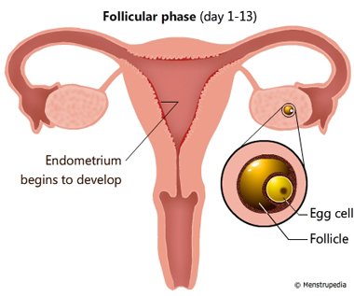
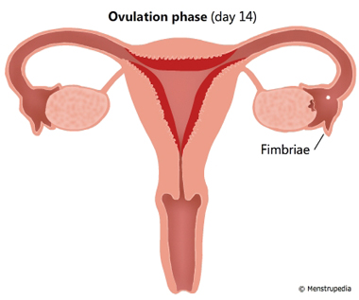
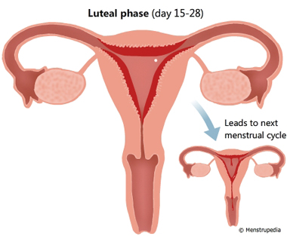
Process of the Menstrual Cycle
Notes:
*Note: This slide will not show when you are in presentation mode.*
Background Knowledge for the Teacher Only:
Picture #1 (Follicular Phase): As the ovaries start producing hormones such as estrogen, a message is given to start maturing an egg cell (ovum).
This phase also begins on the first day of menstruation, but it lasts till the 13th day of the menstrual cycle. The following events occur during this phase:
The pituitary gland secretes a hormone that stimulates the egg cells in the ovaries to grow.
One of these egg cells begins to mature in a sac-like-structure called follicle. It takes 13 days for the egg cell to reach maturity.
While the egg cell matures, its follicle secretes a hormone that stimulates the uterus to develop a lining of blood vessels and soft tissue called endometrium.
Picture #2 (Ovulation Phase):
Once the egg cell (ovum) is mature, hormones send a message to the ovaries to start releasing one ovum, once a month from one ovary into the fallopian tube
This natural process is called ovulation and is usually not felt, but it is the time of the month she may get pregnant
Once the egg cell (ovum) is in the fallopian tube it is possible for a sperm, if present, to fertilize it
At the same time, hormones from the ovaries send messages to the uterus to grow a thick, soft lining of tissue and blood on the inside wall in preparation for a possible pregnancy
The lining, which is called the endometrium has lots of tiny blood vessels and is there to protect and feed a fertilized egg cell
On the 14th day of the cycle, the pituitary gland secretes a hormone that causes the ovary to release the matured egg cell. The released egg cell is swept into the fallopian tube by the cilia of the fimbriae. Fimbriae are finger like projections located at the end of the fallopian tube close to the ovaries and cilia are slender hair like projections on each Fimbria.
Picture #3 (Luteal Phase):
If the egg is not fertilized in approximately 24 – 48 hours it dissolves
Ovulation happens in between a female’s menstrual periods, approximately 14 days before the start of her next period
If an egg is not fertilized by a sperm, then the lining is not needed to nourish a baby
This phase begins on the 15th day and lasts till the end of the cycle. The following events occur during this phase:
The egg cell released during the ovulation phase stays in the fallopian tube for 24 hours.
If a sperm cell does not impregnate the egg cell within that time, the egg cell disintegrates.
The hormone that causes the uterus to retain its endometrium gets used up by the end of the menstrual cycle. This causes the menstrual phase of the next cycle to begin.
Reference:
Menstrupedia (2022). Phases of Menstrual cycle. https://www.menstrupedia.com/articles/physiology/cycle-phases
The Society of Obstetricians and Gynaecologists of Canada (2022). Normal Periods: Menstrual Cycle Basics. https://www.yourperiod.ca/normal-periods/menstrual-cycle-basics/

Slide 16
Personal Care during Menstruation
A few tablespoons to half a cup of blood will come out of the vagina during a period
There are hygiene products to help catch the flow of blood during a period
Cramps may be felt when a person is on their period. Try using a warm heating pad on your lower belly
Notes:
General Information
Is there a certain amount of menstrual blood that I’ll lose?
The amount of menstrual blood lost can be anywhere from a few tablespoons to about half a cup
When menstrual blood is released it doesn’t come out all at once, it can be heavier at times and lighter at others.
Remind students that you cannot stop the flow of your period, it will trickle, it will drip, but there is no way to actually stop your period. However, there are sanitary products that can be used to catch the menstrual period (this will be discussed later on in this presentation)
Personal Care during Menstruation
Menstruation is a normal change of puberty
Personal hygiene (i.e. bathing, washing hair) are even more important at this time due to an increase in hormone production and to prevent bacterial growth
No one will know that you have your period unless you tell them
The fluid usually comes out a bit at a time and is something you have no control over
It will start and stop at different times no matter whether you are sitting, standing or lying down
There are various forms of feminine hygiene products like pads, tampons, and menstrual cups to help catch the flow of blood during a period. There are many different products and you can pick what is best for you and what you are most comfortable with.
Some people experience cramps during a period when the uterus contracts to push out menstrual blood. However, some people might have cramps worse than others. Some ways to help with cramps are a heating pad, exercise, and/or medication. Talk to an adult or a health care provider if cramps are interfering with daily life.
Cramps might feel like lower back pain and/or a throbbing or cramping pain in the lower abdomen.
A common misconception: You need to clean your vagina with lots of soap and body wash. This is incorrect!!
If you use soaps or products that you would normally use on the rest of your body, wash internally (using vaginal douches) or over-wash, you could actually cause or aggravate issues such as odour, dryness or recurrent infections by upsetting the pH balance of your vagina and intimate area. Your vagina naturally cleans itself with an internal lubricant so it’s best to simply wash yourself daily, with warm water and gentle products (yourperiod.ca)
**Should I Watch for Any Problems?
Most people assigned female at birth and with a vagina don't have any problems with their periods. But call your doctor if you:
are 15 and haven't started your period
have had your period for more than 2 years and it still doesn't come regularly (about every 4–5 weeks)
have bleeding between periods
have severe cramps that don't get better with ibuprofen or naproxen
have very heavy bleeding (bleeding that goes through a pad or tampon faster than every 1 hour)
have periods that last more than about a week
have severe PMS that gets in the way of your everyday activities
References:
Wood White, K. (2018, October). Nemours TeensHealth – All About Periods. https://kidshealth.org/en/teens/menstruation.html
**If you’d prefer to show the Personal Care during Menstruation Video that was created by our team at Niagara Region Public Health, please use the following link: https://www.youtube.com/watch?v=nySZsLDBTvU
Image from Canva

Slide 17
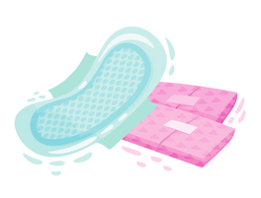
Hygiene Products for a Period
There are products that can be used during menstruation, such as:
Pads or sanitary napkins
Tampons
Menstrual cups
Period underwear
Notes:
General Information
Pads or Sanitary Napkins
Made of material that absorbs the fluid
Most have a sticky strip on one side to hold the pad to the underwear; come in a variety of sizes and shapes
Different size pads are chosen to meet the needs of varying menstrual flow
Need to wear 24 hours a day while menstruating
Change pads frequently- about every 3-4 hours while awake, even if flow isn’t heavy because regular changing prevents buildup of bacteria and eliminates odour
Dispose of pads in wastebasket/container rather than the toilet- NOT flushable
Panty-liners are similar to pads and are used to catch light menstrual flow or vaginal discharge
Keep pads in a backpack, locker or bag
There are many different types of pads, including:
super
slender
overnight
scented
maxi
Mini
Tampons
Small plug of material that fits inside the vagina to absorb the blood and lining
Held in place by the muscles in the vagina – cannot get lost or fall out. The cervix stops the tampon from entering the uterus.
String used to remove tampon – very strong so no fear of breakage
Tampons are often not used by females when they first start having periods
Some females like to use tampons, especially if they are doing physical activities (i.e. swimming, dance, gymnastics) but it is personal choice
You should talk to a parent/adult you trust before using tampons and read the instruction booklet in the tampon package to learn more
Hand washing is important both before and after changing tampons
They need to be changed regularly, every 4-6 hours and should never be worn overnight
Used tampons should be wrapped up in toilet paper and put in the garbage. They are not to be flushed down the toilet
Not practicing good hand and body hygiene and/or not changing tampons regularly could cause a rare but serious and sometimes life-threatening infection called Toxic Shock Syndrome
Briefly explain- Toxic Shock Syndrome
TSS is caused by a toxin (a poisonous substance) that builds up in the body
It is caused by either staphylococcus or streptococcus bacteria.
These bacteria normally live on the skin and in the nose or mouth without causing harm, but if they get deeper into the body they can release toxins that damage tissue and stop organs from working.
The signs of TSS include sudden high fever, nausea and vomiting, diarrhea, headache, generalized aches and pains, dizziness and feeling faint (especially when rising from a lying or sitting position), disorientation, a rash like a sunburn on the palms of the hands and the soles of the feet and extremely low blood pressure and rapid weak pulse (shock)
These signs will typically occur when a person is on their period and using tampons.
Things that can increase the risk of TSS:
Using tampons – particularly if they are left in longer than the recommended use
Using female barrier contraceptives, such as a contraceptive diaphragm or cap
Suggestions:
Alternate between tampons, pads and a sanitary towel or panty liner during your period
Always use a tampon with the lowest absorbency suitable for your period
Change tampons regularly – as often as directed on the pack (usually 4 to 8 hours)
Wash your hands before and after inserting a tampon
Never have more than one tampon in your vagina at a time
Remove a tampon at the end of your period
When using female barrier contraception, follow the manufacturer’s instructions about how long you can leave it in
Background Knowledge
Pads
There are a few types of pads that do the same job, but are used a little bit differently.
Disposable pads
Most pads have a sticky strip along the bottom. You peel off the paper strip that covers the adhesive and press the pad into the crotch of your underwear. If the pad has wings, you wrap these around the bottom of the crotch.
To remove the pad, unstick it from your underwear and wrap it in toilet paper. Put it in the trash can or in the special disposal box that's found in most bathroom stalls. Don't try to flush a pad down the toilet because the toilet can become clogged and make a big mess.
Reusable pads
These pads are washed after each time you wear them. They're sold in natural health stores and online. These kinds of pads snap or clip onto a girl's underwear. Girls might use these pads because they feel they're better for the environment or to save money. It's all a matter of personal preference.
Pantiliners
These are small, thin, disposable absorbent pads that can be used on their own on days of light flow. They can also be used in combination with a tampon, in case of leaks or discharge.
These should not be used every day (when not menstruating or on your period) because they don’t allow the area to breathe.
If this happens, the area could have bacteria build up (i.e., yeast infection), which happens in warm and moist environments.
Menstrual Cups
This is a cup-shaped, flexible silicone or rubber apparatus that is inserted inside the vagina to catch menstrual flow. The cup has a stem on the bottom for removal. Menstrual cups should be emptied every 8-12 hours. Some are disposable and others can be washed and reinserted.
Like a tampon, a menstrual cup is inserted into the vagina. Instead of absorbing blood, the cup catches it before it flows out of the vagina. Menstrual cups are made of flexible materials, like rubber or silicone.
You can't see when the cup is full, so empty it (or, in the case of disposable cups, throw it away) several times a day. Instructions that come with the cup explain how to do this.
Because some menstrual cups look like a diaphragm, girls might wonder if a menstrual cup could be used as birth control. But a menstrual cup does not prevent pregnancy.
Period underwear
Physical Health
Period underwear can reduce the risk of Toxic Shock Syndrome (TSS). Tampons pose a particular health risk for young menstruators. The Journal of Adolescent Health Care reports that nearly half of all TSS cases occur in menstruators under the age of 19 (Litt, 1983).
Article Link: https://www.sciencedirect.com/science/article/abs/pii/S0197007083800102
The use of tampons is also linked to a higher incidence of UTIs in adolescents. According to the Journal of Pediatric and Adolescent Gynecology, tampon-only users were nearly 3x more prone to UTIs than pad-only users (tampons = 32% of study participants versus pads = 12%). Moreover, the primary determinant for selecting tampon/pad usage was maternal influence; not physician recommendation (Omar, Aggarwal, Perkins, 1998).
Article Link: https://www.sciencedirect.com/science/article/abs/pii/S1083318898701342
A medical criticism of period underwear is that some brands contain PFAs. However, Knix (a Toronto-based company) are PFA-free and OEKO-TEX® certified. While my study would not contain any branding information, it is good to know that the proposed product will not contain PFAs.
Link: https://knix.com/blogs/knix-blog/yes-knix-underwear-are-toxic-chemical-free
Mental Health
Advertising of single-use feminine hygiene products often focuses on how the product conceals menstruation and saves users from the shame and embarrassment of leaks (Malefyt & McCabe, 2016). In adolescents, these advertisements have been found to heighten insecurities and perpetuate shame (Simes and Berg, 2001). The parallel look and feel of period underwear to regular underwear can help reduce anxiety by normalizing menses (Sharkey, 2019).
Environmental Health
Rough estimates project that a single menstruator uses between 5-15 thousand pads and/or tampons over their lifetime, almost all of which end up in landfills as plastic waste (Borduna, 2019). Peberdy, Jones, & Green, (2019) found that most people are unaware of the harmful environmental impact of single-use menstrual products and that consumers with higher awareness are more likely to purchase environmental alternatives.
Educational Health (Gender-Equality)
Since period underwear absorbs the equivalent of up to two-four tampons, young menstruators may not have to leave the classroom as often as those who use single-use products. This becomes a gender-equality issue vis-à-vis access to class-time.
Financial Health (Long-Term)
Wier (2015) found that reusable menstrual products had long-term financial, environmental, and physical health benefits over single-use menstrual products.
Check out the following resources for more information on period underwear:
https://knix.ca/collections/period-underwear
https://www.knixteen.ca/
Reference
Anzilotti, A. W. (2019, October). Nemours TeensHealth: Tampons, Pads, and Other Period Supplies. https://kidshealth.org/en/teens/supplies.html
Anzilotti, A. W. (2020, August). Nemours TeensHealth: Pads and Tampons. https://kidshealth.org/en/kids/pads-tampons.html
NHS (2019, September 27). Health A to Z: Toxic Shock Syndrome. https://www.nhs.uk/conditions/toxic-shock-syndrome/#:~:text=Toxic%20shock%20syndrome%20(TSS)%20is,age%20%E2%80%93%20including%20men%20and%20children.
The Society of Obstetricians and Gynaecologists of Canada (SOGC). (n.d.). Normal Periods: Your First Period. https://www.yourperiod.ca/normal-periods/your-first-period/
For more information, visit https://always.com/en-us/tips-and-advice. This resource provides tips and advice for using products that can help a person who is trying to deal with their menstruation/period.
Image from Canva

Slide 18
Video: Your Menstrual Cycle & Periods in 3 Minutes
What is something you learned from the video that you didn’t know before?
Notes:
To access video you must be in present mode to play OR open the hyperlink in a separate Internet browser.
Video link: https://youtu.be/nzVKrDDarjs
Also hyperlinked in the title.
Background Knowledge
Starting your period is an exciting moment, but what exactly is a period? And why do millions of girls get their periods every month? Watch our video and we'll tell you all you need to know about your period and menstrual cycle in less than 3 minutes!
Also visit https://always.com/en-us/tips-and-advice for more information!
Periods are normal and a sign of health. They are just one part of a natural process known as the menstrual cycle (or monthly cycle). The cycle is a way for the body to prepare itself for pregnancy. An average menstrual cycle lasts 28 days (but anything from 21 to 35 is considered normal).
The menstrual cycle has 4 phases:
Menstruation
Pre-ovulation
Ovulation
Pre-menstruation
You can find more information on the menstrual cycle phases and their duration in this video! Visit our official website to learn more about ALWAYS sanitary pads: https://always.com/en-us
For an additional video on the menstrual cycle and having a period, check out: https://www.youtube.com/watch?v=vXrQ_FhZmos
Image from Canva

Slide 19
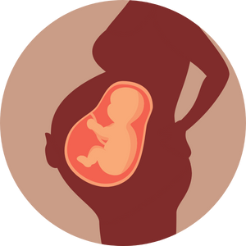
Guiding Question #2
What do you know about pregnancy?
Notes:
Teacher Prompt
What do you know about pregnancy? How do you think people get pregnant? This question is very open-ended because of the grade level and possible literacy levels. With your elbow partner… try to discuss and answer the question.
Notes:
There are four things needed for pregnancy:
Egg
Sperm
Fertilization
Implantation
Any time there is vaginal intercourse a person with a uterus could become pregnant.
Background Knowledge
Pregnancy is different for everyone. When someone will get pregnant also differs. For a person assigned female at birth, as long as they are producing eggs they can become pregnant. A person with a vagina, uterus, and ovaries must begin puberty and begin releasing an egg (ovulating) for pregnancy to be possible. However, a person assigned female at birth and with a vagina can become pregnant before they get their first period, as they usually cannot tell when their body will begin ovulation/ovulating. This process occurs about once a month, and the person cannot tell which days of the month there will be an egg in their fallopian tubes.
Who can become a parent? →
A person assigned female at birth and with a uterus) may give birth to a baby – this could be natural pregnancy, in-vitro fertilization or artificial insemination.
A person who provides sperm to fertilize the egg to conceive
A person who adopts a child or becomes a legal guardian
A person can take on a parenting role by caring for a child (i.e., caregiver)
**Note: Some people are using the term birthing parent instead of mom/mother**
Emphasize, just because a person can provide the sperm or egg for a pregnancy does NOT mean they are ready for pregnancy, or that they are the only type of parent. Some people may choose never to have a baby and that’s ok too! Even if your body is now ready for pregnancy, it doesn’t mean you are! It’s important to know why you get your period and what is happening inside your body. There are many other external factors to be considered for pregnancy and these include age, readiness, and much more.
**Reminder: Many kids might say “my mom” when answering the question. As the teacher, try to use gender-neutral language and inclusive terminology because some family situations are different (i.e., single-parent families, foster and adopted parents, two moms, two dads, surrogate family, etc.)**
Images from Canva

Slide 20
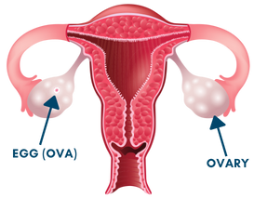
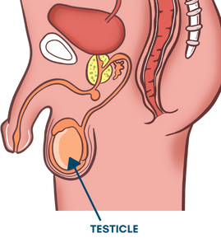
The Role of the Reproductive Systems
Eggs (ovum) are released from the ovary
Sperm is created in the testicles
An egg (ova) and sperm are needed for fertilization
An egg and sperm meet in the fallopian tube to begin the process of fertilization
Notes:
General Information
Conception:
Definition of Conception: the act of conceiving a child or of a child being conceived by having sexual intercourse.
Conception can occur when sperm is ejaculated from the penis into the vagina.
In biology, the beginning of pregnancy is marked by fertilization of an egg by a sperm.
Fertilization:
Sperm is needed for fertilization. When the sperm from the male and the egg from the female join together, pregnancy occurs.
Sperm enters a person through the vagina through sexual intercourse between a person with a penis and a person with a vagina. The sperm swim up through the uterus and into the fallopian tubes. If an egg is in one of the fallopian tubes, the sperm try to join with it. Only one sperm can enter, or fertilize, the egg. The rest of the sperm die.
Once the egg is fertilized, the process of pregnancy will begin
The fertilized egg moves into and implants in the uterus. As it travels it starts to divide into many more cells. After about five or six days these cells burrow into the wall of the uterus. There the cells begin to develop into a baby.
Background Knowledge
“In the male body, the testicles are glands within the scrotum that produce sperm and hormones, beginning at puberty. After sperm develops in the testicles, it can travel through the epididymis until it reaches the vas deferens where it is stored until ejaculation occurs. During ejaculation, the prostate gland releases a liquid that mixes with the sperm from the vas deferens to make semen, which then leaves the body through the urethra. Fertilization can occur when sperm is ejaculated into the vagina, and the sperm and egg connect. Babies can also be conceived by having the sperm and egg connect using assisted reproductive technologies.”
Fertilization is the union of one sperm and one ova (egg) – ovum (eggs). The process takes place in the fallopian tube and happens when a person with a penis ejaculates semen into the vagina of a person with a vagina . Although there are of millions of sperm in this semen only around 1,000 make it as far as the fallopian tubes. The semen containing sperm travel from the vagina, through the cervix, the uterus and finally into the fallopian tube in search of the ovum. If this happens around the time of ovulation there is, or soon will be, an egg (ova) in the fallopian tube. One sperm will penetrate it. This is the moment of fertilization. The remaining sperm cells will die off and dissolve.
Reference:
Gregg, Daphna (n.d.). Britannica Kids: Reproductive System. https://kids.britannica.com/students/article/reproductive-system/276695 (student version - grade 6 to 8) and https://kids.britannica.com/kids/article/reproductive-system/353707 (kids version - up to grade 5)
National Cancer Institute (n.d.). NCI dictionary of cancer terms: Conception. https://www.cancer.gov/publications/dictionaries/cancer-terms/def/conception
Image:
Reece, T., & Jain, Tarun. (2021, April 6). What to expect: How fertilization happens. https://www.whattoexpect.com/getting-pregnant/fertility/how-fertilization-happens.aspx

Slide 21
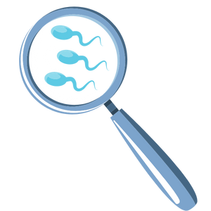
Reproductive System – Spermatogenesis
Spermatogenesis is the creation of sperm
Sperm are produced by the testicles after the start of puberty
Sperm builds up in the tubes around the testicles called the epididymis
When a sperm cell joins an egg cell, this is called fertilization and can create a fetus
Notes:
Spermatogenesis
There are special cells produced in the testicles after the onset of puberty called sperm cells
One cell, the tiniest cell in the body, can reproduce when united with the special egg cell (ovum)
They are very small – need a microscope to see them
Once a person with a penis starts to make sperm they will continue to make about 400 million each day for the rest of their life
Sperm are shaped like tadpoles and are able to swim by lashing their tails
Sperm build up in tubes around the testicles called the epididymis
As sperm is being produced the older ones die off and will be reabsorbed by the body
Fun fact: People born with a penis are not born with sperm. Sperm starts to develop once puberty begins.
When sperm is going to leave the body, in a process called ejaculation they travel through the vas deferens and mix with fluids released from both the seminal vesicles and prostate gland to form a white sticky fluid called semen.
When a sperm cell joins an egg cell, this is fertilization and can create a fetus. As pregnancy continues the fetus will become a baby. This will be expanded on in the Pregnancy PowerPoint Presentation.
Reference:
Hirsch, L. (2019, July). Nemours TeensHealth: Male Reproductive System. https://kidshealth.org/en/teens/male-repro.html

Slide 22
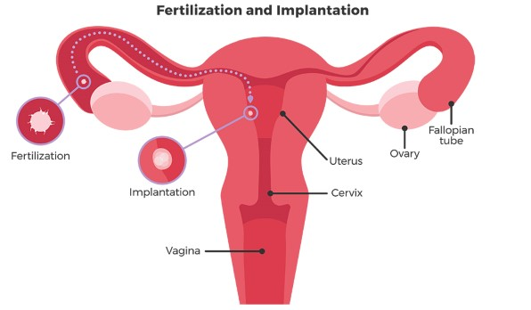
What is Fertilization and Implantation?
Ovulation is when an ovary releases an egg cell (ova)
Fertilization is when one sperm and one egg join together
A fertilized egg attaches to the walls of the uterus and grows into a baby
Notes:
General Information
“Human reproduction happens through sexual contact. You may have heard of the phrase “having sex”. There are many different kinds of sexual contact, but the kind of sexual contact needed for reproduction is called vaginal intercourse or vaginal sex. Vaginal intercourse is when a person with a penis inserts their erect penis into a person with a vagina. The person with a penis then ejaculates, releasing sperm into the vagina, where it may travel to meet an egg (ova), causing pregnancy.”
Background Knowledge
For Teacher Knowledge and Understanding Only:
These two cells then become one cell which is neither a sperm nor an egg (ova), but is called a zygote. This zygote spends the next few days traveling down the fallopian tube. As it travels, it begins to divide within itself into two identical cells, and those two into four, and those four into eight and so on. This zygote (ball of cells) is now called a blastocyst. The blastocyst is made up of an inner group of cells and an outer group of cells. The inner group of cells will become the baby (embryo) and the outer group of cells will become structures which nourish and protect the baby. Once the embryo is inside the uterus and securely attached to the wall of the uterus then the process of implantation is complete and the placenta begins to form. It is at this point that the process of conception is complete.
Reference:
Gregg, Daphna (n.d.). Britannica Kids: Reproductive System. https://kids.britannica.com/students/article/reproductive-system/276695 (student version - grade 6 to 8) and https://kids.britannica.com/kids/article/reproductive-system/353707 (kids version - up to grade 5)
Image:
Reece, T., & Jain, Tarun. (2021, April 6). What to expect: How fertilization happens. https://www.whattoexpect.com/getting-pregnant/fertility/how-fertilization-happens.aspx

Slide 23
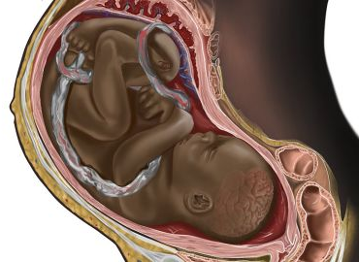
Possible Signs of Pregnancy
Missing a menstrual period
Tender, swollen breasts
Feeling very tired and/or weak
Feeling sick to your stomach
Having to pee more often
Dizzy spells
Notes:
General information
Not all people who become pregnant will experience the same symptoms or even at the same degree… It is different for everyone. They are just some of the some of the possible signs of pregnancy, it will differ for each person.
Other Signs of Pregnancy:
Period changes (late, light or no periods at all)
Spotting/brownish bleeding between periods
Sensitivity to certain smells
Cravings for certain foods and/or dislike of some foods usually liked
Fatigue
Nausea
Heartburn
Abdominal cramping
Symptoms later on in pregnancy may include:
Weight gain
An extended stomach
Abdominal cramping
A feeling of movement in your stomach
A frequent desire to urinate
A person who misses a period might only become pregnant if they have engaged in unprotected sexual intercourse.
*Remind students that they can become pregnant if they are sexually active and do not use any methods of protection (i.e., condoms). They can also become pregnant if methods of protection are used, but used incorrectly (i.e., missing a birth control pill, condom breaks while the penis is in the vagina, etc.). If students are sexually active, the only way to reduce their risk of pregnancy is using a method of protection (contraceptives).
*Clarify that a person can miss their menstrual period after being sexually active. Some individuals who have their period (menstruation/menses) might actually experience dysregulated period cycles. This is nothing to worry about, unless you have been sexually active and have had unprotected sex.
Background Knoweldge
*Note: Information for the teacher only (this is here in case a student asks about pregnancy testing options:
To find out if you’re pregnant there are multiple options:
Urine Tests (Peeing on a stick) → This is the most accurate method to find out if you are pregnant
It checks your urine (pee) for a certain hormone that is only created when a person is pregnant. This hormone (HCG) is released when a fertilized egg attaches to the lining of the uterus – when pregnancy begins. If the tests shows up positive, it means you’re pregnant.
Anyone can get a urine pregnancy test from the grocery store or drugstore.
A blood test
A quantitative human chorionic gonadotropin (HCG) test measures the specific level of HCG in the blood. HCG is a hormone produced in the body during pregnancy.
An ultrasound (also called sonogram) is a prenatal test offered to most pregnant women.
It uses sound waves to show a picture of your baby in the uterus (womb). Ultrasound helps your health care provider check on your baby’s health and development.
This type of test is available at your doctor’s office.
Reference:
Government of Canada. (2022, April 29). Your Guide to a Healthy Pregnancy: Common complaints in pregnancy and You developing baby. https://www.canada.ca/en/public-health/services/health-promotion/healthy-pregnancy/healthy-pregnancy-guide.html#a15
Niagara Parents
Nemours KidsHealth (2020). Parents: Pregnancy Slideshow (baby). https://kidshealth.org/en/parents/babyslideshow.html
Photo Reference:
Kaur, H. (2021, December 9). CNN Health: A viral image of a Black fetus is highlighting the need for diversity in medical illustrations. https://www.cnn.com/2021/12/09/health/black-fetus-medical-illustration-diversity-wellness-cec/index.html

Slide 24
Fun Facts About Pregnancy
Pregnancy usually takes about nine months or 40 weeks before the baby is born
Pregnancy is divided into three stages called trimesters
The baby continues to grow and change over the three trimesters
About 1 in 2,000 babies are born with teeth
Notes:
General Information
The process of pregnancy takes about 9 months or 40 weeks to complete. This time period is divided into 3 stages called trimesters. Trimester one includes the first three months. Trimester two includes months 4-6. Trimester three includes months 7-9.
Background Knowledge
During pregnancy, the baby is constantly growing and changing. Below are some examples of some of the changes happening to the baby in each trimester.
First Trimester:
During the first 0-4 weeks the baby is called an embryo (first month), whereas at 9-12 weeks the baby is called a fetus (third month)
For weeks 5-8 (second month): arm and leg buds are starting to grow; now the baby is about 2.5cm long
From 9-12 weeks, the baby’s eyes, ears, and nose are forming/formed
Second Trimester:
For 13-18 weeks (fourth month): baby has fingernails and toenails; baby can taste and hear sounds
19-22 weeks (fifth month): baby will kick, twist and turn in uterus; baby is approximately 25cm long
23-27 weeks (sixth month): baby can hiccup, and open and close eyes; at this point, the baby will weigh about 1kg
Third Trimester:
The baby can hear and respond to sounds
By the 7th month, the baby will have eyelashes and eyebrows and kicks can be seen
During 32-35 weeks (eighth month): the baby is building layers of fat to stay warm after birth; baby will be about 46cm long
From weeks 36-40 (ninth month): the baby’s skin is pinker and less wrinkled; baby can weigh about 3-4kg
Other Facts about Pregnancy:
About 1 in every 2,000 babies are born with teeth. These are loose natal teeth and sometimes need to be removed by a doctor. They can be painful for the mother during breastfeeding. They can also be dangerous — there’s a risk they may be dislodged and inhaled.
The uterus can expand greatly during pregnancy. During the first trimester, it’s about the size of an orange. By the third trimester, it expands to the size of a watermelon.
The longest recorded pregnancy was 375 days. According to a 1945 entry in Time Magazine, a woman named Beulah Hunter gave birth in Los Angeles nearly 100 days after the average 280-day pregnancy.
The oldest recorded woman to have a baby was 66 years old.
5 Myths about Pregnancy:
1. Myth: The shape of your belly can predict the gender of your baby.
2. Myth: The heart rate of a fetus can predict the gender.
3. Myth: Your face shape and fullness during pregnancy can predict the gender.
4. Myth: Spice during pregnancy causes blindness in babies.
5. Myth: Experiencing heartburn during pregnancy means your baby will be born with hair.
Reference:
Chertoff, J. Medically reviewed by Wilson, D. R. (2018, January 11). Healthline: 30 Facts about pregnancy. https://www.healthline.com/health/pregnancy/pregnancy-facts#facts
Gregg, Daphna (n.d.). Britannica Kids: Reproductive System. https://kids.britannica.com/students/article/reproductive-system/276695 (student version - grade 6 to 8) and https://kids.britannica.com/kids/article/reproductive-system/353707 (kids version - up to grade 5)

Slide 25
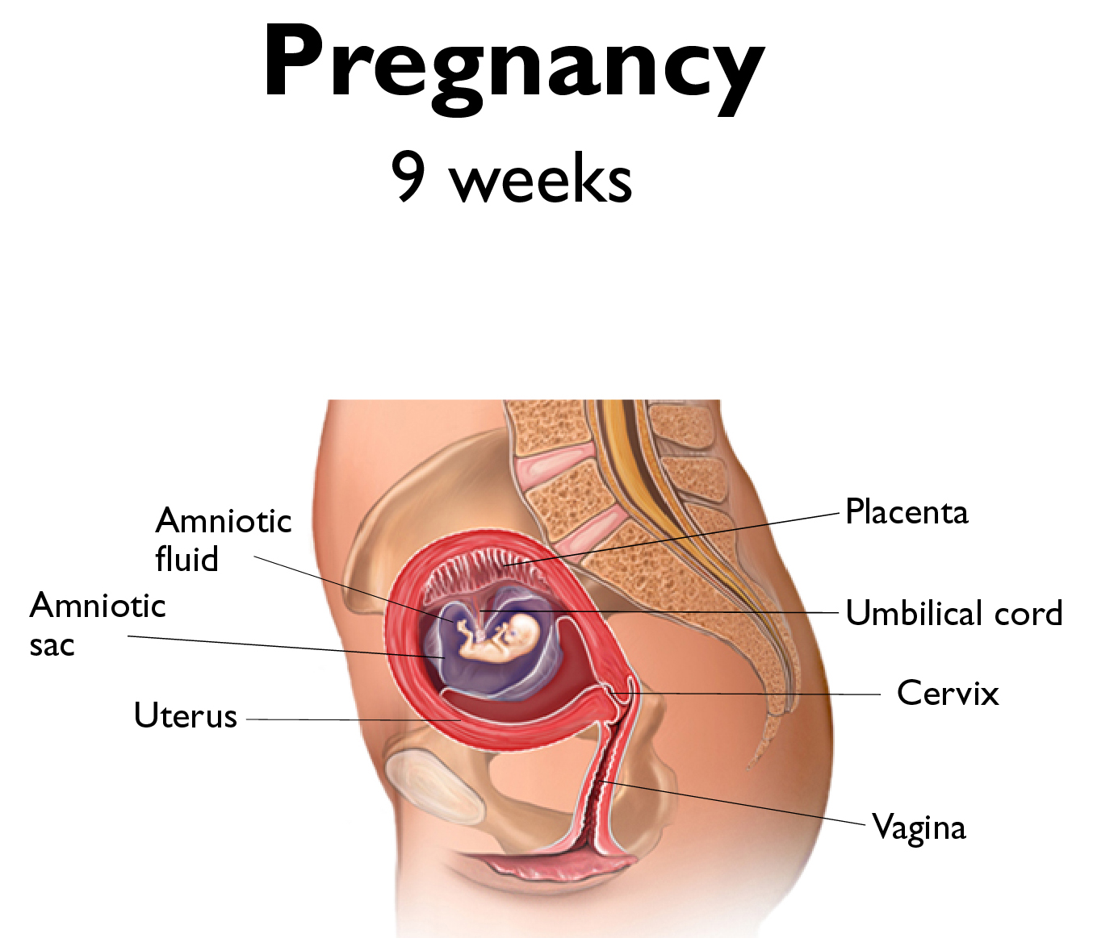
First Trimester: Pregnancy up to 12 Weeks
Placenta
Fetus
Amniotic sac/fluid
Umbilical cord
Uterus
Cervix
Vagina
Notes:
General Information
First Trimester:
0-4 weeks (first month): baby is called an embryo and is about 6mm long
5-8 weeks (second month): arm and leg buds are starting to grow; now the baby is about 2.5cm long
9-12 weeks (third month): baby is called a fetus; eyes, ears, nose are forming/formed
The first trimester is a critical time in the baby’s life. It is the period of rapid growth and development. By the end of these 3 months, all of the baby’s organs will be formed and functioning and its bones and teeth will begin to form. The baby moves around in the amniotic fluid but these movements cannot be felt by the mother yet. The baby’s heart beat may be heard with an electronic listening device.
The baby, called an embryo is not able to eat or breathe on its own so all functions are assisted by a structure called the placenta. The food the pregnant person eats and the oxygen they breathe goes into their bloodstream as very tiny pieces (molecules). These nutrients and oxygen travel through their bloodstream to the placenta, through the umbilical cord and into the baby’s body. The baby eats and breathes inside the uterus. After the baby is born, the umbilical cord is clamped, cut, dries up and falls off, leaving the umbilicus/belly button.
The amniotic sac is a bag of fluid inside the uterus where the embryo grows and develops. It is filled with fluid, in which the embryo floats and moves. The amniotic fluid helps to cushion the embryo from bumps and injury, as well as providing them with fluids that they can breathe and swallow.
The person who is pregnant does not menstruate because the lining is needed to support the pregnancy. The lining nourishes the developing embryo. An early sign of a pregnancy is a missed period (A missed period might mean your are pregnant only if you are having sexual intercourse). It is only when fertilization does not occur that the lining is shed resulting in a period.
A person’s lifestyle is very important when they are pregnant. Alcohol, nicotine and other drugs can cross the placenta and cause damage to the unborn baby.
Background Knowledge
Definitions
Placenta: The organ that supplies your baby with oxygen, nutrients and hormones. It also removes your baby’s waste. It’s delivered after your baby is born.
Uterus: A muscular organ that holds your baby, the amniotic sac and the placenta. It’s also called the womb.
Cervix: The opening at the bottom of the uterus and the top of the vagina.
Rectum: The lower end of the large intestine (bowel).
Anus: Where bowel movements (stools) come out.
Umbilical cord: This joins your baby to the placenta. The cord is cut at birth. Your baby’s navel (belly button) forms where the cord falls off.
Fetus (baby): Your growing baby from 10 weeks of pregnancy to birth.
Amniotic fluid and sac (the bag of waters): The liquid that surrounds and cushions your baby. The sac is the membrane that surrounds the liquid.
Bladder: The sac that holds urine (pee).
Pelvic bones: The bones of your pelvis that support the organs in your abdomen.
Urethra: The tube attached to your bladder that your urine passes through when you urinate.
Vagina: The birth canal that connects the uterus to the outside world.
Reference:
Gregg, Daphna (n.d.). Britannica Kids: Reproductive System. https://kids.britannica.com/students/article/reproductive-system/276695 (student version - grade 6 to 8) and https://kids.britannica.com/kids/article/reproductive-system/353707 (kids version - up to grade 5)
Alberta Health Services (2021). HealthyParentsHealthyChildren: I’m Pregnant. https://www.healthyparentshealthychildren.ca/im-pregnant/overview-of-pregnancy/growing-together-5
Image from Canva

Slide 26
Second Trimester: Pregnancy from 13 to 27 Weeks
Placenta
Fetus
Umbilical cord
Amniotic sac
Uterus
Cervix
Bladder
Vagina
Notes:
General Information
Second Trimester:
13-18 weeks (fourth month): baby has fingernails and toenails; baby can taste and hear sounds
19-22 weeks (fifth month): baby will kick, twist and turn in uterus; baby is approximately 25cm long
23-27 weeks (sixth month): baby can hiccup, and open and close eyes; at this point, the baby will weigh about 1kg
During the second trimester the brain develops a lot. The fetus cannot live outside of the pregnant persons body because its lungs, heart and blood systems have not developed enough yet. By 20 weeks the pregnant person is able to feel her baby’s movements. By the end of the 5th month the baby is about ½ the length of a newborn. The baby’s outline may be felt through the abdomen. Its eyes may be open now.
Background Knowledge
Miscarriages: A miscarriage is when an embryo or fetus dies before the 20th week of pregnancy.
It can be difficult to know exactly why a miscarriage happened, but it’s almost never caused by something the pregnant person did.
Some things that are known to cause miscarriages include:
When the fertilized egg has an abnormal number of chromosomes (genes). This happens at random, so you can’t prevent it or cause it to happen.
Certain illnesses, like severe diabetes, can increase your chances of having a miscarriage.
A very serious infection or a major injury may cause miscarriage.
Late miscarriages — after 3 months — may be caused by abnormalities in the uterus.
If you’ve had more than 2 miscarriages in a row, you’re more likely to have a miscarriage.
There are also several types of miscarriages:
Threatened miscarriage
Inevitable miscarriage
Incomplete miscarriage
Complete miscarriage
Missed miscarriage
Abortion: Abortions are a way of ending pregnancy, likely for personal reasons.
There are two ways of ending a pregnancy: in-clinic abortion and the abortion pill. Both are safe and very common.
Medical abortion, also known as the “abortion pill,” is when you take medicines that you get from a training doctor or health care professional to end an early pregnancy
In-clinic abortion is done in a health care centre by a trained doctor.
Reference:
Gregg, Daphna (n.d.). Britannica Kids: Reproductive System. https://kids.britannica.com/students/article/reproductive-system/276695 (student version - grade 6 to 8) and https://kids.britannica.com/kids/article/reproductive-system/353707 (kids version - up to grade 5)
Planned Parenthood (n.d.). What is a miscarriage?
Planned Parenthood (n.d.) What facts about abortion do I need to know? https://www.plannedparenthood.org/learn/abortion/considering-abortion/what-facts-about-abortion-do-i-need-know
Image from Canva

Slide 27
Third Trimester: Pregnancy from 27 to 40 Weeks
Placenta
Fetus
=
Umbilical cord
Amniotic sac
Uterus
Cervix
Bladder
Vagina
Notes:
General Information
Third Trimester:
27-31 weeks (seventh month): baby has eyelashes and eyebrows; kicks can be seen
32-35 weeks (eighth month): baby is building layers of fat to stay warm after birth; baby will be about 46cm long
36-40 weeks (ninth month): baby’s skin is pinker and less wrinkled; baby can weigh about 3-4kg
During the third trimester the baby could survive if born before it is full term, but would need special care. The closer to full term, the more ready the baby is to cope with the birth process and life outside the uterus. The baby can hear and respond to sounds. Its pupils can react to light and fat forms underneath the baby’s skin.
In order to provide the baby with the best possible conditions to develop in, pregnant people should avoid smoking and second hand smoke; avoid alcohol and drugs; eat a well-balanced diet; get lots of rest and exercise and see their doctor early and through the rest of their pregnancy. In fact, many pregnant people see their doctor before they get pregnant and have a check-up to make sure they are in the best health possible.
After about nine months of development the baby is ready to leave the pregnant persons body. The bottom end of the uterus, called the cervix, expands to create a wide opening into the vagina. The muscles of the uterus contract, or tighten, to push the baby downward. The baby moves slowly through the vagina and out of the body.
Not all babies are delivered vaginally. Some babies are born through a surgical procedure called a cesarean section or C-section. Definition of Cesarean Section: A caesarean section is an operation in which a doctor makes a cut through your belly and uterus (womb) so that your baby can be born.
When the baby is born the umbilical cord and the placenta also leave the body. The newborn baby is cut free from the cord and the placenta. After several days the stump of the cord dries up and falls off the baby’s belly. It leaves behind an indentation called a navel, or belly button.
The pregnant person might need a lot of help/support from their partner, family members, friends, etc. Some of the roles include attending health care provider appointments, prenatal classes, helping with housework/chores and cooking healthy meals to help the baby have the healthiest environment possible in which to grow.
For an interactive tool, show The Three Trimesters (Healthy Parents Healthy Children) resource created by Alberta Health Services. https://www.healthyparentshealthychildren.ca/resources/tools/pregnancy-progress
For more information on the Development Timeline, visit the following resource: https://www.healthyparentshealthychildren.ca/resources/tools/development-timeline#introduction
Reference:
Gregg, Daphna (n.d.). Britannica Kids: Reproductive System. https://kids.britannica.com/students/article/reproductive-system/276695 (student version - grade 6 to 8) and https://kids.britannica.com/kids/article/reproductive-system/353707 (kids version - up to grade 5)
Image from Canva

Slide 28
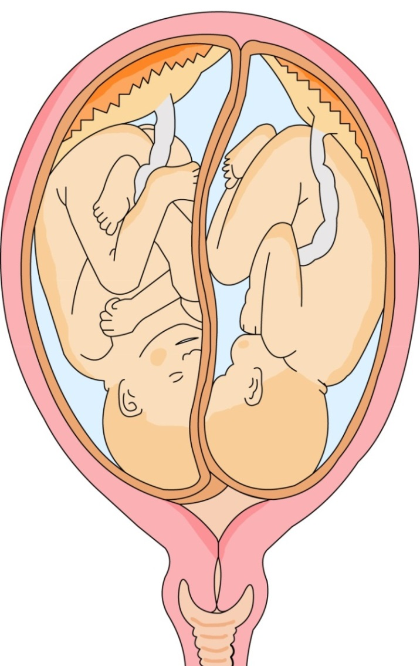
Pregnant with Twins
Types of Twins:
Identical Twins
Fraternal Twins
Do you know what the difference is between identical and fraternal twins?
Notes:
General Information
Sometimes the process of conception can result in more than one baby being created. Twins can either be identical or fraternal.
Identical twins:
Identical twins may or may not share the same amniotic sac, depending on how early the single fertilized egg divides into 2.
Identical twins have the same genetic makeup/material and look exactly the same. Identical twins happen by chance.
Fraternal twins:
Fraternal twins are 2 separate fertilized eggs; they usually develop 2 separate amniotic sacs, placentas, and supporting structures.
Fraternal twins do not share the exact same genes; they are no more alike than they are to their siblings from other pregnancies in the family. Fraternal twins tend to run in some families.
Background Knowledge
Students may also ask about conjoined twins (the term Siamese twins is no longer used). Conjoined twins are always identical twins, who form from a single egg that begins to divide into twins but does not completely separate into two. It is not known why the fertilized egg begins to divide into two, nor why the process is incomplete in conjoined twins. Conjoined twins are born in only about 1 in every 200,000 births.
About 3% of all births are twins. Fraternal twins are much more common than identical twins.
References:
Teaching Sexual Health (n.d.). Grade 6 Growing a Baby Lesson. https://teachingsexualhealth.ca/app/uploads/sites/4/Grade-6-LP2-Growing-Baby-Oct11.pdf
Image from Canva

Slide 29
Final Activity: Two Truths and a Lie
A. Menstruation:
A person might get their period between the ages of 10 and 15
It is not healthy for a period to be less or more than five to seven days
A period is the shedding of the endometrial lining
B. Personal care during menstruation:
A person can lose a few tablespoons to half a cup of blood when on their period
Pads and tampons are the only products that can be used to help with a period
If you use a tampon, you need to change it every 4 to 8 hours
Notes:
Teacher Prompt (Activity)
Activity Description: Divide the students into two teams.
Explain that you, as the teacher, will read three statements aloud to the class.
For each “category” one of these statements is not true and two of them are true. Each team will huddle together and decide which of the three statements they think is a lie, meaning it’s not true. Write the name of each team on the board as you call on the small groups one at a time. The team captain for each group will raise one finger if they think the first statement is a lie, two fingers if they think the second statement is a lie, or three fingers if they think the third statement is a lie. Continue in this way until all of the statements have been read. Remind students that the team with the highest number of points at the end of the game will be the winners.
Ask if there are any questions about the directions of the activity and answer as needed. At the end, the teacher will read the answers aloud after going through the categories. The teacher will give points to all the teams with the correct answer. Tally up the points and designate the winning team(s).
The “Lies” are highlighted below and explained…
A) Menstruation
1. A person will usually start their period around the age of 12, but it can be anywhere between the ages of 10 and 15. Everyone’s bodies are different and there are many factors that affect when a person will start their period (i.e., weight, height, athletic, nutrition, others) (True)
2. It is not healthy for a period to be less or more than five to seven days (Lie! A person’s period will typically be from anywhere between 5-7 days, but it can also be less or more. )
3. A period is the shedding of the endometrial lining (True)
B) Personal care during menstruation
1. A person will usually loose a few tablespoons to half a cup of blood when they are on their period (True)
2. Pads and tampons are the only products that can be used to help with a period. (Lie! Pads, sanitary napkins, tampons, and menstrual cups are all types of products that can be used to help manage their period)
3. If you are using a tampon you need to change it every 4-8 hours, and do not use tampons overnight. Remember to remove each and every tampon. (True)
Adapted from Advocates for Youth: Lesson Plan – Pregnancy Part 2 (https://www.advocatesforyouth.org/wp-content/uploads/storage/advfy/lesson-plans/lesson-plan-pregnancy-part-i-and-ii.pdf)
References:
Government of Canada. (2015, February 12). Drugs and medical devices: Menstrual tampons; Toxic Shock Syndrome (TSS); Minimizing the health risks of tampon use. https://www.canada.ca/en/health-canada/services/drugs-medical-devices/menstrual-tampons.html
Let’s Talk Period (2022). Nurses Resources. https://letstalkperiod.ca/nurses-resources/
The Society of Obstetricians and Gynaecologists of Canada. (2022). Your Period. https://www.yourperiod.ca/
Image from Canva

Slide 30
Two Truths and a Lie Continued
C. Conception:
Egg (ova) and sperm meet in the fallopian tubes
Pregnancy does not begin until the fertilized egg implants in the uterus
It takes a million sperm to create a pregnancy
D. Pregnancy Symptoms:
Some people might have symptoms during their pregnancy, such as nausea
Pregnancy will last an entire year
Pregnancy is broken into three stages called trimesters
Notes:
Teacher Prompt (activity continued)
Activity Description:
Explain that you, as the teacher, will read three statements aloud to the class. For each “category” one of these statements is not true and two of them are true. Each team will huddle together and decide which of the three statements they think is a lie, meaning it’s not true. Write the name of each team on the board as you call on the small groups one at a time. The team captain for each group will raise one finger if they think the first statement is a lie, two fingers if they think the second statement is a lie, or three fingers if they think the third statement is a lie. Continue in this way until all of the statements have been read. Remind students that the team with the highest number of points at the end of the game will be the winners.
Ask if there are any questions about the directions of the activity and answer as needed. At the end, the teacher will read the answers aloud after going through the categories. The teacher will give points to all the teams with the correct answer. Tally up the points and designate the winning team(s).
The “Lies” are highlighted below and explained…
C) Conception
1. The ova (egg) and sperm meet in a person’s fallopian tubes. (True)
2. The pregnancy does not begin until the fertilized egg implants in the uterus. (True)
3. It takes a million sperm to create a pregnancy. (Lie! Hundreds of millions of sperm are ejaculated from a man’s penis but just one is able to fertilize an egg.)
D) Pregnancy Symptoms
1. Some people might have symptoms during their pregnancy, such as nausea (True). Common pregnancy symptoms include breast tenderness, nausea, and food cravings.
2. Pregnancy will last an entire year. (Lie! Pregnancy generally lasts approximately 38-42 weeks. However, it is possible for a aby to survive if it is born earlier if they have special care)
3. Pregnancy is broken into three stages called trimesters (True).
Adapted from Advocates for Youth: Lesson Plan – Pregnancy Part 2 (https://www.advocatesforyouth.org/wp-content/uploads/storage/advfy/lesson-plans/lesson-plan-pregnancy-part-i-and-ii.pdf)
Image from Canva

Slide 31
More Questions? Talk to Someone:
Parents/ Guardians
Teacher/ Principal
Doctor or Health Care Professional
School Health Nurse
Child and Youth Worker
Kids Help Phone
Notes:
General Information
There are many people and places that you can reach out to in order to get help or ask questions about relationships and sexual health. If you ever have questions/concerns, need help or know someone who needs help, you can always talk to someone. There are many options out there available to you.
Among these are:
A trusted adult (such as a parent or teacher)
A health care provider (such as a doctor or nurse)
A child and youth worker
The school health nurse
The school social worker
Any of the Niagara Region Sexual Health Centres
Kids Help Phone
Services for Youth - Niagara Region, Ontario → https://www.niagararegion.ca/health/schools/youth-services.aspx
Other community resources:
Kids Help Phone: Call 1-800-668-6868 or https://kidshelpphone.ca/
Image from Canva

Slide 32
Final Thoughts
A period is started by hormones that send a message from the ovaries telling the uterus to shed the lining
When a sperm and egg join, the egg becomes fertilized and implants in the uterus. This is how pregnancy begins
Pregnancy typically might last anywhere from 38 to 42 weeks
Pregnancy symptoms will be different for every person
Notes:
General Information
Note: Hormonal message from the ovary tells the uterus to shed the lining, flowing through the cervix and then out of the body through the vagina.
Teacher Prompt
“We’ve described what menstruation and spermatogenesis mean from a physical point of view. How might these changes affect you in other ways?”
Elicit: “Not everyone experiences these changes at the same time and in the same way, so teasing people about these changes isn’t right. It can be very hurtful.” “In my culture and my family, becoming an adult is a cause for celebration. In various Indigenous cultures, women are viewed with the highest regard, and menstruation is seen as sacred.” “We don’t talk about it in my family. What I see in the media and online is a bit confusing, so it’s good to know what these changes in my body actually mean. The more I know, the better I can take care of myself.”

Slide 33
Questions?
Notes:
Ask students if they have any questions. Inform students that they will continue learning about puberty in subsequent lessons.
Optional: If a question box or envelope has been created, close the lesson by reading and responding to/discussing some of the questions submitted by students. ***It is very important to review the questions prior to reading them to the class. Do not read any questions aloud that are inappropriate. If inappropriate questions have been submitted, inform the class that if a student submitted a question that is not answered during this period, that they are welcome to discuss it directly with the teacher another time.
Image from Canva

