Slide 1
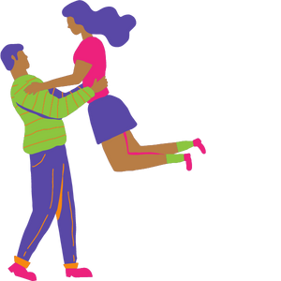
Healthy Relationships
Grade 8
Notes:
**The following slides (1-6) are for teacher use only**
The speaker’s notes are also intended for teacher use only. The notes include general information, background knowledge, questions and/or prompts. The information included in these notes should not be read word for word. Teachers should review the notes before using the presentation to become familiar with the content, as it is to supplement what is on the slide.
Image from Canva
Last Updated: January 2023

Slide 2
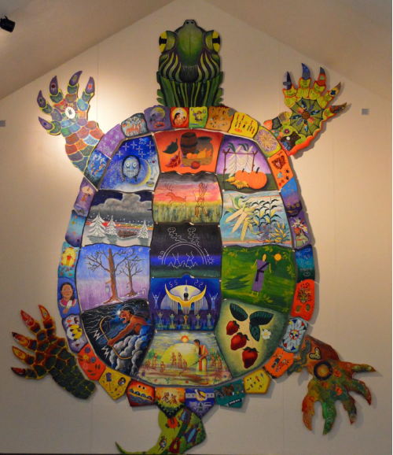
Land Acknowledgement
Notes:
Niagara Region is situated on treaty land. This land is steeped in the rich history of the First Nations such as the Hatiwendaronk (Hat-i-wen-DA-ronk), the Haudenosaunee (Hoe-den-no-SHOW-nee), and the Anishinaabe (Ah-nish-ih-NAH-bey), including the Mississauga's of the Credit First Nation. There are many First Nations, Métis, and Inuit peoples from across Turtle Island that live and work in Niagara today. The Regional Municipality of Niagara stands with all Indigenous peoples, past and present, in promoting the wise stewardship of the lands on which we live.
*Disclaimer: In the Spirit of Truth and Reconciliation, Niagara Region Public Health acknowledges that people are gathered on the customary and traditional lands of the Indigenous Peoples of this territory. We recognize that the land on which you are situated will vary depending on where you are located in Ontario. It is advised that you reach out to your school’s principal or school board for the school-specific treaty land. If you have already done a land acknowledgement on the same day you are presenting this lesson, you are welcome to skip this slide. However, it is always encouraged to complete a land acknowledgement before continuing on with this presentation.*
Information about the image on the left:
There are seven objects that have been purposely selected and included in the design of the artwork: an Inukshuk, an eagle feather, two drums, a Métis sash, an embroidered flower, and wampum belt. Each object reflects the diversity of First Nations, Métis and Inuit in North America. The iconic stone monument, the Inukshuk, is used as a marker identifying important sites and as a navigational tool to communicate direction. The eagle feather is significant to the spiritual beliefs of some Métis and First Nations peoples. Its symbolism includes honour, wisdom, and courage among many others. It is considered an honour to be given an eagle feather. The two drums include the Inuit drum and the Métis and First Nations drum. The drum is symbolic of the heartbeat of Mother Earth and is often played at various traditional gatherings and ceremonies. The embroidered flower is woven into many traditional garments and various objects through beadwork, painting, or etchings. It is also considered one of Canada’s first art forms. The Métis sash was once a tool of the voyageurs and fur traders. It is also a symbol of knowledge and the relationship between the Métis, the First Nations, and Europeans. At the top of the poster are four lines reminiscent of the traditional beaded wampum belt. There are many types of wampum belts with different significant meanings, including agreements made between two groups/nations, knowledge sharing, and storytelling. The four lines in this wampum belt represent the equality and diversity of the four peoples (First Nations, Metis, Inuit, and European settlers) and to acknowledge the journey of living together peacefully (ETFO, 2022).
For more information on Indigenous Education and First Nations, Metis and Inuit (FNMI), check out the following resources:
https://www.otffeo.on.ca/en/learning/indigenous-education
https://www.etfo.ca/socialjusticeunion/first-nation,-metis-and-inuit-(fnmi)
Photo References:
Image on the Left: Elementary Teacher Federation of Ontario (ETFO). (2022). ETFO Land Acnowledgements. https://www.etfo.ca/about-us/governance/etfo-land-acknowledgement
Image on the Right: Creating Our Way Forward: Recommendations for Improving Niagara Region Public Health & Emergency Services’ Indigenous Engagement (2019). https://www.niagararegion.ca/health/equity/pdf/indigenous-engagement-report.pdf
Mural of Turtle Island → Cover photo: Oneida nation artist, Sharon Sarnowski (deceased) This is a picture taken of the mural in the Boardroom of the Oneida Tribal Council office, Oneida, Wisconsin.

Slide 3
Presentation Format
Guiding Questions: Big idea questions that students can brainstorm and share previous knowledge or new information with.
Think, Pair, Share: Opportunity for students to work with a partner or in a group and share ideas based on a prompt.
Notes:
Images from Canva

Slide 4
Presentation Format
Videos: Students can watch a short video clip that connects with the topic. Discussion can follow before or after videos.
Final Activity: Activity that concludes the presentation.
Notes:
Images from Canva

Slide 5
Curriculum Expectations – Grade 8
D3.3 analyze the attractions and benefits associated with being in a healthy relationship, as well as the benefits, risks, and drawbacks, for themselves and others, of relationships involving different degrees of sexual intimacy.
Notes:
Image from Canva

Slide 6
Healthy Relationships
Grade 8
Notes:
This is where the presentation begins.
Image from Canva
Disclaimer (Trigger Warning): Before starting a classroom conversation, be aware that some students may have experienced situations related to the topic, either directly or indirectly, in the past or present.

Slide 7
Learning Objectives
At the end of this presentation, you will understand the attractions, benefits, drawbacks and risks of being in a relationship. You will also:
Learn to appreciate the changes you might experience as you grow up
Improve the class environment by helping everyone feel welcomed, included, accepted, and supported
Understand that everyone has differences and this makes them unique
Notes:
General Information
The information we are going to talk about today is important for many reasons.
We want to ensure that you learn that everyone is unique and the things that make you unique is what makes you interesting and special.
We want you to feel good about your body, how it is changing, and how you approach different types of relationships you may have with people.
It is important that everyone feels safe, accepted and included at school and understand that differences are ok. This will help to reduce bullying and feelings of loneliness or isolation.
Background Knowledge
Students will learn and understand themselves and their bodies as they grow and mature
Students need to understand that everyone has different qualities that make up their self-concept; this makes them unique
There needs to be an emphasis on feeling safe, included and accepted in the school community
Empathetic towards others…

Slide 8
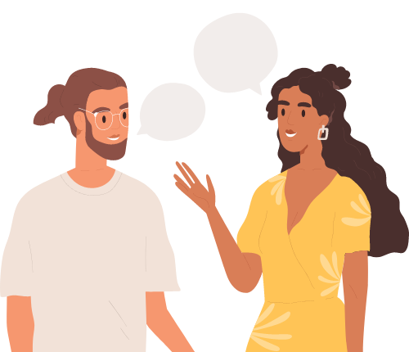
Making Decisions About Your Health
Notes:
General Information
When it comes to your health, there are many decisions you will have to make throughout your life as you mature and grow. Making decisions about your health is important because relationships can impact your well-being.
When deciding what is best for you and your health, you should understand and be well informed about the choices available. It is important that information comes from a trusted source that is current and accurate.
There is a lot of great information available on the internet and social media, but sometimes there is a lot of misinformation as well, this is why we recommend talking to a trusted adult, as they can offer information to help you make the best decisions for you and your health.
Images from Canva

Slide 9
Feelings about Relationships
It’s Okay…
To feel embarrassed or uncomfortable
To ask questions
To not know much about this topic
To learn about different types of relationships
To talk about relationships
Notes:
General Information
Things to remember…
4 Okay’s
Today we’re going to be talking about what makes us different, and what makes us the same. We understand that for some of you, this may be the first time you’re learning about this topic, and for others this may be something you know a lot about. It may feel uncomfortable to talk about relationships with your parents or friends, but it’s important we all learn about relationships so we can understand the qualities of healthy, unhealthy and abusive relationships.
So let’s review the 4 OK’s. It is perfectly OK:
If you feel embarrassed or uncomfortable. The only way for us to overcome this uncomfortable feeling is to learn and grow. We can often feel uncomfortable about things we don’t fully understand. But if we take the time to learn about a topic and understand it, we become more educated and comfortable. Which creates a supportive environment for everyone!
It’s okay to be curious and to ask questions.
It’s okay if you don’t know this information already. We’re all going to learn this together.
And… It is okay for us to know about relationships and each other’s experiences. This helps us to understand one another better, and be respectful of each individual person’s relationships.
Images from Canva

Slide 10
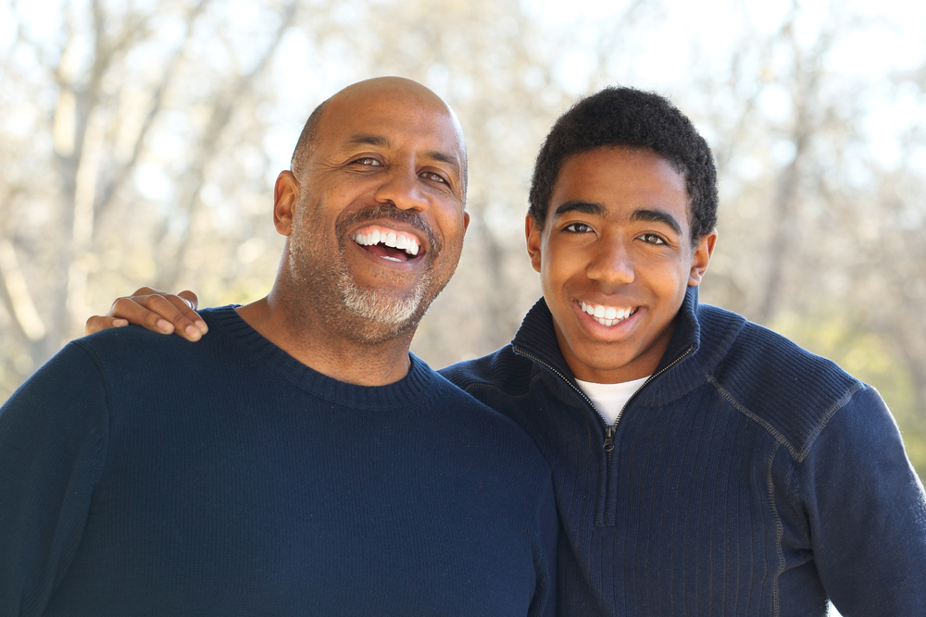
Types of Relationships
As you grow up, you will meet many different people. You will also have many different types of relationships throughout your life.
Some examples of relationships are with friends, family, classmates, teammates
You are likely to have romantic and intimate relationships during your life
Notes:
General Information
Understanding the differences between healthy, unhealthy and abusive relationships will help you model and teach your students the difference between them. These differences are also part of online relationships.
Discuss the following…
Definition of Intimacy: Intimacy (intimate) is linked with feelings of closeness among partners in a relationship. It is usually characterized by love and attachment.
This is not an exact definition, but it seems that intimacy and healthy relationships go hand in hand. Indeed, intimacy is basic in any meaningful relationship: the basis of friendship and one of the foundations of love.
The main forms of intimacy are emotional intimacy and physical intimacy. Intellectual intimacy, familiarity with a person's culture and interests, is common among friends. Members of religious or philosophic groups may also perceive a "spiritual intimacy" in common.
There are several terms for intimate partners and for partners in various degrees of love, such as partner, significant other, and spouse
Reference:
Kiddle encyclopedia (2022, July 21). Kids Encyclopedia Facts: Intimacy facts for kids. https://kids.kiddle.co/Intimacy
Teaching Sexual Health. (n.d.). Relationships – Healthy, Unhealthy & Abusive Relationships. https://teachingsexualhealth.ca/parents/information-by-topic/relationships/
Photo Reference:
Shutterstock_246110146

Slide 11
Guiding Question #1
What qualities are part of a healthy relationship?
What qualities are part of an unhealthy relationship?
Notes:
Teacher Prompt
“what qualities are part of a healthy relationship? What qualities are part of an unhealthy relationship?”
On the white board or smart board, write a T-chart with healthy on one side and unhealthy on the other. Ask students to think of healthy qualities first. Then after collecting healthy, ask students to think of unhealthy qualities and write them in the appropriate section
Below are the traits of healthy, unhealthy and abusive relationships. Most of these traits can relate to any kind of relationship, but a few deal with romantic, sexual or intimate relationships.
Healthy
Feeling happy when you’re with another person
Feeling safe around the person
Mutual respect and understanding
Trust
Compromise
Individuality (being yourself)
Strong/Open lines of Communication
Problem solving
Self-confidence
Healthy sexual relationship (when both partners are older and mature enough and have discussed boundaries and consent)
Religious/Cultural beliefs are respected
Respect of boundaries
Unhealthy
Anger
Hostility
Control
Dishonesty
Disrespect
Intimidation
Violence (physical, sexual, emotional, etc.)
Dependence
Jealousy
Distrust
Not respectful of religious/cultural beliefs
Not willing to hear others’ perspectives
Poor communication
Gaslighting or false accusations
Love bombing
Reference:
Youth.gov (n.d.). Characteristics of Healthy and Unhealthy Relationships. https://youth.gov/youth-topics/teen-dating-violence/characteristics#:~:text=Respect%20for%20both%20oneself%20and,sexually%2C%20and%2For%20emotionally.
Image from Canva

Slide 12
Qualities of Healthy Relationships
Be yourself
Honesty
Good communication
Respect
Feeling safe
Trust
Equality
Support
Notes:
Background Knowledge
The following are qualities of healthy relationships:
Being yourself: you feel comfortable around the person you’re dating. Changing yourself to please someone else won’t work in the long run and can frustrate your friends and family, so it’s important to be yourself.
Honesty: you feel comfortable talking about things in the relationship, including problems or concerns.
Good communication: you discuss things that are important to you or your relationship. You ask each other what you’re thinking and feeling and you listen to each other.
Respect: you respect and support each other, and listen to each other’s concerns. It’s important to treat yourself with respect and say no to things that make you uncomfortable.
Feeling safe: if you feel threatened in any way, you’re not in a healthy relationship. Feeling safe is both emotional and physical. It’s important to know that a healthy partner won’t try to hurt your feelings or your body.
Trust: trust is about being able to count on someone. It’s about believing that someone will be honest with you and follow through on their promises. When you trust someone, you know that they’ll support you and look out for you. You have each other’s best interests at heart.
Equality: equality keeps relationships safe and fair. For example, being equal in a relationship means sharing the power and not bossing each other around. Equality can also mean sharing the effort. If you text or call your partner often, but they don’t seem to have time for you, your relationship may be unequal.
Support: support is about feeling cared for and respected. In healthy relationships, people listen to each other, help out with problems and show support by attending important events.
Reference:
Kids Help Phone. (Published: 2018, June 19; Updated: 2021, December 7). Healthy relationships vs. unhealthy relationships. https://kidshelpphone.ca/get-info/healthy-relationships-vs-unhealthy-relationships
Image from Canva

Slide 13
What is a Healthy Romantic Relationship?
A healthy relationship is one where you and your partner:
Don’t always agree with each other, but cooperate and work together
Use open and honest communication
Feel comfortable and safe
Trust and respect each other
Notes:
*Note: Usually when talking about relationships we will use the term partner to describe a romantic relationship*
General Information
Signs of a Healthy Relationship:
A healthy relationship makes you feel good about yourself and your partner. You have fun together and you and your partner can be yourselves.
Respect, trust, and establishing healthy boundaries are all characteristics of a healthy relationship
Qualities are explained more in-depth on the next slide.
In healthy relationships, people can feel safe, respected and accepted for who they are. In unhealthy relationships, people may feel anxious, confused, uncertain and even unsafe. Knowing these differences can help you make choices about who you date and for how long.
For additional assistance in teaching about Healthy Relationships, refer to Sam Killermann’s Columns & Shawdows: A Healthy Relationship Model. https://www.itspronouncedmetrosexual.com/2016/11/rest-columns-shadows-healthy-relationship-model/
Image from Canva

Slide 14
Think, Pair, Share
With a partner or in a group, try to answer the following questions:
How do people decide when or if they want to be in a romantic relationship?
What qualities are important to you in a romantic relationship?
Where can people go for support when they have questions about a relationship?
Why might people decide to get married?
Notes:
Teacher Prompt
Next, facilitate a discussion on the qualities important for healthy relationships and factors that influence decision making pertaining to sexual activity, using the following questions:
With a partner or in a group, answer the following questions:
How do people decide when or if they want to be in a relationship?
What is important in a healthy relationship?
Where can people go for support for dealing with relationship questions?
Teacher prompt: “Why might people decide to get married?”
Student: “Many religions and cultures place importance on marriage. Marriage can be a healthy and loving committed partnership between two people who respect each other. Many religions and cultures affirm and celebrate marriage and family life as a fulfilling aspect of human life.”
Additional possible questions *might depend on maturity level of the students*:
Do you need to be in a relationship to engage in sexual activity?
Does being in a relationship entitle you to engage in sexual activity when you decide you are ready or whenever you like?
Adapted from…
Resource:
OPHEA (n.d.). Making Informed Decisions about Sexual Health. https://teachingtools.ophea.net/lesson-plans/hpe/grade-8/understanding-healthy-development/making-informed-decisions-about-sexual-health
Image from Canva

Slide 15
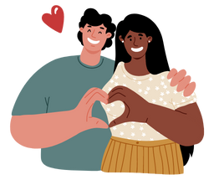
Attractions and Benefits of Romantic Relationships
There are many reasons that people have relationships with a partner.
Sense of Security
Support
Understanding
Enjoyment
Friendship
Notes:
General Information
“There are pros and cons to being in a relationship, and when you are in a romantic relationship, there are positive things and drawbacks associated with different levels of intimacy. All of them are important to think about. There is a range of intimate behaviours that people can use to show caring and connection in a relationship, and different levels of risk associated with different levels of intimacy. Intimate behaviours can include holding hands, hugging, kissing, touching bodies and genitals, and engaging in sexual intercourse.”
“Individuals need to consider their own values and beliefs and treat each other’s choices and limits with respect. If one partner chooses to abstain from a sexual activity – for example, a person might want to kiss but not want to have any genital contact – the other partner needs to respect that decision. Both partners need to have the confidence and comfort level to talk about how they can show their affection while respecting each other’s decisions.”
Reference:
OPHEA (n.d.). Sexual Health and Safety. https://teachingtools.ophea.net/lesson-plans/hpe/grade-8/understanding-healthy-development/sexual-health-and-safety
Image from Canva

Slide 16
Video: Ready or Not Ready
Questions to keep in mind while watching:
How do you know if you are ready to date?
How will you know when you are ready for an intimate relationship?
Notes:
To access video you must be in present mode to play OR open the hyperlink in a separate Internet browser.
Video link: https://youtu.be/XGoRKZ3u68A
Also hyperlinked in the title.
Length of Video: 14 minutes → *Note: The video is long, so review it before you use it in this PowerPoint presentation, and decide which parts of the video are appropriate or important to share with your class.*
The following videos will discuss signs to help know whether you are ready for a intimate relationship.
Background Knowledge
How do I know if I’m ready to date? How will I know when I’m ready to kiss someone? What if I never feel ready for any of this stuff? In this episode the kids discover that readiness can mean different things for different folks — take it from Ginger & Blue! Nadine and Eva remind us that some firsts are great, and some, not so much! Whether we try again, take a break, or decide something just isn’t for us, each of us gets to decide if we’re ready or not! Watch the whole episode to find out what question we have from our guest about figuring out when you’re ready. Also, the teens share some words of wisdom on the topic.
Reference: Every Body Curious. (n.d.). Read or Not. https://sexedschool.ca/episodes
For another relevant video about Sexual Health, check out: Every Body Curious – Sexual Health https://youtu.be/GWveFUAtpeg
Image from Canva

Slide 17
Potential Risks and Drawbacks of Relationships
It can be challenging to juggle commitments on top of the romantic relationship
Feelings could be hurt when a relationship ends or if trust is broken
When sexually active in a relationship there is a chance of pregnancy or sexually transmitted infections (STIs)
Notes:
Teacher Prompt
“How can being in an intimate relationship affect other relationships in your life?”
Student: “When you have a partner, sometimes you might start hanging out with different people or spending less time with some of your friends. You might have less time to spend with family. It’s important to be aware of what is happening, so that you can take steps to avoid neglecting other relationships that are important to you.”
Background Knowledge
Risks/Drawbacks:
It can be challenging to juggle commitments, such as friends, family, school and other activities, on top of the relationships
There might be hurt feelings when a relationship ends or trust is broken
In sexually intimate relationships there is the risk of becoming sexually involved before feeling ready (physically and emotionally)
When a person engages in sexually intimate relationships before feeling 100% ready, afterwards they might have feelings of regret (emotional turmoil)
When sexually active in a relationship there is a chance (risk) of sexually transmitted infection (STIs), if suitable protection isn’t used (i.e., condoms)
Becoming a parent before you are ready (unintended/ unplanned pregnancy)
Others Risks/Drawbacks:
There is a potential for dating violence, although it is not common
Sexual harassment
Sexual Exploitation / Sextortion (for more information, refer to the following resource: Don’t Get Sextorted → What is Sextortion? https://dontgetsextorted.ca/#about)
Abuse
Dependency on partner (emotionally, physically, financially)
Commitment and time invested in a relationship can help to make communication easier and build trust, which makes talking about important topics and serious conversations easier.
In sexually intimate relationships where unintended pregnancy might occur, this is specific to heterosexual relationships where there is no method of protection or contraception used during sexual intercourse.
For more information about sexual harassment and sexual abuse, refer to the Grade 8 Making Decisions about Sexual Health teaching tool, which should follow after this PowerPoint presentation.
Reference:
OPHEA (n.d.). Sexual Health and Safety. https://teachingtools.ophea.net/lesson-plans/hpe/grade-8/understanding-healthy-development/sexual-health-and-safety
Image from Canva

Slide 18
Warning Signs in Romantic Relationships
Jealousy
Aggression
Put downs or humiliation
Controlling behaviours
Unpredictability
Pressure
False accusations or “gaslighting”
Love bombing
Notes:
General Information
The opposite of a healthy relationship is an unhealthy and/or abusive relationship. Abusive relationships often revolve around control, fear, and lack of respect.
“Red Flags”
Jealousy
Aggression: Does your partner get aggressive, angry, or scare you?
Put Downs/Humiliation: Does your partner make fun of your appearance, intelligence or decisions? Your partner calls you names, puts you down or makes you feel bad in front of others.
Controlling: Does your partner decide were you go, what you do, the clothes you wear, who you talk to? Your partner is controlling if they tell you what to do, what to wear or who to hang out with. They constantly check up on you or use threats (for example, to harm you or themselves) to make you do things.
Unpredictability: your partner gets angry easily and you don’t know what will set them off. You feel like you’re walking on eggshells.
Pressure: your partner pushes you to do things you don’t want to do or aren’t ready for, including sex or using drugs and alcohol. They don’t take “no” for an answer and they use threats or ultimatums.
False accusations or Gaslighting: Manipulating someone to make them question themselves (i.e., form of psychological abuse)
Love bombing: Excessive gift-giving and other grand gestures in order to influence or manipulate a person
Other types of abuse;
Love bombing: This is a tactic used by narcissists as a dangerous form of emotional abuse. It is characterized by excessive attention, admiration, and affection with the goal to make the recipient feel dependent and obligated to that person.
Gaslighting: A form of psychological manipulation (abuse) in which the abuser attempts to make the victim confused and doubting themselves. Gaslighters seek to gain power and control over the other person, by distorting reality and forcing them to question their own judgement and intuition.
Reference:
Kids Help Phone. (Published: 2018, June 19; Updated: 2021, December 7). Healthy relationships vs. unhealthy relationships. https://kidshelpphone.ca/get-info/healthy-relationships-vs-unhealthy-relationships
L’amie, L. (2022, September 15). Cosmopolitan: Everything You Need to Know About Love Bombing and Why It’s So Dangerous. https://www.cosmopolitan.com/sex-love/a26988344/love-bombing-signs-definition/
Newport Institute (n.d.). How to Tell If Someone Is Gaslighting You. https://www.newportinstitute.com/resources/mental-health/what_is_gaslighting_abuse/#:~:text=Gaslighting%20is%20a%20form%20of,their%20own%20judgment%20and%20intuition.
Image from Canva

Slide 19
Guiding Question #2
Consider a situation where a friend might pressure you to do something that you aren’t comfortable doing.
How would you respond? What could you say to your friend?
Notes:
Teacher Prompt
“Have you ever been in a situation where you have felt pressured to do something that you weren’t comfortable doing? For example, maybe your friends wanted to go to a party in town and asked you to join, but you didn’t want to or didn’t feel comfortable. Sadly, they kept pressuring you and making comments that you didn’t appreciate.”
Ask students to reflect upon their behaviours in situations where they have felt pressure. Inform students that pressure can exist within relationships (e.g., relating to intimacy, or activities you do with your partner), as well as in everyday life (e.g., in a school setting, at home, or with sports teams).
Highlight that identifying what someone might do in order to make you feel pressured is often the first step in being able to resist the pressure.
Record student responses about times they have felt pressured on the board or chart paper.
Reference:
OPHEA (n.d.). Sexual Health and Safety. https://teachingtools.ophea.net/lesson-plans/hpe/grade-8/understanding-healthy-development/sexual-health-and-safety
Image from Canva

Slide 20
Examples of Negative Pressures that People Use
Rejection
Threats
Intimidation
Comments (“Everybody is doing it”)
Put-downs
Dares
Guilt
Incentives or rewards
Notes:
General Information
Techniques people may use to pressure others may include:
bad/good logic (“You are a good person/bad person if you do/don't do it.”)
encouragement
put-downs
modelling
guilt
incentives or rewards (“You’ll get this if you do this”)
dares
rejection (“You won't be included in a group if you don't do it.”)
trust (exploitation of trust in a relationship to pressure someone)
threats
false generalization (“Everybody is doing it.”)
curiosity
intimidation
Reference:
OPHEA (n.d.). Sexual Health and Safety. https://teachingtools.ophea.net/lesson-plans/hpe/grade-8/understanding-healthy-development/sexual-health-and-safety
Image from Canva

Slide 21
Video: Aunt Scenario
Consider the following questions while watching the video.
Do you think there are any problems in this situation?
Do you think privacy in relationships is important?
Notes:
To access video you must be in present mode to play OR open the hyperlink in a separate Internet browser.
Video link: https://www.youtube.com/watch?v=ro5B0nXEYgE&list=PL-3fUblIRJtI8aOzNbYjBJaB0cnh_Ta5K&index=9
Also hyperlinked in the title.
In Part 1 of the video, Julie Lalonde presents the complexity of the issue presented in the Draw the Line Aunt’s Love Interest scenario including:
The characteristics of a healthy relationship
The importance of maintaining one’s independence
The importance of privacy, trust, and boundaries in relationships
In Part 2 of the video, Julie summarizes the key lessons from the Draw the Line Aunt’s Love Interest scenario.
Teacher Prompt:
Guiding discussion questions (*these are following the video and after the questions on the slide are answered*):
Why is it important to respect other people’s privacy?
How do you establish boundaries and maintain your independence in relationships?
How do you communicate your boundaries to your partner?
How can you manage your insecurities in a relationship?
How would you respond if someone shared something private about you without your consent or violated your privacy?
Activity Reference:
OPHEA (n.d.). Sexual Violence Prevention Education Resources – Aunt's Love Interest Scenario Activity. https://ophea.net/gender-based-violence-prevention-education-resources/activities/aunts-love-interest-scenario
Other Possible Video: Watch ‘Healthy vs Unhealthy Relationships’ to learn how healthy relationship can help us feel good about ourselves and how to know if a relationship is unhealthy.
Hyperlink available: https://youtu.be/AvMgSorNthc
Reference:
Talking about sexuality in Canadian Communities (2022). Relationships and Dating. https://tascc.ca/for-youth-with-disabilities/relationships-dating/
Image from Canva

Slide 22
What is Privacy?
Privacy can be…
Spending time alone
Choosing what thoughts and feelings to share
Deciding what personal information to share
“Red Flags” that your privacy is not being respected:
Personal information is shared without your consent
You are asked to share your location more than you are comfortable with
Notes:
Everyone has a right to privacy.
Teacher Prompt: Co-construct the definition of privacy with the class/students. Afterwards, read the definition of privacy (from the speaker’s notes) to compare to your classroom definition.
General Information
Definition of Privacy: “Broadly speaking, privacy is the right to be left alone, or freedom from interference or intrusion. Information privacy is the right to have some control over how your personal information is collected and used” (International Association of Privacy Professionals, 2022).
What Is It All About? – Relate to Aunt’s Love Interest Scenario Activity (continued on next slide)
Privacy can be your personal right to share information with whom you choose, and/or when you choose.
Respect, trust, and establishing healthy boundaries are all characteristics of a healthy relationship. Youth need to understand the characteristics of healthy relationships and know the signs of unhealthy relationships in order to equip themselves with the skills to develop and maintain healthy relationships throughout their lives.
In any relationship, you have the right to keep things in your life a secret, especially if you don’t want to disclose or explain, and no matter how trivial or how important. You also have the right to spend some time alone and with only yourself.
Red Flags that your privacy is not being respected:
Partner going through your personal belongings and phone without your permission
Spying and snooping
Location tracking without permission
Your partner is forcing you to spend time with them (breaking personal boundaries)
Possible Teacher Prompt:
Why is it important to respect other people’s privacy?
What does it mean to violate someone’s privacy?
What kinds of things might people say or do that violate another person’s privacy?
Why is it important to be able to keep some things private?
For more information and activities on privacy, check out the following resource: https://www.priv.gc.ca/en/about-the-opc/what-we-do/awareness-campaigns-and-events/privacy-education-for-kids/resources-for-teachers/
Activity Reference:
International Association of Privacy Professionals (IAPP). (2022). About the IAPP: What is privacy. https://iapp.org/about/what-is-privacy/
Office of the Privacy Commissioner of Canada (2022, January 24). Privacy education for kids: Resources for teachers. https://www.priv.gc.ca/en/about-the-opc/what-we-do/awareness-campaigns-and-events/privacy-education-for-kids/resources-for-teachers/
OPHEA (n.d.). Sexual Violence Prevention Education Resources – Aunt's Love Interest Scenario Activity. https://ophea.net/gender-based-violence-prevention-education-resources/activities/aunts-love-interest-scenario

Slide 23
Privacy in Relationships – What could you do?
Notes:
What Is It All About? – Relate to Aunt’s Love Interest Scenario Activity
Teacher Prompt
What could you do in this situation if you are the aunt? What could you do in this situation if you are the child?
WHY DRAW THE LINE
Healthy relationships are built on respect and trust. Restricting who someone can talk to isn't love; it's control.
WHEN TO DRAW THE LINE
Monitoring text messages, screening calls and limiting someone's social circle are signs of an unhealthy relationship.
HOW TO DRAW THE LINE (as the child)
There's always more than one option for a bystander. Take a stand safely and do something you feel comfortable with. You could:
Check in with your aunt: "How do you feel about them doing that?"
Offer her support. Let her know that she can talk to you, but she should reach out to someone she trust’s.
Offer support. Offer resources and support (i.e., tell them to talk to another trusted adult – mom, dad, grandma, grandpa, friend).
Background Knowledge
With the increase of social media, it is important to remind students that no one should take their privacy for granted. The Privacy Commission of Canada say it’s critically important to teach students about how to protect their privacy, exercise control over their personal information, while also respecting the privacy of others (Cohen, 2018).
When you are a minor, there may be incidents where adults may be perceived as invading your privacy, but it is important to understand that adults (parents/guardians/caregivers) have a responsibility to keep kids safe and sometimes this requires them to know what is happening in your life. The best way to keep adults informed is through open communication.
Photo References:
Cohen, T. (2018, November 28). EdCan Network: Educating Kids About Digital Privacy. https://www.edcan.ca/articles/educating-kids-about-digital-privacy/
Draw the Line (n.d.). Draw the Line – Engaging Ontarians in a dialogue about sexual violence. http://www.draw-the-line.ca/resources/dtl-text.html and https://ophea.net/gender-based-violence-prevention-education-resources/gender-based-violence-prevention-activities

Slide 24
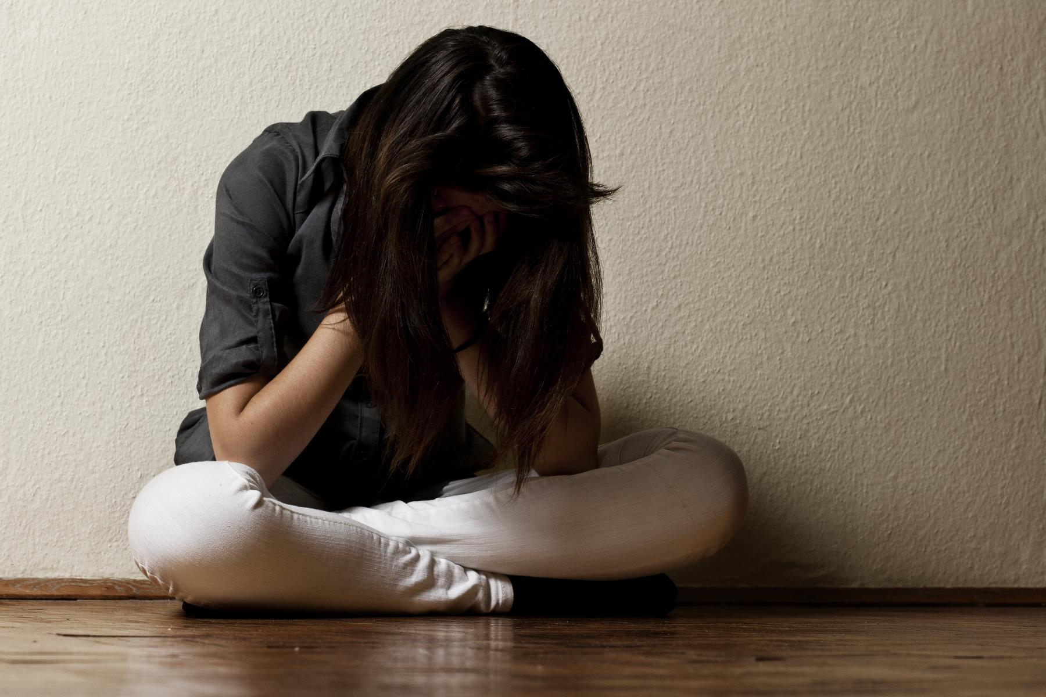
Abuse in Relationships
Abuse can be...
Physial
Sexual
Emotional
Financial
Notes:
General Information
Abuse means treating someone with violence, disrespect, cruelty, harm, or force. When someone treats their partner in any of these ways, it’s called an abusive relationship. Abuse in a relationship can be physical, sexual, or emotional. Or it could be all of these.
An abusive partner might use mean words, threats, or shaming. They might act with jealousy or controlling behavior. Or with physical or sexual violence. These things can start small and build over time.
Reference:
Dovi, Allison T. (2021, August). Nemours TeensHealth: Abusive Relationships. https://kidshealth.org/en/teens/abuse.html
Photo Reference:
Person with their head in their hands: Shutterstock_63776014
Image from Canva

Slide 25
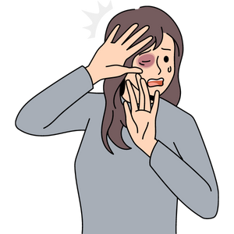
Physical Abuse in Relationships
Physical Abuse is…
Hitting
Pushing or punching
Kicking
Invading someone’s physical space
Notes:
General Information
Physically hurting an individual.
This could be when someone hurts another person’s body, including hitting, shaking, burning, pinching, biting, choking, beating, and other actions that cause physical injury, leave marks, or cause pain.
References:
Deutsch, Stephanie A., and Dovi, Allison T. (2020, November). Nemours TeensHealth – Abuse: What You Need to Know. https://kidshealth.org/en/teens/family-abuse.html
Dovi, Allison T. (2021, August). Nemours TeensHealth: Abusive Relationships. https://kidshealth.org/en/teens/abuse.html
Image from Canva

Slide 26
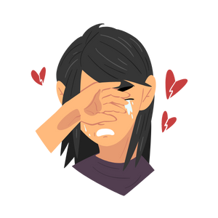
Emotional Abuse in Relationships
Emotional Abuse is:
Insults, yelling, threats
Isolating a person from their friends and family
Ignoring you or making cruel comments
Notes:
General Information
This happens when yelling or anger go too far or when a person is constantly criticized, threatened, or talked down until their self-esteem is damaged and they feel bad about themselves.
Emotional abuse can hurt and cause damage just like physical and sexual abuse can.
References:
Deutsch, Stephanie A., and Dovi, Allison T. (2020, November). Nemours TeensHealth – Abuse: What You Need to Know. https://kidshealth.org/en/teens/family-abuse.html
Dovi, Allison T. (2021, August). Nemours TeensHealth: Abusive Relationships. https://kidshealth.org/en/teens/abuse.html
Image from Canva

Slide 27
Sexual Abuse in Relationships
Sexual Abuse is…
Being forced to kiss or touch someone
Being forced to engage in sexual activities without consent
Unwanted rough or violent sexual activity
Notes:
General Information
Any type of sexual contact between two people that is not agreed too or forced upon by one of the partners.
Sexual activities might include, but are not limited to, sexual intercourse, sex (anal or oral), sexual touching, kissing, grabbing, fondling, humping**
Includes unwanted rough or violent sexual activity (rape or attempted rape).
Emphasize the concept of consent in romantic, intimate and sexual relationships!!
References:
Deutsch, Stephanie A., and Dovi, Allison T. (2020, November). Nemours TeensHealth – Abuse: What You Need to Know. https://kidshealth.org/en/teens/family-abuse.html
Dovi, Allison T. (2021, August). Nemours TeensHealth: Abusive Relationships. https://kidshealth.org/en/teens/abuse.html
Government of Ontario (2017, August 08). Age of Consent to Sexual Activity. https://www.justice.gc.ca/eng/rp-pr/other-autre/clp/faq.html
Image from Canva

Slide 28
Financial Abuse in Relationships
Financial Abuse is when your partner:
Takes your money without permission
Forces you to pay for everything
Controls the money
Notes:
General Information
Taking money can include taking someone's paycheque…
Controls the money by deciding/choosing how it is spent/used
References:
Deutsch, Stephanie A., and Dovi, Allison T. (2020, November). Nemours TeensHealth – Abuse: What You Need to Know. https://kidshealth.org/en/teens/family-abuse.html
Dovi, Allison T. (2021, August). Nemours TeensHealth: Abusive Relationships. https://kidshealth.org/en/teens/abuse.html
Image from Canva

Slide 29
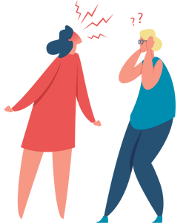
Possible Warning Signs of Dating Violence
You should be aware of the warning signs and get help if you notice a person is:
Avoiding friends and family
Loses interest in their favourite activities
Struggling in school and their grades are dropping
Showing up with unexplained injuries
Notes:
General Information
Unfortunately, there are times when dating violence occurs. We must be aware of the warning signs and get help if there is reason to believe someone is experiencing dating violence.
Background Knowledge
It’s common for students to have mood swings and to try out different behaviours. However, sudden changes in the student’s attitude or behaviour could be a sign that something more serious is going on. If you think this may be the case, talk to the student to find out more.
If you notice that they are showing up with unexplained injuries (i.e., bruises or scratches), this is a serious concern.
Reference:
Teaching Sexual Health. (n.d.). Relationships – Warning Signs of Dating Violence. https://teachingsexualhealth.ca/parents/information-by-topic/relationships/
Image from Canva

Slide 30
Healthy, Unhealthy and Abusive Relationships
Notes:
Teacher Prompt:
Guiding Question → What do you know about the term intimacy? Can intimacy look different for different people? It is important for students to hear about the term now so that they can start thinking about it.*
Review the three distinct categories of healthy, unhealthy and abusive relationships regarding intimacy and sex
Examples of healthy, unhealthy & abusive relationships… Refer to: Teaching Sexual Health. (n.d.). Relationships – Healthy, Unhealthy & Abusive Relationships. https://teachingsexualhealth.ca/parents/information-by-topic/relationships/
**As noted on the resource, *Adapted from myhealth.alberta.ca*

Slide 31
Final Activity: Babysitting Scenario
The person you have been dating for a few months doesn’t like to be excluded from your plans. They often ask to join you while you are with friends.
Now they want to visit you while you are babysitting.
You do not think it would be appropriate for them to visit while you are watching the children.
What could you say in this situation?
Notes:
Teacher Prompt
The person you have been dating wants to visit you while you are babysitting.
Things you can say:
“I like that you want to hangout but I don’t feel comfortable with you coming over while I’m working”
“This is not a good time because I’d like to remain professional while I’m working”
“I think it’s kind of you to want to visit me, but maybe we could meet up after I’m done working?”
If you feel like you have to lie then the relationship probably isn’t healthy. You should be able to have an open and honest conversation with your partner and be able to explain how you are feeling without worrying about the other person being upset with you or angry.
Image from Canva

Slide 32
More Questions? Talk to Someone:
Parents/ Guardian
Teacher/ Principal
Doctor or Health Care Professional
School Health Nurse
Child and Youth Worker
Kids Help Phone
Notes:
General Information
There are many people and places that you can reach out to in order to get help or ask questions about relationships and sexual health. If you ever have questions/concerns, need help or know someone who needs help, you can always talk to someone. Sometimes people experience abuse/dating violence in a relationship, such as physical, sexual, emotional, and/or financial… if this happens, encourage the person to talk to a trusted adult, such as a parent/guardian, teacher, or friend. There are many options out there available to you.
Among these are:
A trusted adult (such as a parent or teacher)
A health care provider (such as a doctor or nurse)
A child and youth worker
The school health nurse
The school social worker
Any of the Niagara Region Sexual Health Centres
Kids Help Phone
Services for Youth - Niagara Region, Ontario → https://www.niagararegion.ca/health/schools/youth-services.aspx
Other community resources:
Kids Help Phone: Call 1-800-668-6868 or https://kidshelpphone.ca/
Image from Canva

Slide 33
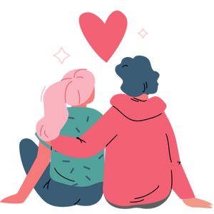
Final Thoughts
A healthy relationship has honesty and trust, open communication, and makes you happy
An unhealthy relationship might have jealousy, lack of respect, and may make you feel pressured to do something you are not comfortable with. An unhealthy relationship might make you feel anxious and confused
Notes:
General Information
Relationships can have benefits, but they can also be challenging at times.
Healthy
Feeling happy when you’re with another person
Feeling safe around the person
Mutual respect and understanding
Trust
Compromise
Individuality (being yourself)
Strong/Open lines of Communication
Problem solving
Self-confidence
Healthy sexual relationship (when both partners are older and mature enough and have discussed boundaries and consent)
Religious/Cultural beliefs are respected
Respect of boundaries
Decides are made together
Unhealthy
Anger/Aggression
Hostility
Control
Dishonesty
Disrespect
Humiliation/Put downs
Intimidation
Violence (physical, sexual, emotional, etc.)
Dependence
Jealousy
Distrust
Not respectful of religious/cultural beliefs
Not willing to hear others’ perspectives
Poor communication
Gaslighting or false accusations
Love bombing
Image from Canva

Slide 34
Questions?
Notes:
Image from Canva

