Slide 1
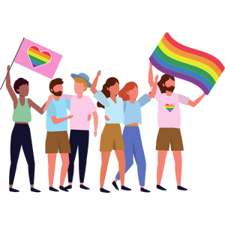
Gender and Sexual Diversity
Intermediate
Notes:
**The following slides (1-6) are for teacher use only** (Introduce self, indicate your pronouns)
The speaker’s notes are also intended for teacher use only. The notes include general information, background knowledge, questions and/or prompts. The information included in these notes should not be read word for word. Teacher’s should review the notes before using the presentation to become familiar with the content, as it is to supplement what is on the slide.
Image from Canva
Last Updated: January 2023

Slide 2
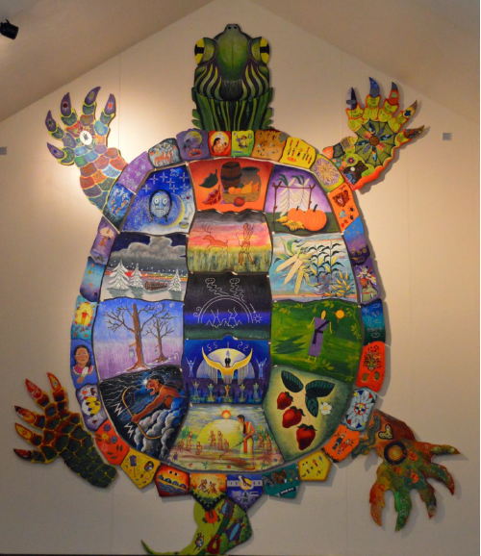
Land Acknowledgement
Notes:
Niagara Region is situated on treaty land. This land is steeped in the rich history of the First Nations such as the Hatiwendaronk (Hat-i-wen-DA-ronk), the Haudenosaunee (Hoe-den-no-SHOW-nee), and the Anishinaabe (Ah-nish-ih-NAH-bey), including the Mississauga's of the Credit First Nation. There are many First Nations, Métis, and Inuit peoples from across Turtle Island that live and work in Niagara today. The Regional Municipality of Niagara stands with all Indigenous peoples, past and present, in promoting the wise stewardship of the lands on which we live.
*Disclaimer: In the Spirit of Truth and Reconciliation, Niagara Region Public Health acknowledges that people are gathered on the customary and traditional lands of the Indigenous Peoples of this territory. We recognize that the land on which you are situated will vary depending on where you are located in Ontario. It is advised that you reach out to your school’s principal or school board for the school-specific treaty land. If you have already done a land acknowledgement on the same day you are presenting this lesson, you are welcome to skip this slide. However, it is always encouraged to complete a land acknowledgement before continuing on with this presentation.*
Information about the image on the left:
There are seven objects that have been purposely selected and included in the design of the artwork: an Inukshuk, an eagle feather, two drums, a Métis sash, an embroidered flower, and wampum belt. Each object reflects the diversity of First Nations, Métis and Inuit in North America. The iconic stone monument, the Inukshuk, is used as a marker identifying important sites and as a navigational tool to communicate direction. The eagle feather is significant to the spiritual beliefs of some Métis and First Nations peoples. Its symbolism includes honour, wisdom, and courage among many others. It is considered an honour to be given an eagle feather. The two drums include the Inuit drum and the Métis and First Nations drum. The drum is symbolic of the heartbeat of Mother Earth and is often played at various traditional gatherings and ceremonies. The embroidered flower is woven into many traditional garments and various objects through beadwork, painting, or etchings. It is also considered one of Canada’s first art forms. The Métis sash was once a tool of the voyageurs and fur traders. It is also a symbol of knowledge and the relationship between the Métis, the First Nations, and Europeans. At the top of the poster are four lines reminiscent of the traditional beaded wampum belt. There are many types of wampum belts with different significant meanings, including agreements made between two groups/nations, knowledge sharing, and storytelling. The four lines in this wampum belt represent the equality and diversity of the four peoples (First Nations, Metis, Inuit, and European settlers) and to acknowledge the journey of living together peacefully (ETFO, 2022).
For more information on Indigenous Education and First Nations, Metis and Inuit (FNMI), check out the following resources:
https://www.otffeo.on.ca/en/learning/indigenous-education
https://www.etfo.ca/socialjusticeunion/first-nation,-metis-and-inuit-(fnmi)
Photo References:
Image on the Left: Elementary Teacher Federation of Ontario (ETFO). (2022). ETFO Land Acnowledgements. https://www.etfo.ca/about-us/governance/etfo-land-acknowledgement
Image on the Right: Creating Our Way Forward: Recommendations for Improving Niagara Region Public Health & Emergency Services’ Indigenous Engagement (2019). https://www.niagararegion.ca/health/equity/pdf/indigenous-engagement-report.pdf
Mural of Turtle Island → Cover photo: Oneida nation artist, Sharon Sarnowski (deceased) This is a picture taken of the mural in the Boardroom of the Oneida Tribal Council office, Oneida, Wisconsin.

Slide 3
Presentation Format
Guiding Questions: Big idea questions that prompt students to brainstorm and share previous knowledge or new information.
Think, Pair, Share: Opportunity for students to work with a partner or in a group and share ideas based on a prompt.
Notes:
Images from Canva

Slide 4
Presentation Format
Videos: Students can watch a short video clip that connects with topic. Discussion can follow before or after videos.
Final Activity: Activity that concludes the presentation.
Notes:
Images from Canva

Slide 5
Curriculum Expectations - Grade 8
D1.5 demonstrate an understanding of gender identity, gender expression, and sexual orientation, and identify factors that can help individuals of all identities and orientations develop a positive self-concept.
Notes:
When looking at the Ontario elementary Health and Physical Education curriculum (2019), the expectation specifically states: male, female, Two-Spirit, transgender, heterosexual, gay, lesbian, bisexual, pansexual, and asexual are gender identities and sexual orientations that should be covered (refer to page 282 of the curriculum document).

Slide 6
Gender and Sexual Diversity
Intermediate
Notes:
**This is where the presentation officially begins**
For additional information on Sex, Sexual Orientation, Gender Identity and Gender Expression, refer to the following resource:
Westheimer, K. (2015). Learning for Justice: Sex? Sexual Orientation? Gender Identity? Gender Expression? https://www.learningforjustice.org/magazine/summer-2015/sex-sexual-orientation-gender-identity-gender-expression
Image from Canva

Slide 7
Learning Objectives
At the end of this presentation, you will understand the difference between gender identity, gender expression, and sexual orientation. You will also:
Learn how to develop a positive self-concept as you grow and mature
Understand that everyone has differences and this makes them unique
Create an environment that is safe and inclusive for your peers
Notes:
General Information
The information we are going to talk about today is important for many reasons.
We want to ensure that you learn that everyone is unique and the things that make you unique is what makes you interesting and special.
We want you to feel good about your body, how it is changing, and how you approach different types of relationships you may have with people.
It is important that everyone feels safe, accepted and supported at school and understand that differences are ok. This will help to reduce bullying and feelings of loneliness or isolation.
Background Knowledge/Notes:
Students will learn about and understand themselves and their bodies as they grow and mature
Students need to understand that everyone has different qualities that make up their self-concept; this makes them unique
There needs to be an emphasis on feeling safe, included and accepted in the school community
Empathetic towards others…

Slide 8
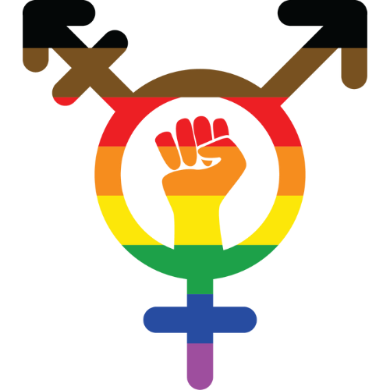
Making Decisions About Your Health
Notes:
General Information
When it comes to your health, there are many decisions you will have to make throughout your life as you mature and grow. Making decisions about your health is important, especially when it is related to your gender and sexual diversity. There are many factors that help to form your identity, which can have an impact your self-concept and well-being.
When deciding what is best for you and your health, you should understand and be well informed about the choices available. It is important that information comes from a trusted source that is current and accurate.
There is a lot of great information available on the internet and social media, but sometimes there is a lot of misinformation as well, this is why we recommend talking to a trusted adult, as they can offer information to help you make the best decisions for you and your health.
Images from Canva

Slide 9
Things to Remember
It’s okay…
If you feel embarrassed or uncomfortable
To ask questions
To not already know about this
For us to learn about each other’s identities, orientations, and experiences
Notes:
General Information
4 Okay’s
Today we’re going to be talking about what makes us different, and what makes us the same. We understand that for some of you, this may be the first time you’re learning about this topic, and for others this may be something you know a lot about. It may feel uncomfortable to talk about your body and your sexuality with your parents or friends, but it’s important we all understand gender and sexual diversity so we can be supportive and respectful of others.
So let’s review the 4 OK’s. It is perfectly OK:
If you feel embarrassed or uncomfortable. The only way for us to overcome this uncomfortable feeling is to learn and grow. We can often feel uncomfortable about things we don’t fully understand. But if we take the time to learn about a topic and understand it, we become more educated and comfortable. This creates a supportive environment for everyone!
It’s okay to be curious and to ask questions.
It’s okay if you don’t know this information already. We’re all going to learn this together.
And… It is okay for us to know about each other’s bodies and experiences. This helps us to understand one another better, and be respectful of each individual person regardless of our similarities and differences.
Images from Canva

Slide 10
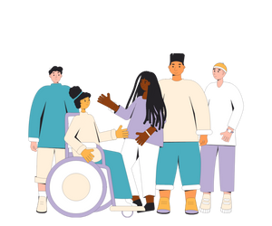
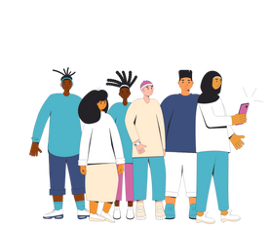
Diversity is all the ways we are different from each other…
We see diversity in:
Sex assigned at birth
Sexual orientation
Gender identity
Gender expression
Race
Religion
Culture
Family
Status
Notes:
Teacher Prompt
What is Diversity? What does the term diversity mean to you? Ask students to take a few seconds to think to themselves…
Diversity can mean many things to each of us. It’s important that each definition reflects our ability to accept and celebrate other people. Diversity is all the ways we are different from each other. It includes things like race, religion, culture, physical ability, mental ability, family make-up, socio-economic status and sexual and gender diversity.
Images from Canva

Slide 11
What is Self-Concept?
Self-concept is:
The idea a person has of their own identity
Unique for everyone
Formed from experiences and interactions with others
Influenced by others opinions
What makes you, ‘you’
Notes:
**Note: This concept should have been covered in Grade 5, but students may have forgotten what the term self-concept means. Most of the information below is review. The teacher can decide what information they’d like to cover on this slide**
General Information:
Self-esteem and self-concept play a large part of your identity.
Self-Esteem
Self-esteem means you mostly feel good about yourself. It helps with your self-confidence, as well as self-concept
Self-esteem is when you (Lyness, 2018):
Feel good about yourself
Are proud of what you can do
See the good things about yourself
Believe in yourself, even when you don’t do well at first
Feel liked and accepted by others
Accept yourself, even when you make mistakes
Self-concept (review from Grade 5):
Is what makes you, “you”
Is part of your identity
Is created through experiences with others
Might be affected by what others think about you
Is knowing the things you like about yourself
Teacher Prompt:
“How can we recognize and respect the uniqueness of all people so that everyone can develop a positive self-concept?”
Explain to students that a person’s self-concept can be affected by a number of factors. Some factors are external – they come from outside of ourselves. Some factors are internal – they come from within ourselves.
Every person is worthy of respect and has the right to be free from discrimination, regardless of their sexual orientation, gender identity, or gender expression. We can talk about our differences and what makes us unique with respect, and listen carefully when others share their experiences. We can accept that sometimes we will have to agree to disagree. Accepting the uniqueness of every individual may be a way to become more accepting of ourselves. We can treat others with dignity and the same degree of respect we would like to be treated with ourselves. We all need love and support as we grow and mature. When needed, support can come from school and community organizations.
Background Information
Definition of Self-esteem: “the degree of worth and competence that we attribute to ourselves.”
Definition of Self-concept: The perception a person has of his or her own identity. People form their self-concept using interpretations of information they acquire about themselves through experiences and interactions with others and their environment. A person’s self-concept can be influenced by the opinions of others, reinforcement of behaviour, and explanations or understanding of one’s own behaviour or actions. Unlike self-esteem, self-concept is not positive or negative, but rather accurate or inaccurate, or extensive or narrow. (Health and Physical Education Curriculum – OME, 2019, p. 313).
Reference:
Canadian Association for the Advancement of Women in Sport. (2013). Self-esteem, sport and physical activity. Retrieved from: http://www.caaws.ca/e/wp-content/uploads/2013/02/Self_Esteem.pdf
Health and Physical Education Curriculum – Ontario Ministry of Education (2019)
Lyness, D. (2018, June). Nemours KidsHealth: Self-Esteem. https://kidshealth.org/en/kids/self-esteem.html
Image from Canva

Slide 12
Gender and Sexual Diversity: Self-Concept
Gender and sexual diversity play an important role in a person’s self-concept. Self-concept can be impacted by other factors such as:
Factors:
Education
Media
Culture
Relationships
Age
Environment
Notes:
Teacher Prompt
“How can/ or What role does gender and sexual diversity have in the development of a person’s self-concept?”
Turn to a classmate/friend and discuss (5 minutes)
Bring the students attention back and discuss as a class…
General Information
A person’s self-concept is continually developing during each life stage and is closely linked to their emotional and social development. A person’s self-concept can be affected by a number of factors. Some factors are external – they come from outside of ourselves. Some factors are internal – they come from within ourselves.
Background Knowledge
Examples of Factors:
Age
The image that you have of yourself today will not be the same when you reflect later on in life (i.e., age 40, 60, or 80 years old)
Physical, intellectual, emotional and social changes will effect self-concept over time
Appearance
A person’s physical features, their clothes and their non-verbal behaviour all influence and express aspects of their self-concept/self-confidence.
Gender
Culture
Ethnicity affects self-concept by influencing people’s feelings of belonging to a particular culture or social group
It can also lead to people being treated differently (in unfair or discriminatory ways), and might effect their sense of self-esteem, self-confidence, and self-worth.
Relationships
People form different types of relationships at different stages of their life.
Family relationships tend to be the most important during infancy and childhood.
Friendships become more important through adolescence. Friendships tend to boot a person’s self-esteem and self-confidence, and help to develop important social skills. Overall, friendships make an important contribution to an individual’s emotional and social development and the formation of their self-concept.
Family and Socialisation
The relationship that an individual develops within their family or school will have a powerful effect on their self-concept. Early relationships are built on effective attachments to parents and close family members. The sense of security and feelings of being loved that can develop from these bonds help towards developing a positive self-concept.
Poor family relationships can have a lasting effect on emotional insecurity, poor self-esteem, negative self-esteem, lack of confidence, low self worth, poor relationship skills
Media
Television and magazines are often criticised for presenting inappropriate stereotyped images of men and woman, which then readers try and copy. Unattainable body images, wealthy lifestyles are often featured on TV. These media images can affect an individuals body image and self-concept if they believe them to be true or very desirable.
Education
Educational experiences can have a major impact on a person’s self concept. Teachers and fellow students can effect our self-image and self-esteem.
At this stage, children and young people are open to figuring out what they like, and who they want to be. Schools can be both positive and negative in this case, and might leave some individuals feeling incapable, having a negative view of themselves, their skills and self-worth.
Environment
Growing up, kids will learn to mature in the environment that they’re in. Whether that is familial environment or school environment. However, if kids do not have a supportive environment at home, with family or adults that are caring and provide a safe place to live, students self-concept will be negatively impacted.
As for school, an inclusive environment is essential for students to grow. When kids see and hear about other people who have similarities (LGBTQ2S+) that aren’t often expressed, it might make them feel represented and welcome, and positively impact their self-esteem and self-concept.
External factors:
having support from family and caring adults
Growing up/ having a safe place to live
being involved in activities that make you feel proud of what you’ve accomplished
Seeing inclusivity in our community: when people have similarities (i.e., gender identity, expression, etc.), it might make a person feel represented, included and welcomed in that same environment
Internal factors:
having a sense of purpose in life
having a clear sense of who you are
feeling that you are capable of taking steps to make things better
being optimistic
having high expectations of yourself
having the skills you need to solve problems
feeling confident/proud in the body you are in; feeling like you can express your identity
Consider extending the discussion on positive self-concept to reinforce the ideas that everybody is unique and different in their own ways and that being different is something to embrace.
Reference:
Canadian Association for the Advancement of Women in Sport. (2013). Self-esteem, sport and physical activity. Retrieved from: http://www.caaws.ca/e/wp-content/uploads/2013/02/Self_Esteem.pdf
Health and Physical Education Curriculum – Ontario Ministry of Education (2019)
Lyness, D. (2018, June). Nemours KidsHealth: Self-Esteem. https://kidshealth.org/en/kids/self-esteem.html
Image from Canva

Slide 13
Guiding Question #1
What are some things you can do in your class to ensure everyone feels included and celebrated for their uniqueness?
Notes:
General Information
Every person is worthy of respect and has the right to be free from discrimination, regardless of their sexual orientation, gender identity, or gender expression. We can talk about our differences and what makes us unique with respect, and listen carefully when others share their experiences. We can accept that sometimes we will have to agree to disagree. Accepting the uniqueness of every individual may be a way to become more accepting of ourselves. We can treat others with dignity and the same degree of respect we would like to be treated with ourselves. We all need love and support as we grow and mature. When needed, support can come from school and community organizations.”
Images from Canva

Slide 14
Each piece helps to make you, YOU!
Experiences
Skills
Values and Morals
Culture and Religion
Personality Traits
Sex Assigned at Birth
Gender Identity
Gender Expression
Sexual Orientation
Notes:
General Information
These are just some of the different qualities that make everyone unique.
When we talk about sexual and gender diversity, it’s important to understand these terms. Each person’s sexual orientation, gender identity and gender expression are different from one another, but are all pieces that make up who they are.
*Note: A definition for the gender and sexual diverse words that are mentioned above (and on the slide) will provided in the following slides*
Image from Canva

Slide 15
Video: Human Sexuality is Complicated…
While watching the video, consider the following:
Are gender and sex related?
What is the difference between sexual orientation and sexual behaviour?
Notes:
To access video you must be in present mode to play OR open the link in a separate Internet browser.
Video link: https://youtu.be/xXAoG8vAyzI
Also hyperlinked in the title.
Length of video: 3:48
This video addresses the question “how should we talk about sexuality?” and discusses what the difference is between sex and gender and between sexual orientation and sexual behaviour.
Background Knowledge:
Social Gender is the third dimension of gender that includes gender expression and the roles/expectations that arise from gender norms.
While people tend to use the terms “sex” and “gender” interchangeably, this is actually incorrect. While connected, the two terms are not the same.
Generally, Doctors will assign a newborn’s sex as either male or female based on the baby’s genitals (external organs and internal reproductive organs). Once a sex is assigned, people often presume the child’s gender to be the same (i.e., assigned female at birth = female).
However, gender aligns with gender-related ideas and assumptions associated with their sex. Nevertheless, while gender may begin with the assignment of sex, it doesn’t stop here or mean that everyone will always identify as the sex they were assigned at birth.
A person’s gender is the interrelationship between three dimensions: body, identity, and social gender. (This answers the question: “what makes up a person’s gender?”)
Reference:
Gender Spectrum (n.d.). Understanding Gender – Dimensions of Gender. https://genderspectrum.org/articles/understanding-gender

Slide 16
Guiding Question #2
What do the following terms mean:
Sex assigned at birth
Sexuality
Sexual Orientation
Notes:
Teacher Prompt
“What do the following terms mean: sex, sexuality, sexual orientation”
Give the students about 5 minutes to turn to their elbow buddy and discuss the following terms. After asking students for their responses, inform them that they will learn about the terms and their definitions in the following slides.
Image from Canva

Slide 17
Sex Assigned at Birth
The physical sex characteristics used to categorize people as “male”, “female” or “intersex” at birth.
Factors that decide assigned sex:
Genitalia
Hormones
Chromosomes
Notes:
Background Knowledge
Sex. The category of male or female, based on characteristics that are biologically determined. See also gender, gender identity, and intersex. (Health and Physical Education Curriculum – OME, 2019, p. 313).
Sex Assigned at Birth
The first thing that we can see here is Biological or Assigned Sex. This is the physical sex characteristics that generally categorize someone as male, female or intersex at birth, including genitalia, body shape, hormones, and chromosomes.
Some people do not like the term “biological sex” because it does not take into consideration what is happening in the brain. Instead Assigned Sex can be the preferred term since the sex of a child is determined or ‘assigned’ at birth.
Some individuals, when talking about gender and sex, will use these terms interchangeably, but we have come to realize that gender and sex describe unique characteristics. Biological sex is referring to the biological characteristics that make up a person, while gender is much more complex. So when you hear about someone having a gender reveal party for their baby, it’s actually to reveal the biological/assigned sex of the child.
The factors that decide the biological or assigned sex of a child begin as soon as the fertilization of the egg occurs; when the chromosomes from the sperm and the egg combine. All eggs have X chromosomes, and sperm can have either an X or Y chromosome.
References:
Ontario Ministry of Education (OME). (2019). Health and Physical Education Curriculum. http://www.edu.gov.on.ca/eng/curriculum/elementary/2019-health-physical-education-grades-1to8.pdf
Sex & U. (2022). Gender Identity: Sex. https://www.sexandu.ca/lgbttq/gender-identity/
Image from Canva

Slide 18
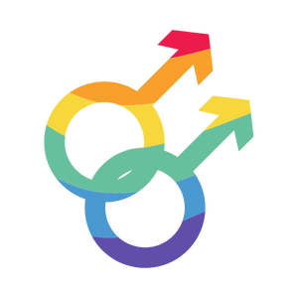
Sex - Assigned Male at Birth
A person born with XY chromosomes and reproductive organs such as a penis and testicles
For a person assigned male at birth, they will have the ability to produce the hormone testosterone and, eventually, sperm
Notes:
Background Knowledge
Male
At birth, a person with XY chromosomes typically have reproductive organs such as a penis and testicles.
The male sex is also characterized by the body’s ability to one day produce the hormone testosterone, and eventually the production of sperm. Also known as Spermatogenesis.
Image from Canva

Slide 19
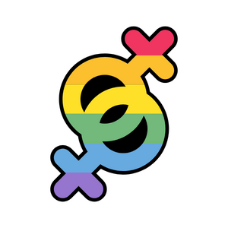
Sex - Assigned Female at Birth
A person born with XX chromosomes and reproductive organs such as a vagina and uterus
This sex will typically have the ability to produce estrogen and progesterone, and release eggs during the menstrual cycle (ovulate)
Notes:
Background Knowledge
Female
At birth, a person with XX chromosomes typically have female reproductive organs such as a vagina and uterus.
The Female sex can also be characterized by the body’s’ ability to produce the hormones estrogen and progesterone; the hormones responsible for puberty in females, including menstruation. It is also categorized by the ability to eventually ovulate - meaning the body releasing an egg during the menstrual cycle.
Image from Canva

Slide 20
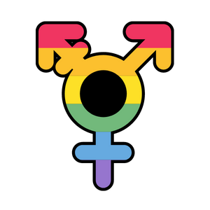
Intersex
A person born with chromosomes and anatomy who do not fit the definition of female or male
Example: A person with sex characteristics for both reproductive systems or a person who is missing part of a reproductive organ
Notes:
General Information
Intersex
Sometimes at birth, a person may have a different arrangements of chromosomes, which can also be referred to as intersex. This is a term used for a person who is born with a reproductive or sexual anatomy that doesn’t seem to fit the binary definitions of female or male. This could involve someone with both “male” and “female” reproductive organs, or someone who is missing part of a reproductive organ. This is a naturally occurring variation in humans, and occurs in about 1 in 1500 to 1 in 2000 births.
https://isna.org/faq/frequency/
Background Knowledge
Intersex. According to the Ontario Human Rights Commission, “a term used to describe a person born with reproductive systems, chromosomes and/or hormones that are not easily characterized as male or female. This might include a woman with XY chromosomes or a man with ovaries instead of testes. Intersex characteristics occur in one out of every 1,500 births. Typically intersex people are assigned one sex, male or female, at birth. Some intersex people identify with their assigned sex, while others do not. Some choose to identify as intersex. Intersex people do not typically identify as transgender or transsexual.” (From Policy on Preventing Discrimination because of Gender Identity and Gender Expression.) See also gender identity and transgender. (OME, 2019, pg. 308)
References:
Ontario Ministry of Education (OME). (2019). Health and Physical Education Curriculum. http://www.edu.gov.on.ca/eng/curriculum/elementary/2019-health-physical-education-grades-1to8.pdf
Sex & U. (2022). Gender Identity: intersex. https://www.sexandu.ca/lgbttq/gender-identity/
Teaching Sexual Health (2022}. Sexual & Gender Diversity: Words You May Hear. https://teachingsexualhealth.ca/parents/information-by-topic/sexual-diversity/
Image from Canva

Slide 21
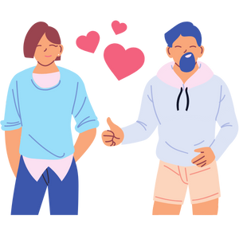
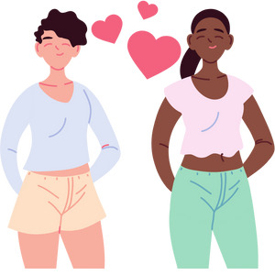
Sexual Orientation
Refers to a person’s emotional, physical and sexual attraction to other people
Notes:
General Information
Sexual Orientation
Everyone has a sexual orientation. Sexual orientation refers to a person’s emotional, physical and sexual attraction to others. Each person’s sexual orientation is a part of who they are. Some people know at a very early age what their sexual orientation is, and others may not. A person’s sexual orientation might stay the same over their whole life, or it may change. It can be fluid and may or may not reflect sexual behaviors.
Attraction
Attraction is a very broad term. A person might be emotionally connected to their friends, but it doesn’t mean they want to date them or are sexually/romantically attracted to them. People connect with others all of the time through their emotions and feelings, which is how we get along, and sometimes we tend to gravitate towards people who we are emotionally connected to.
Physical Attraction: Sexual orientation. It is important to note that sexual and romantic/emotional attraction can be from a variety of factors including but not limited to gender identity, gender expression/presentation, and sex assigned at birth.
Emotional Attraction: Romantic/emotional orientation. It is important to note that sexual and romantic/emotional attraction can be from a variety of factors including but not limited to gender identity, gender expression/presentation, and sex assigned at birth. There are other types of attraction related to gender such as aesthetical or platonic. These are simply two common forms of attraction.
Background Knowledge
Definition of Sexual orientation: According to the Ontario Human Rights Commission, “the direction of one’s sexual interest or attraction. It is a personal characteristic that forms part of who you are. It covers the range of human sexuality from lesbian and gay, to bisexual and heterosexual.” (From Teaching Human Rights in Ontario: A Guide for Ontario Schools). (Health and Physical Education Curriculum – OME, 2019, p. 313).
References:
Ontario Ministry of Education (OME). (2019). Health and Physical Education Curriculum. http://www.edu.gov.on.ca/eng/curriculum/elementary/2019-health-physical-education-grades-1to8.pdf
Teaching Sexual Health (2022}. Sexual & Gender Diversity: Words You May Hear. https://teachingsexualhealth.ca/parents/information-by-topic/sexual-diversity/
Trans Student Educational Resources. (n.d.). Gender Unicorn. https://transstudent.org/gender/
Images from Canva

Slide 22
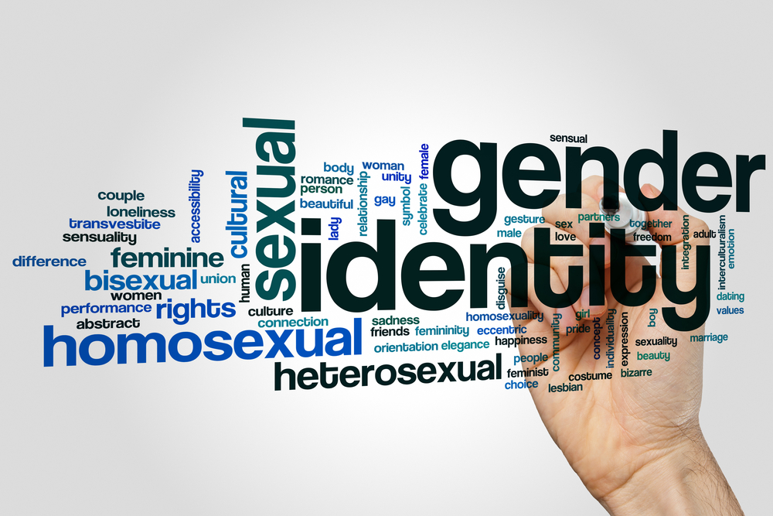
Sexuality Definitions
Heterosexuality: Attraction between persons of opposite sex or gender
Homosexuality: Attraction between persons of the same sex or gender
Pansexual: Attraction to people of any sex or gender
Asexual: Lack of sexual attraction to others
Notes:
Background Knowledge
Sexuality. A term that encompasses sex, gender identities and roles, sexual orientation, eroticism, pleasure, intimacy, and reproduction. Sexuality is experienced and expressed in thoughts, fantasies, desires, beliefs, attitudes, values, behaviours, practices, roles, and relationships. While sexuality can include all of these dimensions, not all of them are always experienced or expressed. Sexuality is influenced by the interaction of biological, psychological, social, economic, political, cultural, ethical, legal, historical, religious, and spiritual factors. (From World Health Organization, Defining Sexual Health: Report of a Technical Consultation on Sexual Health [Geneva, Switzerland: WHO, 2002]; referenced in Sex Information and Education Council of Canada [SIECCAN], Canadian Guidelines for Sexual Health Education, 2019, at http://sieccan.org/ sexual-health-education/.) (Health and Physical Education Curriculum – OME, 2019, p. 314).
Additional Information:
Heterosexual: According to the Ontario Human Rights Commission, “a person who has emotional, physical, spiritual and sexual attraction to persons of the opposite sex.” (From Teaching Human Rights in Ontario: A Guide for Ontario Schools.)
Pansexual. A person who has emotional, physical, spiritual, and/or sexual attraction to people regardless of their gender or sex. (OME, 2019, pg. 311)
Asexual. A person who experiences little or no sexual attraction. They may or may not feel emotionally or romantically attracted to others (OME, 2019, pg. 303). This is a term used to describe a person who either: 1. Does not experience sexual attraction 2. Does not experience a desire for sex, or 3. Experiences these to a lesser degree than most.
References:
Ontario Ministry of Education (OME). (2019). Health and Physical Education Curriculum. http://www.edu.gov.on.ca/eng/curriculum/elementary/2019-health-physical-education-grades-1to8.pdf
Sex & U. (2022). LGBTTQ+: Sexual Orientation. https://www.sexandu.ca/lgbttq/sexual-orientation/
Teaching Sexual Health (2022}. Sexual & Gender Diversity: Words You May Hear. https://teachingsexualhealth.ca/parents/information-by-topic/sexual-diversity/
Photo Reference:
Shutterstock_417882265

Slide 23
Guiding Question #3
What do the following terms mean:
Gender
Gender Identity
Gender Expression
Notes:
Teacher Prompt
“What do the following terms mean: gender, gender identity, gender expression”
Give the students about 5 minutes to turn to their elbow buddy and discuss the following terms. After asking students for their responses, inform them that they will learn about the terms and their definitions in the following slides.

Slide 24
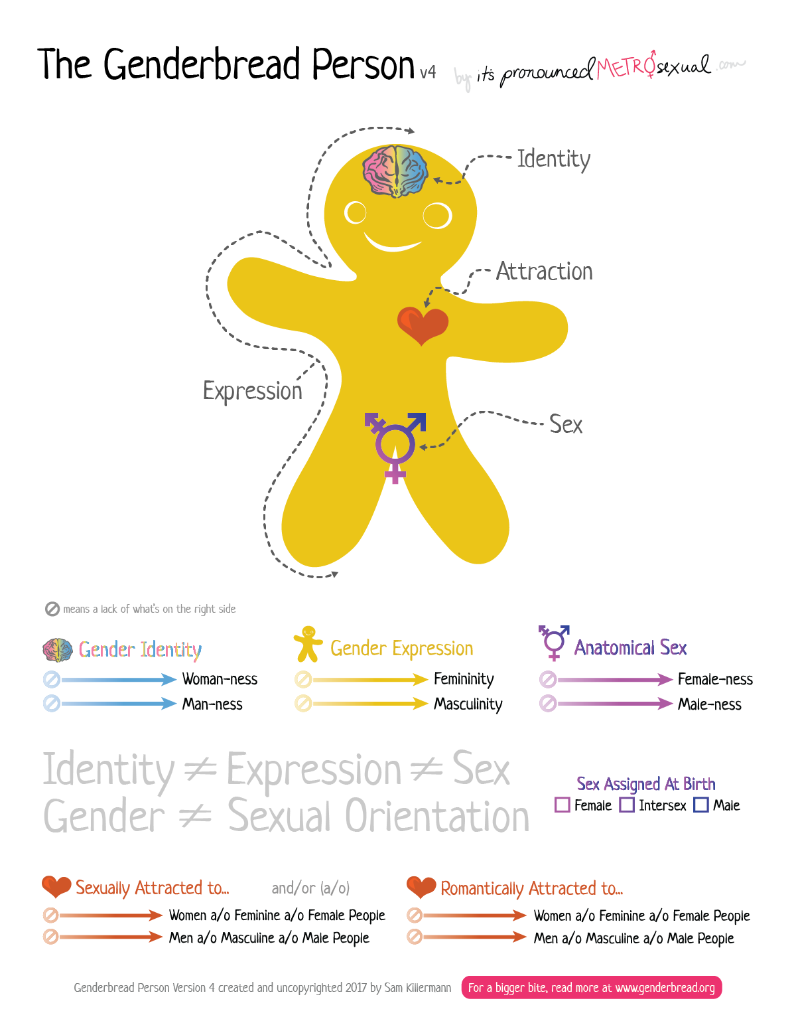
The Genderbread Person
Notes:
The Genderbread Person shown on the following slide is Version 4, which is the most recent and up to date.
Teacher prompt:
“Where do we get our ideas or understandings of gender?”
Possible responses might include: media, school, culture, faith, and community. Highlight that ideas about what gender is (stereotypes and expectations) are reflected by society and may change over time — in other words these ideas are “socially constructed”.
General Information
Gender identity is how a person identifies based on their internal sense of woman-ness, man-ness, neither, or both, as well as how you express your gender to the world.
People who’s gender identity does not match their reproductive organs are considered transgendered, meaning that they identify with a gender that is different from their biological sex.
Gender expression is how you express your gender to the world – through things like how you dress, act, and behave
No one type of person or relationship is ‘normal’ – but all people and relationships deserve respect.
Background Knowledge
Explain what gender is… Gender: According to the Ontario Human Rights Commission, “the social classification of people as masculine and/or feminine.” (From Teaching Human Rights in Ontario: A Guide for Ontario Schools.) See also gender identity, gender expression, and sex. (Health and Physical Education Curriculum – OME, 2019, p. 307).
The following has already been covered but you may want to discuss it in terms of the Genderbread Person:
Biological sex (sex assigned at birth) is the sex organs you are born with. Some people are born with organs or hormones from both sexes – this is called being intersex.
Some people may have sexual organs or hormones from both sexes; this is called being intersex.
Sexual Orientation is who you are attracted to physically, spiritually, and emotionally. This may include being attracted to someone of the same or opposite sex as you. This may also include being attracted to both sexes.
Some sexual orientations you will identify with, and some you will not.
People might identify with a sexual orientation that changes during different times of their lives. As you grow up, people tend to find themselves and figure out their sexual orientation over time.
Regardless of your own sexual orientation, you will go to school, work, and be friends with people who may identify with a different sexual orientation than yourself.
We all need to be able to respect every person we come into contact with, regardless of their sexual orientation.
Photo Reference:
Killerman, S. (n.d). The Genderbread Person – Version 3. https://www.itspronouncedmetrosexual.com/2015/03/the-genderbread-person-v3/#menu
Killerman, S. (2018). The Genderbread Person – Version 4. https://www.itspronouncedmetrosexual.com/2018/10/the-genderbread-person-v4/

Slide 25
Gender Identity
Your internal sense of identity as female, male, both or neither, regardless of your assigned sex
Your gender identity may be the same or different from the sex you were assigned at birth
Notes:
General Information
Gender Identity: Gender Identity is a person’s internal sense of identity as female, male, both or neither, regardless of their biological sex assigned at birth. As we discussed earlier, gender identity is separate from the physical body parts and mechanisms that one is born with. Although historically gender has been associated with specific biological components, we have learned that this is not always the case. People’s perceptions of gender are often influenced by masculine and feminine stereotypes that our society establishes. Gender stereotypes are always evolving and changing, and vary based on place, time and between different cultures. We know that the way a person chooses to express themselves, activities a person enjoys, and colours a person likes, for example, do not determine their gender, and vice versa.
*Remember: Gender expression is different from gender identity. You can’t assume a child’s gender identity based on their gender expression (for example, their choice of toys, clothing, or friends).
Background Knowledge
Definition of Gender Identity: According to the Ontario Human Rights Commission, “each person’s internal and individual experience of gender. It is their sense of being a woman, a man, both, neither, or anywhere along the gender spectrum. A person’s gender identity may be the same as or different from their birth-assigned sex. . . . People . . . may see their gender identity as fluid and moving between different genders at different times in their life.” (From Policy on Preventing Discrimination because of Gender Identity and Gender Expression.) (OME, 2019, pg. 307)
Gender identity is developed throughout your life starting in childhood. For some children, their gender identity will remain in their life, but other children might change what they identify as over time.
Younger children may express their gender very clearly. For example, they may say “I am a she, not a he!”
Stereotypes/Expectations:
Some societies – like ours – tend to recognize that there are only two genders, male and female, which is exclusive of other genders. The idea that there are only two genders is sometimes called the “gender binary”.
Other Example: Some may think that certain toys are only for girls or boys (trucks = boys; dolls = girls)
Some children might find ways to express themselves and do it very strongly. For example, a child might go through a stage of insisting on wearing a dress everyday, or refusing to wear a dress even on a special occasion. Some might even try to do their own makeup and wear it everyday.
Many children begin to reduce outward expressions of gender as they feel more confident that others recognize their gender. For example, a girl may not feel that she has to wear a dress every day because she knows that others see her as a girl no matter what she wears.
References:
Caring for Kids (2021, March). Gender Identity. https://caringforkids.cps.ca/handouts/behavior-and-development/gender-identity
Ontario Ministry of Education (OME). (2019). Health and Physical Education Curriculum. http://www.edu.gov.on.ca/eng/curriculum/elementary/2019-health-physical-education-grades-1to8.pdf
Sex & U. (2022). Gender Identity: Gender Identity. https://www.sexandu.ca/lgbttq/gender-identity/
Teaching Sexual Health (2022}. Sexual & Gender Diversity: Words You May Hear. https://teachingsexualhealth.ca/parents/information-by-topic/sexual-diversity/
Image from Canva

Slide 26
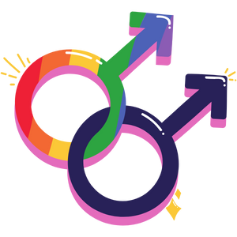
Cisgender
A person whose sense of identity and gender matches their sex assigned at birth
Example: You were assigned female at birth and you identify as a female
Notes:
General Information
Cisgender
This is the term used for a person whose gender identity matches their sex assigned at birth. In other words, most people who are assigned female at birth identify as girls or women, and most people who are assigned male at birth identify as boys or men. The term used to describe this circumstance is cisgender (or cis).
For more information, check out the following resource: what do transgender and cisgender mean? (plannedparenthood.org)
Reference:
Teaching Sexual Health (2022}. Sexual & Gender Diversity: Words You May Hear. https://teachingsexualhealth.ca/parents/information-by-topic/sexual-diversity/
Image from Canva

Slide 27
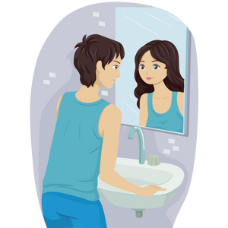
Transgender
A person whose gender does not match the sex assigned at birth
Example: You were born and assigned the sex male at birth, but you identify as female
Notes:
General Information
Transgender: This is a term used for a person whose gender identity does not match their sex assigned at birth. For example, they were born with a vulva, vagina, and uterus, but they identify as male. The term used to describe this circumstance is transgender (or trans), which is what the “T” stands for in LGBTQ2S+. This is also true for non-binary genders, which we will learn about shortly. This is a good reminder that pronouns are determined by how individuals self-identify, not by their body parts.
Background Knowledge
Definition of Transgender/trans: According to the Ontario Human Rights Commission, “an umbrella term that describes people with diverse gender identities and gender expressions that do not conform to stereotypical ideas about what it means to be a girl/woman or boy/man in society. ‘Trans’ can mean transcending beyond, existing between, or crossing over the gender spectrum.” (From Policy on Preventing Discrimination because of Gender Identity and Gender Expression.) (OME, 2019, pg. 308 and 316)
For more information, check out the following resource: what do transgender and cisgender mean? (plannedparenthood.org)
References:
Ontario Ministry of Education (OME). (2019). Health and Physical Education Curriculum. http://www.edu.gov.on.ca/eng/curriculum/elementary/2019-health-physical-education-grades-1to8.pdf
Sex & U. (2022). Gender Identity: Transgender. https://www.sexandu.ca/lgbttq/gender-identity/
Teaching Sexual Health (2022}. Sexual & Gender Diversity: Words You May Hear. https://teachingsexualhealth.ca/parents/information-by-topic/sexual-diversity/
Image from Canva

Slide 28
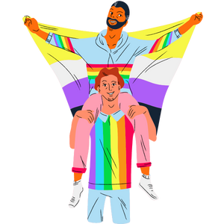
Non-Binary
A person who does not identify as either male or female
Examples of non-binary gender identities:
Gender fluid
A-gender
Gender non-conforming
Notes:
General Information
Non-Binary: Non-binary is a term used for people who do not identify as exclusively male or female. They may feel like they don’t identify with either gender or that they are a blend of both genders. Non-Binary can be a gender identity on its own, but there are other terms that fall under the “umbrella” of non-binary such as: gender fluid, A-gender, and gender non-conforming. These individuals often, but not exclusively, use the pronouns “they/them.”
Gender Fluid: A person’s gender identity changes based on how the feel that day. For example, one day they might identify as female, while the next they might identify at both, then the next day they might identify as male, and then the next day it might be neither.
A-gender: a person who does not identify themselves as having a particular gender.
Gender non-conforming: According to the Ontario Human Rights Commission, “individuals who do not follow gender stereotypes based on the sex they were assigned at birth. They may identify and express themselves as ‘feminine men’ or ‘masculine women’ or as androgynous, outside of the categories ‘boy/man’ and ‘girl/woman’. People who are gender non-conforming may or may not identify as trans.” (From Policy on Preventing Discrimination because of Gender Identity and Gender Expression.) (OME, 2019, pg. 307)
References:
Ontario Ministry of Education (OME). (2019). Health and Physical Education Curriculum. http://www.edu.gov.on.ca/eng/curriculum/elementary/2019-health-physical-education-grades-1to8.pdf
Teaching Sexual Health (2022}. Sexual & Gender Diversity: Words You May Hear. https://teachingsexualhealth.ca/parents/information-by-topic/sexual-diversity/
Image from Canva

Slide 29
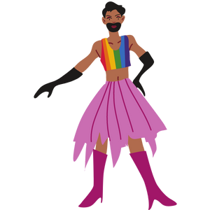
Gender Expression
Known as how you present yourself to the world around you. It can be expressed through:
Names
Clothing
Hairstyle or hair cuts
Voice
Body characteristics
Pronouns
Notes:
General Information
Gender Expression
Gender expression refers to how you demonstrate your gender through the ways you act, dress, and behave, and the pronouns you choose to use in reference to yourself.
Gender expression is about how someone presents themselves to the world around them, which might be expressed through things such as names (preferred name or nickname), pronouns, clothing, hairstyle / haircuts, behaviour, voice, body characteristics, choice of toys, games, sports, and more.
For example, some men wear makeup, some women have facial hair, and some gender non-conforming individuals might switch up their gender expression from time to time.
A person’s gender expression does not have to stay the same, it can change over time. No one should feel as though they have to express themselves according to a box that society puts them in. Always remember, you can’t assume someone’s gender identity or pronouns by looking at them.
https://itgetsbetter.org/blog/lesson/glossary/
Background Knowledge
Definition of Gender Expression: According to the Ontario Human Rights Commission, “how a person publicly presents or expresses their gender. This can include behaviour and outward appearance, such as dress, hair, make-up, body language and voice. A person’s chosen name and pronoun are also common ways people express their gender. Others perceive a person’s gender through these attributes.” (From Policy on Preventing Discrimination because of Gender Identity and Gender Expression.) (Health and Physical Education Curriculum – OME, 2019, p. 307).
References:
Caring for Kids (2021, March). Gender Identity. https://caringforkids.cps.ca/handouts/behavior-and-development/gender-identity
Ontario Ministry of Education (OME). (2019). Health and Physical Education Curriculum. http://www.edu.gov.on.ca/eng/curriculum/elementary/2019-health-physical-education-grades-1to8.pdf
Teaching Sexual Health (2022}. Sexual & Gender Diversity: Words You May Hear. https://teachingsexualhealth.ca/parents/information-by-topic/sexual-diversity/
Image from Canva

Slide 30
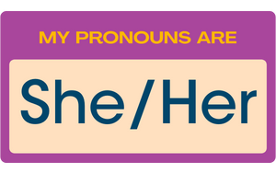
Pronouns
Pronouns are labels we use to identify our gender identity to others in conversation.
It is important to not assume someone's pronoun.
If you are unsure of someone’s pronoun, you can ask: “What are your pronouns?”
Notes:
General Information
Gender pronouns (it’s important to ask someone’s pronouns)
Pronouns are what words you use instead of someone’s name in conversation. Remember, we can't assume someone's gender identity based off of pronouns.
Image from Canva

Slide 31
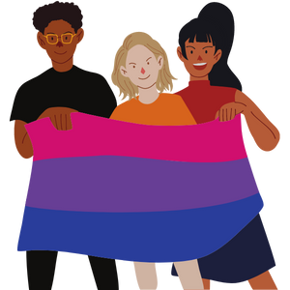
Pronouns People Might Use
She/her/hers → For those who identify as female
He/him/his → For those who identify as male
They/them/theirs → Common gender-neutral pronouns
Some people might also use other pronouns.
Notes:
Background Knowledge
Examples of pronouns include:
→ She/her/hers and he/him/his. Some people call these “female/feminine” and “male/masculine” pronouns, but some people avoid these labels because not everyone who uses he feels like a “male” or “masculine,” for example.
There are also lots of gender-neutral pronouns in use. Here are a few you might hear:
→ They/them/theirs. This is a pretty common gender-neutral pronoun and it can be used in the singular. (They ate their food because they were hungry.)
Some people prefer not to use pronouns at all, using their name as a pronoun instead. (Ash ate Ash’s food because Ash was hungry)
*Never refer to a person as “it” or “he-she” unless they have specifically asked you to do so. Typically these are offensive slurs used against trans and gender non-conforming individuals, though some may actually request the pronoun “it.”*
They are alternative pronouns that could be used, this is not an exhaustive list:
Ze/hir/hir. Ze is pronounced like “zee” can also be spelled zie or xe, and replaces she/he/they. Hir is pronounced like “here” and replaces her/hers/him/his/they/theirs. (Tyler ate hir food because ze was hungry.)
She/they (he/they) or they/she (they/he) might depend on the individual. Some people might use both, but prefer one over the other. It is still important to ask an individual what pronouns they use.
Reference:
https://uwm.edu/lgbtrc/support/gender-pronouns/
Image from Canva

Slide 32
Think, Pair, Share
Do you know what the acronym 2SLGBTQ+ means?
Discuss it with a classmate.
Notes:
Teacher Prompt:
Find a classmate and discuss the acronym. Try to figure out what each of the letters mean.
Many of you may have probably heard of the term LGBTQ or LGBTQ2S+. This term reflects the genders and sexualities that are not cisgender and heterosexual. LGBTQ2S+ includes Lesbian, Gay, Bisexual, Transgender, Queer or Questioning, 2 spirited and more.
The acronyms LGBTQ2S+, LGBTQ*, LGBTQ +, GLBT, LGBTTQ and LGBTQ2 refer to the spectrum of sexual and gender identities that are not cisgender and heterosexual. They include lesbian, gay, bisexual, transgender, two‑spirit, queer, questioning, intersex and asexual. The asterisk (*) or plus sign (+) shows there are other identities included that aren’t in the acronym. These acronyms mean the same as ‘sexual and gender minorities’.
Reference:
Teaching Sexual Health (n.d.). Sexual and Gender Diversity. https://teachingsexualhealth.ca/parents/information-by-topic/sexual-diversity/
Image from Canva

Slide 33
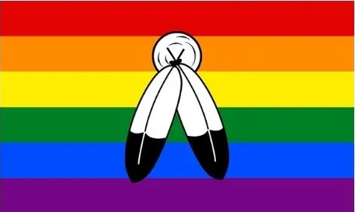
Definition: Two-Spirit
2S: Two-Spirit – A term chosen by some Indigenous Peoples to describe an aspect of their identity. The term two-spirit is understood differently among various First Nations, communities and individuals
Notes:
General Information
Here are some definitions to help you understand some of the terms that LGBTQ2S+ stands for:
2 Spirited: A term used by some Indigenous people who identify as having both a masculine and a feminine spirit, and is used by some Indigenous people to describe their sexual, gender and/or spiritual identity. In some Indigenous cultures, it is considered a gift to be two spirited.
The term might be understood and used differently among various First Nations, communities and individuals…
Overall, “two-spirit” is a term used within some Indigenous communities, encompassing cultural, spiritual, sexual and gender identity.
References:
Teaching Sexual Health (2022}. Sexual & Gender Diversity: Words You May Hear. https://teachingsexualhealth.ca/parents/information-by-topic/sexual-diversity/
Queer in the World (2021). What Is The Two-Spirit Pride Flag, And What Does It Stand For? https://queerintheworld.com/two-spirit-pride-flag/
Image from Canva

Slide 34
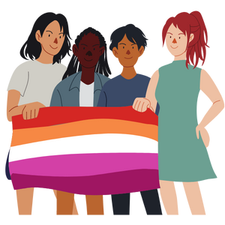
Definitions: Lesbian, Gay or Bisexual
L: Lesbian – A female who is attracted to other females
G: Gay – A person who is attracted to someone of the same sex
B: Bisexual – A person who is attracted to people of the same sex and people of the opposite sex
Notes:
Background Knowledge
Here are some definitions to help you understand some of the terms that LGBTQ2S+ stands for:
Lesbian: A female who is physically and/or emotionally attracted to other females
Lesbian. According to the Ontario Human Rights Commission, “a woman who has emotional, physical, spiritual and/or sexual attraction to other women.” (From Teaching Human Rights in Ontario: A Guide for Ontario Schools.) (OME, 2019, pg. 309)
Gay: A person who is physically and emotionally attracted to someone of the same sex or gender. The word gay can refer to both male and females. However, this term is most often used for a male who has attraction to males.
Gay. According to the Ontario Human Rights Commission, “people whose enduring physical, romantic and/or emotional attractions are to people of the same sex.” (From Teaching Human Rights in Ontario” A Guide for Ontario Schools.) (OME, 2019, pg. 307)
Bisexual: A person who is attracted physically and/or emotionally to people of the same sex, as well as people of sex.
Bisexual. According to the Ontario Human Rights Commission, “a person who is emotionally, physically, spiritually and/or sexually attracted to members of more than one gender.” (From Teaching Human Rights in Ontario: A Guide for Ontario Schools.) See also sexual orientation. (OME, 2019, pg. 304)
References:
Ontario Ministry of Education (OME). (2019). Health and Physical Education Curriculum. http://www.edu.gov.on.ca/eng/curriculum/elementary/2019-health-physical-education-grades-1to8.pdf
Teaching Sexual Health (2022}. Sexual & Gender Diversity: Words You May Hear. https://teachingsexualhealth.ca/parents/information-by-topic/sexual-diversity/
Image from Canva

Slide 35
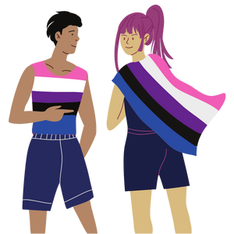
Definitions: Transgender, Queer or Questioning
T: Transgender – A person whose gender is not the same as the sex assigned at birth
Q: Queer – A term for anyone not cisgender or heterosexual
Q: Questioning – A person who is unsure and/or exploring their sexual orientation or gender identity
Notes:
Background Knowledge
Here are some definitions to help you understand some of the terms that LGBTQ2S+ stands for:
Transgender: A person whose self-identified gender identity, is not the same as the sex assigned at birth.
Queer: Historically, a negative term for LGBTQ2S+ people that has been reclaimed by the community as a term for anyone who is not cis gender and/or heterosexual. That’s why you will sometimes hear the LGBTQ2S+ community referred to as the queer community.
Questioning: A person who is unsure or is exploring their sexual orientation or gender identity.
References:
Teaching Sexual Health (2022}. Sexual & Gender Diversity: Words You May Hear. https://teachingsexualhealth.ca/parents/information-by-topic/sexual-diversity/
Image from Canva

Slide 36
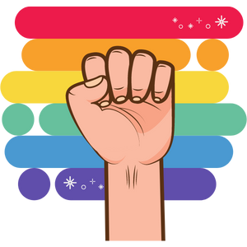
‘Coming out of the Closet’
Telling people about one’s sexual orientation or gender identity.
The process of coming out can be scary for members of the LGBTQ2S+ community.
It is important for the individual to decide what information to share and when it is safe to share with others.
Notes:
General Information
Coming out:
The term ‘coming out of the closet’ is usually when a person tells other people about their sexual orientation or gender identity. However, for people who identify as part of the LGBTQ2S+ community, “coming out” is often something they have to do throughout their daily lives, as they meet and interact with new people.
It may seem overwhelming to think about revealing your sexual orientation or gender identity to your social circle, particularly if it is different from the people around you.
One thing to remember is that sometimes it takes people longer to “come out”. If they’ve confided you with this information and ask you to keep it a secret, you must respect this person’s decision because it is up to them when they want to tell others.
The process of coming out to family, friends, or others can be a very scary process for members of the LGBTQ2S+ community. The next few slides discuss how you can offer support, and make it an easier process.
Check out the following resource for Support and Networking that people might find helpful if hey are trying to “come out”: https://www.sexandu.ca/lgbttq/coming-out/#tc3
References:
Teaching Sexual Health (2022}. Sexual & Gender Diversity: Words You May Hear. https://teachingsexualhealth.ca/parents/information-by-topic/sexual-diversity/
It Gets Better Project. (2022). LGBTQ+ Glossary. https://itgetsbetter.org/blog/lesson/glossary/
Image from Canva

Slide 37
Creating a Positive Environment
Help everyone in your classroom feel valued and respected
Be a safe and supportive friend
Provide space for people to feel comfortable and welcomed
Notes:
General Information
What creates a positive environment?
Now that we have covered some of the basics, we wanted to take some time to discuss another very important component to supporting the LGBTQ2S+ community, and that is our environment. This can include anything from the physical room/space itself, the resources accessible within the space, or the general attitudes amongst the people within that space, whether it is a classroom, health clinic, community setting, someone’s home, a sports team, etc.
Background Knowledge
Some key components that have an impact on these environments can include...
Representation: Representation is so important. Seeing yourself represented in different aspects of the world, helps us feel valued in society. This is especially important for those who are of minority population groups such as the LGBTQ2S+ community.
This includes representation on social media, TV, posters on walls, pictures in school textbooks, examples in homework questions, and so much more. It is also important to note that this representation should be POSITIVE in nature, and should certainly not be perpetuating inaccurate or unjust stereotypes and/or heteronormative values.
Support networks/family acceptance: Fear of a lack of understanding or acceptance from family and/or friends is often a huge struggle faced by people of the LGTBQ2S+ community.
Many times it pushes individuals to stay “in the closet” for longer periods of time, or to simply deny a part of their identity.
That is why it is SO IMPORTANT that as allies, we make sure our friends and family know that we are a safe and supportive person to come to in times when they might be struggling. When someone of the LGBTQ2S+ community has supportive family and friends, it makes their coming out journey and overall experience exceptionally more positive.
Having said that, when someone does not have supportive family and/or friends, there are many other great support networks out there for them to access, including many online communities, peer support programs, LGBTQ2S+ specialized healthcare professionals, LGBTQ2S+ support phone lines, and so much more. We will share some of these resources in more detail at the end of this presentation.
Visual Support: Other signs of safe and accepting spaces: Displaying pride flags and pride logos is such a simple yet impactful way for people, institutions and businesses to show their support, and in turn this helps people of the LGBTQ2S+ community feel more comfortable and accepted in that space. Having gender-neutral bathrooms in spaces is another huge sign to someone of the LGBTQ2S+ community that they are supported, especially for individuals who do not identify as “cisgender.”
Inclusive Language: Spaces that use inclusive language is another sign that the environment is accepting. This can be noted on things such as surveys, school permission forms, legal/government documentation, etc.
These forms should be neutral, and not assume family dynamics, gender, sexual orientation, or sexual identity.
This should also be something people consider when speaking with others, even within your peer groups at school. It is important not to assume someone’s pronoun or orientation by asking questions such as “do you have a BOYFRIEND?” when talking to a female, or “what does your wife do” to a male grown-up who is wearing a wedding ring on his finger, or saying things like “he’s going to be a lady’s man one day” about a younger boy in kindergarten. Instead, you should use terms like, “do you have a PARTNER?” or “what does your spouse do for work?” Part of using inclusive language also includes addressing someone using their appropriate pronoun. So if you don’t know this about someone, you should wait for them to disclose this to you, or ask, “What are your pronouns?”
Reference:
North Bay Parry Sound District Health Unit. (n.d.). Health Topics – LGBTQ2S+: Positive Spaces and Other Training. https://www.myhealthunit.ca/en/health-topics/positive-spaces-and-other-training.asp
Image from Canva

Slide 38
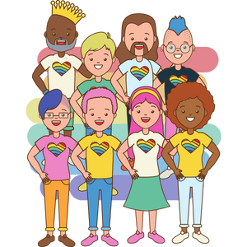
Becoming an Ally
Educate yourself
Be a role model
Be supportive
Take action
Be respectful
Notes:
General Information
How to be an ally
As we mentioned, an ally is a person who promotes or supports the human, civil and sexual rights of sexual and gender minorities. We’re going to talk about the ways that you can be an ally for people in your life who may identify as someone from the LGBTQ2S+ community. Remember, even the smallest actions can bring about changes.
LGBTQ+ allies are critical to the success of the movement to accept and embrace sexual diversity.
Educate yourself.
It’s important to educate yourself about sexual and gender diversity. Remember that heterosexual and cisgender identities are often times thought of as ‘normal’ in our society. Try and think about what you can do to challenge this norm! Try and think about how you can make sure your language is more inclusive.
Be a role model and set a positive example for those around you.
If you use anti-LGBTQ2S+ language and slurs, stop. Don’t laugh at jokes making fun of a person’s sexual orientation, gender identity or gender expression. Use gender inclusive language and don’t assume someone’s sexual orientation or gender identity.
Continue to do what you have always done together. LGBTQ+ people often fear that coming out will change most aspects of their lives, especially the nature of their relationships with family and friends; this can be overwhelming and frightening to think about.
Be supportive and respond in a positive way.
It takes a lot of courage for a person to come out. If you make a mistake, say sorry and move forward.
Use this opportunity to learn and grow. After all, we’re all human. If someone discloses to you their sexual orientation it means they trust you.
Be respectful, open minded and non-judgmental. Keep your conversations private. This is their story to tell. Not yours. A person can choose who they tell and don’t tell about their gender or sexuality. It’s for their own comfort and safety.
If someone comes out to you regarding their sexual orientation or gender identity, you should ask who else knows, and who they DO NOT want to know.
Ask the person that has come out to you what they need.
Take action.
Identify and address inappropriate behaviour or actions. If you see someone being bullied for their gender identity or sexual orientation, speak up. We want to create a safe space for everyone, regardless of a person’s gender or sexual orientation.
If you aren’t part of the solution, you are part of the problem.
Be respectful.
If one of your friends has come out to you, you can feel good that they have reached out and trusted you to help them work through some of the challenges that they may face.
You may be curious, but be sensitive when asking questions. Respect the person’s privacy – it is up to them to decide when and how they tell you, and others, as well as how much information they feel comfortable sharing.
Teacher prompt:
“Gender identity, gender expression, and sexual orientation are connected to the way you see yourself and to your interactions with others. Understanding and accepting your gender identity and your sexual orientation can have a strong impact on the development of your self-concept. Young people can develop positively if they understand their gender identity and their sexual orientation and if these are respected by themselves, their family, and their community. What kind of support do people need to help them understand their gender identity and their sexual orientation?”
Sample response “It is important for people to have role models that they can relate to – for example, people of similar ages or cultures. It’s also important to have all gender identities and sexual orientations portrayed positively in the media, in literature, and in materials we use at school. When we treat everyone with respect and kindness, we provide the support that people need. Family, school, and community support are crucial. Additional help can come from trusted adults, community organizations, and school support groups such as gay-straight alliances.”
Reference:
Teaching Sexual Health (2022}. Sexual & Gender Diversity: Words You May Hear. https://teachingsexualhealth.ca/parents/information-by-topic/sexual-diversity/
Sex & U. (n.d.). LGBTTQ+ Coming Out: Supporting Someone Who Has Come Out. https://www.sexandu.ca/lgbttq/coming-out/#tc2
Image from Canva

Slide 39
Allyship – Do’s
Use gender neutral and inclusive language
Listen to 2SLGBTQ+ people and support them
Be careful not to disclose any personal information that is not yours to share
Challenge homophobic/transphobic comments and/or jokes in public and private spaces
Do not make assumptions about someone’s gender identity or sexual orientation
Notes:
General Information
Do:
Use inclusive language such as “partner” or “significant other”, instead of “boyfriend/girlfriend” or “friends” and “folks”, instead of “guys”; “parents” instead of “mom/dad” or “mother/father”
Don’t:
Avoid using heteronormative language.
Do not make assumptions because it is a way of showing respect and honouring diversity
Do not let someone coming out determine how you treat them or act around them…
When someone discloses their sexual orientation and/or gender identity, you should still treat them in a positive and respectful manner, and appreciate that their decision to tell you could have been difficult.
LGBTQ+ people often fear that coming out will change most aspects of their lives, especially the nature of their relationships with family and friends; this can be overwhelming and frightening to think about.
Background Knowledge
Many people use words that assume everyone is heterosexual (also known as “straight”). Heterosexual means a person who is physically or sexually attracted to the opposite sex. This is called heteronormative language. For example, a form that asks for ‘mother and father’s names’ assumes that all kids have two “straight” parents. Saying ‘when a girl grows up and has a boyfriend’ assumes that all girls are straight and are attracted to boys. This kind of language reinforces stereotypes and assumptions about who people are, who they are attracted to, and who they can love. When we make assumptions about people’s orientations or relationships, we may be telling them that anyone who does not fit such an expectation is ‘abnormal’, ‘different’, or just not part of the ‘typical human experience”. Using inclusive language that does not make assumptions is a way of showing respect and honouring diversity as a strength. You can’t assume someone’s sexual orientation by looking at them.
Great resources for understanding how to be an ally to all orientations and identities →
Sexuality Do’s and Don’ts: https://www.dailyuw.com/special_sections/sexuality-do-s-and-don-ts/article_a0bcbcc0-0d3d-11e8-bc25-8fb582324307.html
Jubenvill, H. (2020). Edmonton Federation of Community Leagues – LGBTQ+ Do’s and Don’ts: A Guide to Being Respectful and Inclusive of LGBTQ+ Community Members. https://efcl.org/wp-content/uploads/2020/04/LGBTQ-Dos-and-Donts.pdf
The Network/La Red (2017). Some Do’s and Don’ts for working with LGBQ/T Folks. https://avp.org/wp-content/uploads/2017/04/TNLR_Dos_and_Donts_Working_with_LGBTQ.pdf
Image from Canva

Slide 40
Final Activity: Scenario
One of your classmates has recently announced that they are changing their name and now identify as non-binary (pronouns they/them).
At recess you notice some of your classmates have started making fun of this student and are calling them names.
What could you say to stand up to your classmates and show that you are an ally?
Notes:
Teacher Prompt:
How can you be an ally in this situation? What could you say to the bullies?
Sample Responses:
What to do:
Tell the students that it is not ok to say the things they are saying, in fact it is mean and disrespectful
Use the name the person asks you to use
If you’re unsure what pronouns they use, ask
Recognize that you don’t have to understand what it means to be non-binary, but that you can still respect them
Speak up when someone makes homo/bi/transphobic or heterosexist remarks
Be aware and recognize your own beliefs, but still respectful of others
What not to do:
Join in because you think its funny
Purposely use the persons previous name
Continue using the wrong pronouns without correcting yourself or allowing to be corrected by others
Using inappropriate nicknames (i.e., he/she, it, thing)
For further class discussions, use The Trevor Project on How to Be an Ally to Transgender and Non-binary People. PDF Link: https://www.thetrevorproject.org/wp-content/uploads/2020/03/Guide-to-Being-an-Ally-to-Transgender-and-Nonbinary-Youth.pdf
Background Knowledge
Concepts to Consider Discussing:
homophobia. According to the Ontario Human Rights Commission, “the irrational aversion to, fear or hatred of gay, lesbian or bisexual people and communities, or of behaviours stereotyped as ‘homosexual’.” (From Teaching Human Rights in Ontario: A Guide for Ontario Schools.) (Health and Physical Education Curriculum – OME, 2019, p. 308).
transphobia. According to the Ontario Human Rights Commission, “the aversion to, fear or hatred or intolerance of trans people and communities.” (From Policy on Preventing Discrimination because of Gender Identity and Gender Expression.) (Health and Physical Education Curriculum – OME, 2019, p. 316).
Photo Reference:
Shutterstock_2092101421 (image on left side of slide)
Image from Canva (checklist on right side of slide)

Slide 41
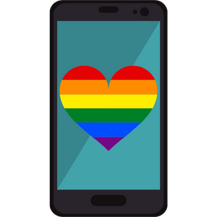
Support
Quest Community Health Centre
145 Queenston Street, St. Catharines
905-688-2558
Niagara Falls Community Health Centre
4790 Victoria Ave, Niagara Falls
LGBTQ2S+ Support Coordinator
Call/Text 289-321-0588
Notes:
General Information
Support
Niagara Falls Community Health Centre. You can reach out to Celeste, a LGBTQ2+ Support Coordinator. They offer 1-on-1 support, group programming, and family education. You can call or 289-321-0588, or email them at cturner@nfchc.ca.
Quest Community Health Centre, Rainbow Niagara 2SLGBQT+ Services. Offers primary care, trans specific healthcare, assessment and referral, mental health counselling, and much more. https://questchc.ca/participate-at-quest/rainbowniagara
Image from Canva.

Slide 42
Support
LGBT Youthline (youthline.ca)
Confidential peer support line
Call or Text: 905-688-2558
Niagara-on-the-Lake Regional Native Centre:
905-688-6484
Fort Erie Native Friendship Centre: 905-871-8931
Notes:
General Information
LGBT Youthline. Confidential, non-judgmental, and informed peer support through text, phone, and chat services. They can be reached at 647-694-4275 or through their website, https://www.youthline.ca/
Niagara Region Friendship Centres:
Fort Erie Native Friendship Centre → https://www.fenfc.org/
Phone #: 905-871-8931
796 Buffalo Road, Fort Erie, Ontario
Niagara Regional Native Centre (Niagara-on-the-Lake) → https://ofifc.org/friendship-centre/niagara-regional-native-centre-niagara-on-the-lake/
Phone #: 905-688-6484
382 Airport Road R.R.#4, Niagara-on-the-Lake, Ontario L0S1J0
Niagara Regional Native Centre → https://nrnc.ca/
Main Centre
382 Airport Road
Niagara-on-the-Lake, ON L0S 1J0
Phone: 905-688-6484
Fax: 905-688-4033
Literacy and Employment
15B-140 Welland Avenue
St Catharines, ON L2R 2N6
Phone: 905- 685-8547
Indigenous Community Justice Programs
18-140 Welland Avenue
St. Catharines ON L2R 2N6
Phone: 905-685-5246
Soaring Eagles Elementary and Secondary Alternative Schools
3024 & 3054 Orchard Hill
Fonthill, ON L0S 1E6
Phone: 905-892-3578 / 905-892-9111
Image from Canva.

Slide 43
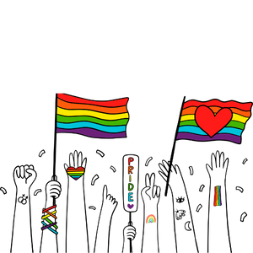
Additional Community Resources
Egale
Rainbow Health Ontario
PFLAG St. Catharines and Niagara
Transgender Niagara
OUT Niagara
Notes:
General Information
Niagara Region Sexual Orientation and Gender Identity Resources: https://www.niagararegion.ca/living/health_wellness/sexualhealth/orientation.aspx
Egale → https://egale.ca/ (https://egale.ca/awareness/supporting-gender-diverse-child/)
Rainbow Health Ontario → https://www.rainbowhealthontario.ca/
Pflag Niagara Region → https://sites.google.com/pflagcanada.ca/pflagniagara/
Transgender Niagara → http://www.transgenderniagara.com/
OUT Niagara → https://www.outniagara.org/
Rainbow Niagara → https://www.queerevents.ca/community-resources/community-resources/rainbow-Niagara
Image from Canva

Slide 44
More Questions? Talk With Someone:
Parents/ Guardian
Teacher/ Principal
Doctor or Health Care Provider
School Health Nurse
Child and Youth Worker
Kids Help Phone
Friendship Centre
Notes:
General Information
There are many people and places you can reach out to in order to get help or ask questions about relationships and sexual health. If you ever have questions/concerns, need help or know someone who needs help, you can always talk to someone. There are many options out there available to you.
Among these are:
A trusted adult (such as a parent or teacher)
A health care provider (such as a doctor or nurse)
A child and youth worker
The school health nurse
The school social worker
Kids Help Phone
Friendship Centres
Services for Youth - Niagara Region, Ontario → https://www.niagararegion.ca/health/schools/youth-services.aspx
Other community resources:
Kids Help Phone: Call 1-800-668-6868 or https://kidshelpphone.ca/
Additional Niagara Region Sexual Orientation and Gender Identity Resources: https://www.niagararegion.ca/living/health_wellness/sexualhealth/orientation.aspx
Egale → https://egale.ca/ (https://egale.ca/awareness/supporting-gender-diverse-child/)
Rainbow Health Ontario → https://www.rainbowhealthontario.ca/
Pflag Niagara Region → https://sites.google.com/pflagcanada.ca/pflagniagara/
Transgender Niagara → http://www.transgenderniagara.com/
OUT Niagara → https://www.outniagara.org/
Rainbow Niagara → https://www.queerevents.ca/community-resources/community-resources/rainbow-Niagara
Image from Canva.

Slide 45
Kids Help Phone
Notes:
General Information
Kids Help Phone: Canada’s only 24/7, national support service. They are a confidential service that offers professional counselling, information and referrals, and volunteer-led support to young people in both English and French. You can call Kids Help Phone at 1-800-668-6868, or text and live chat at https://kidshelpphone.ca/.
Photo Reference: Jack.org (2022). Educational Social Media Posts: Kids Help Phone Social Media Pack. https://jack.org/Resources/COVID-19-Youth-Mental-Health-Resource-Hub?lang=en-ca

Slide 46
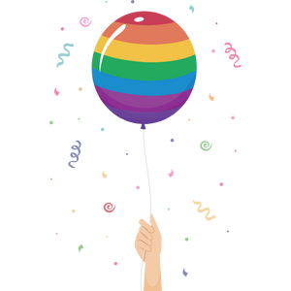
Final Thoughts
Accept and support everyone for who they are
Treat others how you would want to be treated
Allow people to “come out” on their own terms
Always respect others and their identities
Allies are important in accepting and embracing gender and sexual diversity
Notes:
General Information
LGBTQ+ allies are critical to the success of the movement to accept and embrace sexual diversity.
Image from Canva

Slide 47
Questions?
Notes:
Image from Canva

