Slide 1
Sexually Transmitted Infections

Slide 2
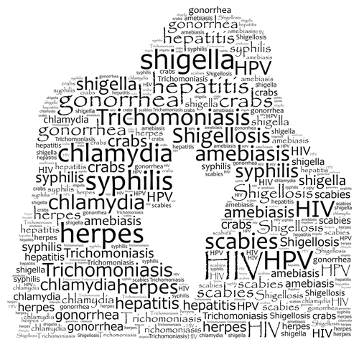
What is a Sexually Transmitted Infection (STI)?
What is a Sexually Transmitted Infection (STI)?
Contracted through sexual contact with someone who is infected
Most transmitted through bodily fluids
Some transmitted by skin to skin contact
Notes:
An STI is a contagious or infectious condition passed from one person to another during the exchange of body fluids – i.e. semen, vaginal secretions, blood, breast milk, and shared needles.
STIs can be passed on during oral sex, vaginal sex or anal sex. Some can even be passed on by skin-to-skin genital contact.
If student questions STD label: comment that it was relabeled to STI because technically most diseases cause symptoms and affect the functioning on the body whereas infections can have no symptoms for years or they have mild signs and symptoms that can be easily overlooked
N.B. :half of all cases of STIs occur between the ages of 15 to 24 years

Slide 3
I feel great…
Often there are no symptoms
You can have an STI and not even know.
Notes:
You cannot tell if someone has a STI by just looking at them.
Often there are no signs or symptoms but the infection is still causing damage.
You can pass on an infection and not even know that you yourself are infected.
Reinforce importance of communication with partner and testing.

Slide 4
Common Sexually Transmitted Infections
Common Sexually Transmitted Infections
Chlamydia
Caused by bacteria
Can be cured
Gonorrhea
Syphilis
Herpes
Caused by virus
Cannot be cured
Can treat only the symptoms
Genital Warts (HPV)
HIV
Notes:
COMMENT: There are many STIs, some are more common than others.
This chart identifies the most common STIs:
The first 3 are caused by bacteria and can be cured using antibiotics (as long as you don’t re-infect yourself)
The last 3 are caused by viruses. They cannot be cured but their symptoms can be managed / treated.

Slide 5
Symptoms
Symptoms
Bumps
Sores
Rash
Burning/pain when urinating
Deep abdominal pain
Pain/swelling of the testicle
Unusual discharge
Pain during/after intercourse
Itching
Unusual vaginal bleeding
Notes:
As the previous slide mentioned, some STIs have NO symptoms. Others may take time before symptoms are present.
Here are a few symptoms a person may experience
The important thing is to know your bodies. Get comfortable with your reproductive parts. Know what is normal and what is not normal for you.
If you notice something has changed, then you need to seek medical care.
It may not even be an STI but you will not know, unless you get checked.

Slide 6
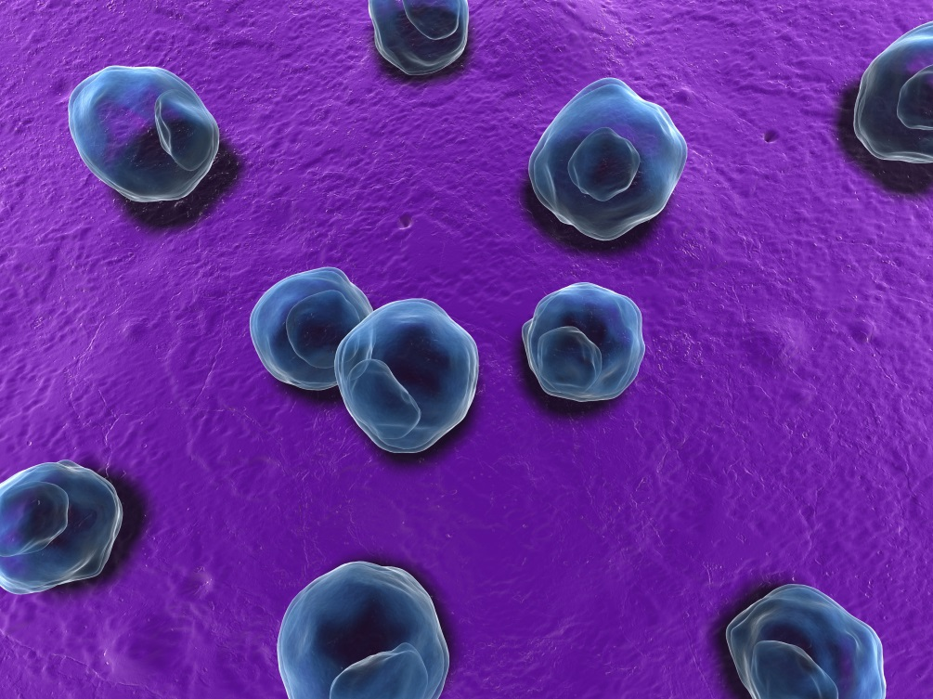
Chlamydia
Chlamydia
Most common bacterial STI in Canada
Most cases in 15-24 year olds
80% of women and up to 60% of men have NO signs or symptoms
Notes:
Most common bacterial STI in Canada
Symptoms:
Most people have no symptoms, but for those who do experience symptoms, they may include:
Itching, unusual discharge , pain or burning when going pee, sore throat (if contracted from oral sex). Infection can also spread to the eyes by touching an infected area and then touching the eye.
Women: pain in lower abdomen and bleeding between periods or during / after sex.
Men: pain or swelling of the testicles.
Symptoms may appear between 2 days to 2 weeks or longer after contact.
Spread:
Unprotected sexual intercourse (oral, vaginal & anal) by contact with infected partner.
Condom breaks
Test:
Usually: Pee in a cup (ask your school nurse about convenient way to be tested in your community/school)
Occasionally: Swab of cervix (Sexual Health Centre, Dr.’s office / walk in clinic)
Treatment:
Antibiotics ( which are free, and available from your school PHN or the SHC and some walk-in clinics )
Possible complications if left untreated:
Infertility
Women : Chronic Pelvic Pain, Pelvic Inflammatory disease (PID), increased risk of ectopic pregnancy (pregnancy in the tubes).
Men: Infection in the tubes that carry sperm (epididymitis), swollen testicles

Slide 7
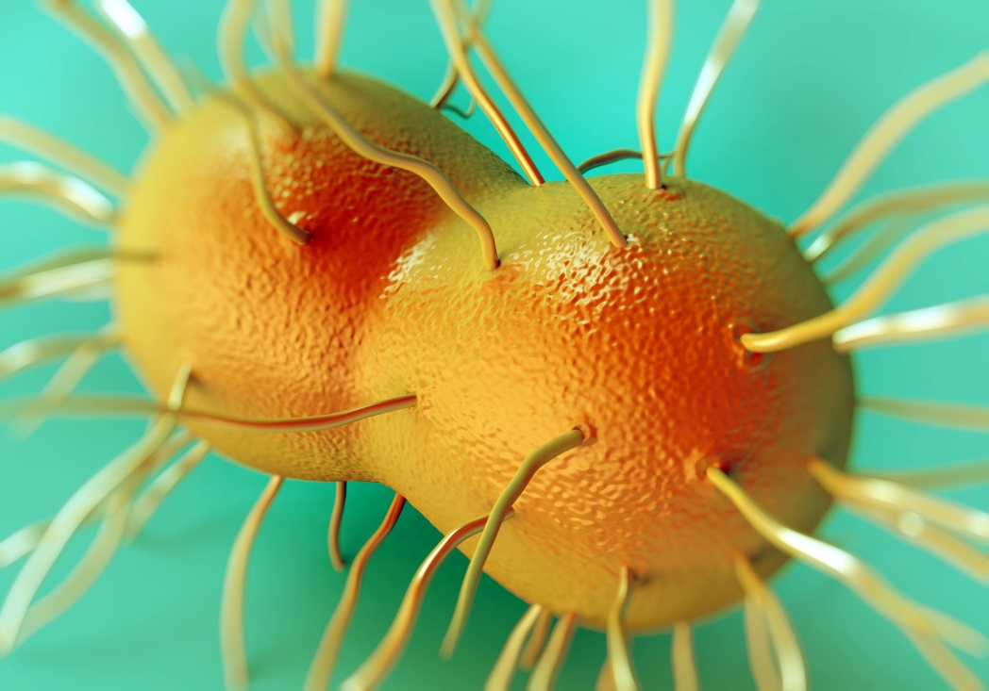
Gonorrhea
Gonorrhea
Second most common bacterial STI in Canada
Most cases in 15-29 year olds
Most people show no symptoms
Notes:
2nd most common bacterial infection
Symptoms:
Most people have no symptoms, but for those who do experience symptoms, they may include:
Itching, unusual discharge, pain or burning when going pee, sore throat (if contracted from oral sex). Infection can also spread to the eyes by touching an infected area and then touching the eye.
Women: pain in lower abdomen and bleeding between periods or during / after sex.
Men: pain or swelling of the testicles.
Symptoms may appear between 2 days to 2 weeks or longer after contact.
Spread:
Unprotected sexual intercourse (oral, vaginal & anal) by contact with infected partner.
Condom breaks
Test:
Usually: Pee in a cup (ask your school nurse about convenient way to be tested in your community / school)
Occasionally: Swab of cervix (Sexual Health Centre, Dr.’s office / walk in clinic)
Treatment:
Antibiotics ( which are free, and available from your school PHN or the SHC )
Possible complications if left untreated:
Infertility
Women : Chronic Pelvic Pain, Pelvic Inflammatory disease (PID), increased risk of ectopic pregnancy (pregnancy in the tubes).
Men: Infection in the tubes that carry sperm (epididymitis), swollen testicles

Slide 8
Syphilis
Rates in Canada are increasing
Most common in men who have sex with men
Painless sore
Rash, hair loss, body aches
Years later may cause damage to major
body’s organs
Notes:
Rates are increasing in Ontario and Niagara. Most common in men who have sex with men. (transmitted through unprotected, oral, anal and vaginal sex)
Symptoms:
Primary: starts as a painless sore (ulcer) where the bacteria enters the body. You may not even realize you have this sore. This sore then heals and goes away in about 3-6 weeks.
Secondary: Skin rash, usually on the palms of the hands and soles of the feet, fever, lethargy, muscle aches, joint pain, swollen lymph nodes, vision changes, patchy hair loss
Tertiary: damage to the heart, lungs, brain (neurosyphilis).
Test: blood testing - at Sexual Health Centre, Dr’.s office or walk in clinic.
Treatment: penicillin injections

Slide 9
Genital Warts (HPV)
Genital Warts (HPV)
Most common STI in Canada
Single or clusters in genital warts
Soft, hard, round, flat, cauliflower-like
Many people have no symptoms of HPV
Notes:
Over 100 types of HPV – some can lead to cancer
Gardasil Vaccine protects against many cancer causing strains
Once infected this virus lives on the skin of the genitals
Symptoms:
Many people have no symptoms however others may develop genital warts within 1-8 months.
Warts can be single or found in clusters in and around the genital area (penis, scrotum, vaginal walls, cervix, vulva, anus)
Warts may be round, flat or cauliflower – like shaped bumps that are flesh / yellow/ gray coloured.
Itching bleeding/discomfort with sex – not painful (just like any other warts)
Spread:
Direct sexual contact (vaginal/anal). Intimate contact (genital rubbing). HPV can be spread through oral sex
Can be spread even if no warts are present
Condom may not fully protect you (WHY? – only covers the penis)
Test:
Checked by a Doctor or Nurse Practitioner if bumps are showing
Treatment:
There is no cure to eliminate HPV infection.
The good news is that most warts will go away by themselves over time.
For people who want treatment - a doctor or nurse practitioner may freeze the wart with sprays, or liquids depending on the type of wart and where it is. Sometimes a special cream can be ordered that helps the immune system fight HPV.
Most symptoms clear within 2 years
The warts can reappear
Important Information:
Avoid sex when tingling/burning starts until lesions have completely healed.
It is important for women to have regular Pap tests done after the age of 21.
Complications:
Re-occurrence, cancers, depression and sexual dysfunction
Prevention:
Gardasil Vaccine

Slide 10
Herpes
Herpes
Viral - yours for life
Herpes Simplex Virus Type 1 - Oral Herpes
Herpes Simplex Virus Type 2 - Genital Herpes
Sores go away and come back during “outbreaks”
Notes:
QUESTION: DID YOU KNOW THAT THERE ARE 3 DIFFERENT TYPES OF HERPES VIRUS. HERPES ZOSTER (Chicken Pox and Shingles) , HSV 1 AND HSV 2. TWO OF THESE ARE SEXUALLY TRANSMITED
We are going to talk about HSV1 AND HSV2
.
HSV1 – Oral Herpes in the form of cold sores : may or may not be transmitted sexually (i.e. can get from kissing – even when grandma thanks you for your Christmas present)
HSV2 – Genital Herpes - always transmitted sexually
Once infected this virus can show on the skin of the genitals
Symptoms:
You may not know. Some people have the virus, but have no symptoms, and can pass the virus anyway (asymptomatic shedding)
Symptoms may start up to 3 weeks after having skin to skin contact with an infected person
Often the first infection is the worst
Blisters / sores
Rashes
Pain, tingling, itching
Aches and chills (flu-like symptoms)
Symptoms usually get better within 2 weeks
Spread:
Skin to skin contact
Can be spread even if no sores are showing
Condom /dental dam may not fully protect you
Infected pregnant women can pass virus to infants during birth. If you are pregnant and have genital herpes, please tell your health care provider.
Test:
Swab can be done when sores are showing
Treatment:
Anti-viral medication available to help lessen pain and shorten / prevent outbreak
This virus you have for life with periods of active and inactive “outbreaks”
After sores heal, recurrent outbreaks can occur – they can recur every month or every year (different for every person)
Outbreaks may be triggered by: stress, sex, menstrual cycle, exposure to sun, illness / fever, surgery, pregnancy and use of some medications
Prevention:
Condoms /dental dams have limited effectiveness at preventing infection as they don’t cover entire genital area.
If you have herpes wash hands well after touching any sores or blisters to prevent spreading to another person or another part of your body
Important Information:
If you give or get oral sex from someone who has oral herpes (cold sores) you can get the infection from them
- can be passed by receiving oral sex from a partner with a history of cold sores.
*Important to discuss history of cold sores with partner
*Outbreaks occur where virus first entered the skin
Transmitted through direct vaginal, oral or anal sexual contact with infected partner.
.
.
FYI ONLY: Health Risk
Pain and discomfort.
Emotional effects due to the on-going nature of the disease and the unpredictability of outbreaks.

Slide 11
HIV/AIDS
HIV/AIDS
Human Immunodeficiency Virus
Acquired Immunodeficiency Syndrome
Viral - yours for life
May go undetected for years
Notes:
This virus lives in blood, semen, breast milk, and vaginal fluid
Symptoms:
Many have no symptoms
Some will have symptoms like fatigue, loss of appetite, night sweats, etc
Spread:
Unprotected oral, vaginal or anal sex with an infected partner (Sex without a condom or a condom breaks)
Direct contact with infected blood (sharing needles, drug equipment)
Test:
Window Period: HIV may take 12 weeks to show in the blood
Test will only be accurate if taken 12 weeks after last high risk activity
Blood test
Treatment:
No cure,
Drugs are available that can control HIV infection to keep you healthy longer
Prevention:
ALWAYS use a condom
Do not share needles or other objects that may contain infected blood (razors, toothbrushes etc.)

Slide 12
Other Women’s Health Concerns
Other Women’s
Health Concerns
Yeast
Not an STI
Bacterial Vaginosis
Common infection of the vagina
Trichomoniasis
Caused by a parasite -
usually transmitted sexually
Notes:
Some of these are present in men, but most commonly found in women.

Slide 13
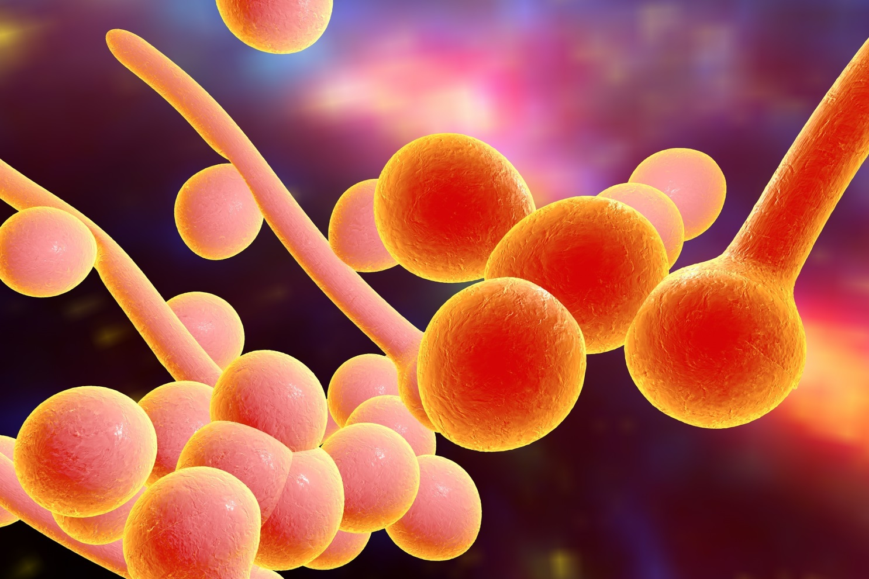
Yeast
Yeast
Notes:
A yeast infection is a common problem for women. It is not necessarily a sexually transmitted infection. Yeast naturally occurs in a woman’s vagina, and it can cause symptoms when it overgrows.
This sometimes happens when women use antibiotics, or when they have other illnesses that weaken their immune system.
Symptoms:
Vaginal itching
Swollen or red genitals
Thick white vaginal discharge that looks like cottage cheese
Pain when peeing
pain during sex
Test:
Physical exam including vaginal swab
Treatment:
Antifungal medication
Prevention:
Never put anything into your vagina to clean it (i.e. douche)
Use only soap and water to clean your genitals

Slide 14
Bacterial Vaginosis
Bacterial Vaginosis
Notes:
BV is a common infection of the vagina. It happens when too much of one type of normal bacteria overgrows. This infection is usually harmless.
Symptoms:
A grayish-white discharge from the vagina
The discharge may have a fishy smell
Test:
Physical exam including vaginal swab
Treatment:
Antibiotics ( which are free, and available from your school PHN or the SHC )
Prevention:
Never put anything into your vagina to clean it (i.e. douche)
Use only soap and water to clean your genitals

Slide 15
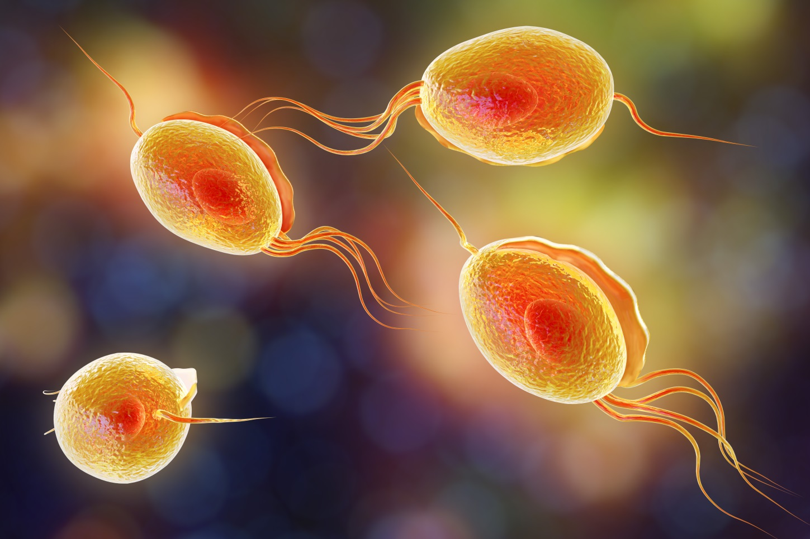
Trichomoniasis
Trichomoniasis
Notes:
Trichomonas is a parasitic infection of the penis or vagina..
Symptoms:
Grey, yellow, or green discharge from vagina or penis
Discharge may be thin, bubbly and smell bad
The vagina or penis may be red, itchy or sore
Pain with sex and / or peeing
Spread:
It is usually caused by having sex with someone who has it.
It can live on wet objects such as towels and washcloths
Test:
Physical exam including vaginal swab
Treatment:
Antibiotics ( which are free, and available from your school PHN or the SHC)
Partners need to be treated at the same time
Do not share towels while being treated

Slide 16
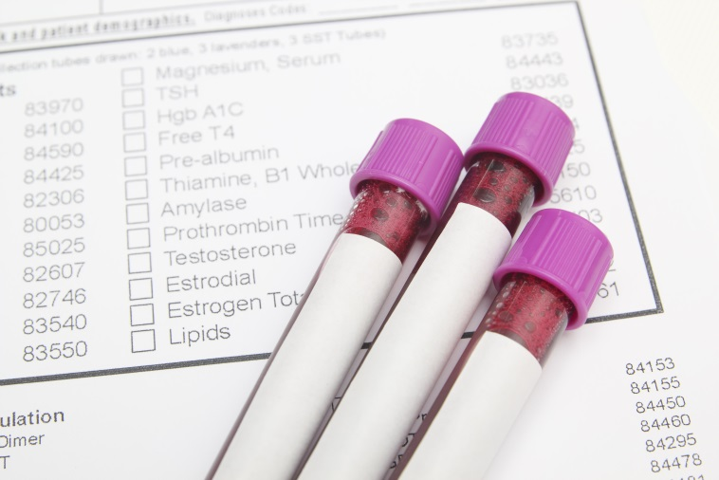
Testing
Testing
Blood
Urine
Physical Exam
Notes:
The early detection and treatment of STIs and Vaginal infections is crucial
Ask your school nurse about how to access convenient, free testing!

Slide 17
Abstinence
Abstinence
Abstinence is the most
effective way to prevent STIs
70% of teens are not having sex
Delay sexual activity until you are ready
Use a condom or dental dam with all sexual activity
Notes:
http://www.sexualityandu.ca/sexual-health/statistics1/statistics-on-sexual-intercourse-experience-among-canadian-teenagers
Most students at this age are not sexually active and students should not feel pressured to become sexually active before they’re ready.
Adolescents may feel that many of their peers are sexually active because of stories they hear and from media influences that portray young people who are sexually active. However, in the most recent Canadian Community Health Survey (2009/2010), in response to the question “Have you ever had sexual intercourse?” 30% of 15 to 17 year-olds and 68% of 18 to 19 year-olds reported that they had had intercourse (Roterman, 2012).
While postponing sexual involvement is the norm for this age group, some adolescents do choose to become sexually active for a variety of reasons. It is important that all students understand the risks involved with being sexually active.

Slide 18
Why do teens take risks?
Why Do Teens Take Risks?
They don’t know STIs are a serious problem
They feel uncomfortable talking about it
May be under the influence of drugs or alcohol
Pressure from partner to go without protection
Notes:
Even with all of the information youth have received in health classes , and all of the information available on the internet, some STI rates (i.e. chlamydia) continue to climb every year.
So, why do teens continue to take risks?
Do you have any thoughts on this??

Slide 19
Don’t Pass It On
Alicia
Jennifer
Nick
Marco
Kyle
Justine
Jessica
Dana
Eric
Notes:
Eric has a Sexually Transmitted Infection.
Eric names his sexual contacts.
Who did Eric get the infection from?
Who did Jessica get the infection from?
Where did Nick get the infection?
If Eric refuses to name one of his contacts, what will happen?
Is there any point in concealing contacts?
*Presenter’s Note: Some students may question male to male (Kyle to Marco).
Remind them that there are all different types of relationships. It may not be something they relate to, but likely someone else in the class does, and we need to be inclusive and respect everyone / all relationships.

Slide 20
Discussion with partner
Discussion with Partner
Before any sexual activity, talk to your partner about safe sex
Set expectations for condom / dental dam use
Get tested together
Notes:
There may be pressure from peers/partner to make certain decisions but in the end YOU are the one that makes the choice
That choice may also have risks/consequences that YOU have to deal with…NOT your peers/partner
Communication is very important in relationships. A person needs to make sure that they are both comfortable with their decisions, and that the people involved both know what the other feels comfortable doing.

Slide 21
Communication
If you are not comfortable talking with your partner about sex… you may not be ready.
Notes:
Communication is very important in relationships.
A person needs to make sure that they are both comfortable with their decisions, and that the people involved both know what the other person feels comfortable doing.

Slide 22
Consent
Consent
No means no
Intoxicated people cannot give consent
Consent is asking every time
Notes:
Consent for any sexual activity must be freely given.
Consent cannot be given by someone who is intoxicated, unconscious, or otherwise considered incapable of giving their consent.
As well, consent is not considered to be freely given if it follows from threats to personal safety, or threats to harm others.
Once sexual activity has begun, consent can be withdrawn at any time, and this can be indicated with either words or actions.
No always means no, even if you have initially agreed to sexual activity.

Slide 23
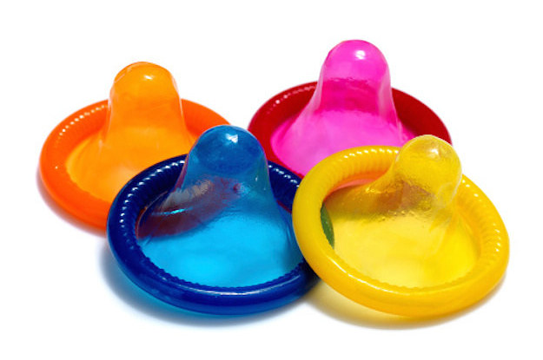
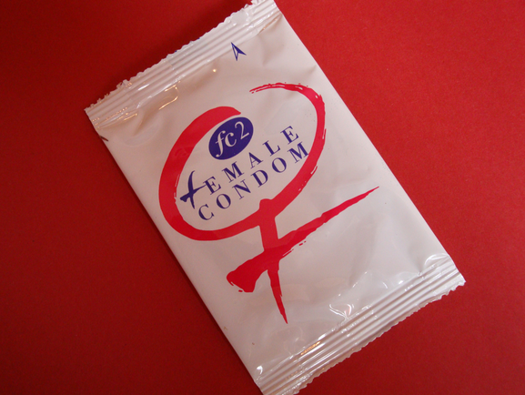
Condoms and dental dams
Condoms and Dental Dams
Free at Sexual Health Centre, and from your School Nurse
Purchase at drug stores, corner stores, gas stations
Notes:
Ask your school nurse about how you can conveniently access condoms / dental dams.

Slide 24
Using a Condom Video
Notes:
Video of condom demo:
https://www.youtube.com/watch?v=fbo9_0IgcFA

Slide 25
STI Myths
STI Myths
FACT?
FICTION?

Slide 26
STI Myths
TRUE
You can get an STI if it’s your first time having sex
FALSE
No symptoms = no STI?
FALSE
All STIs are curable
FALSE
Herpes will eventually go away on its own
TRUE
A person can give spread an STI
even if they don’t ejaculate
Notes:
There are many myths or stories about STIs (getting an STI from a swimming pool or toilet seats, etc.)
Make sure you are getting your information from reliable sources

Slide 27
Sexual Health Centres
Four Sexual Health Centres in Niagara
Provide free, non-judgmental, and confidential services
Aim to enhance the sexual health of our community
St. Catharines Sexual Health Centre
277 Welland Avenue, St. Catharines
Welland Sexual Health Centre
200 Division Street, Welland
Niagara Falls Sexual Health Centre
5710 Kitchener Street, Niagara Falls
Fort Erie Sexual Health Centre
1264 Garrison Road, Unit 12, Fort Erie
905-688-3817
1-800-263-5757
For current hours call or visit: niagararegion.ca/health
Notes:
The Sexual health Centre in your community provides free, confidential health information to anyone of age of consent.
Here are a few of the services that they provide. Your school nurse may also be able to provide some of these services in your school / community. Ask her!
Birth control information
STI testing and treatment
Pregnancy testing
Birth control at a lower cost (with doctor’s prescription)
Counselling for females and males
Plan B (emergency contraceptive pills)
Free condoms and dental dams

Slide 28
No Condom? No Sex
Protect yourself and your partner by practicing safer sex.
No condom? No Sex

