Slide 1
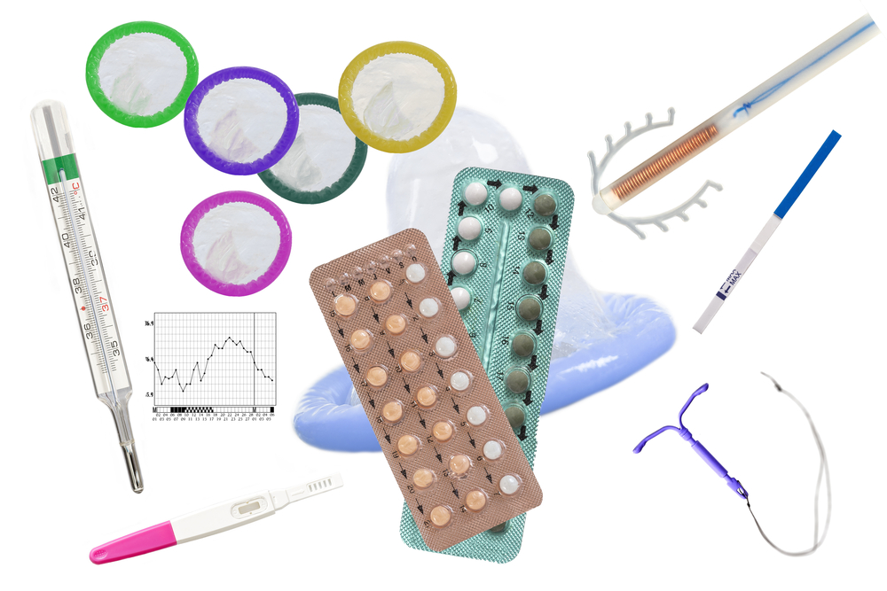
Contraception
Notes:
Why is it important to learn about contraception?
Teaching about contraception is not an assumption that students in class are sexually active. In fact, by the time they finish high school less than ½ of students will have had sexual intercourse. Factual information, however, is critical to make healthy decisions now and in the future
Adolescence is a time of change and experimentation with regard to everything from hairstyles to sexual expression. Teens are encouraged to feel independent, strong and mature in terms of decision-making.
Deciding when to have sexual intercourse is different for everyone. There is no "magical" age when someone is ready to have sex. There is no natural time in a relationship to start having sex, and there is no rule which says you must have sex with someone, even if you have been dating for a long time.
Sex should be a joyful, comfortable and guilt-free experience for both you and your partner. Respect yourself and know what you want. Remember, you always have the right to say "No" to sex, even if you have said "Yes" before!
What is the same for everyone, though, is that once a couple decides to have sexual intercourse there are consequences – and pregnancy is one of the most preventable consequences – by learning about and using contraceptives correctly.
CONTRACEPTION TEACHING KIT CAN ACCOMPANY PRESENTATION AS A VISUAL AID

Slide 2
Consent
No means no.
Mutual consent must occur before every sexual encounter.
Notes:
Consent for any sexual activity must be freely given, and can only be given at the time of the activity (not ahead of time). Consent cannot be given by someone who is intoxicated, unconscious, or otherwise considered incapable of giving their consent. As well, consent is not considered to be freely given if it follows from threats to personal safety, or threats to harm others. Once sexual activity has begun, consent can be withdrawn at any time, and this can be indicated with either words or actions. No always means no, even if you have initially agreed to sexual activity.
Under the Criminal Code of Canada, consent is defined "as a voluntary agreement to engage in sexual activity with another person."
The consent must be clearly expressed in words if the individual:
Consent cannot be given in the following circumstances and it is sexual assault if sexual activity occurs when:
A person is impaired by alcohol or drugs
A person is unconscious or sleeping
One of the participants is in a position of trust or authority (e.g. babysitter, teacher, coach, employer) over the youth
One of the participants uses intimidation or threats to coerce a person into sexual activity
An individual changes his or her mind and says no –and the action continues
One of the partners is 12-15 years old and there is a bigger age gap than the Criminal code allows. (see below) Consent can only be given within certain ages.
PRESENTER REFERENCE ONLY
It refers to the age that a person can legally consent to sexual activity. This law is in place to protect young people from being sexually exploited or abused by adults.
12 and 13 year-olds can consent to have sex with other youth who are not more than 2 years older than they are.
There is also a provision called the 5-year peer group provision, which states that youth aged 14 or 15 are able to consent to sex with partners who are no more than 5 years older than themselves.
It is very important to note that the close-in-age exception will NOT apply (so consent cannot be given) where:
The other person is in a position of trust or authority over the child (e.g. babysitter, teacher, coach, relative, priest/pastor/minister, employer)
The relationship is exploitative (e.g. prostitution, where the age difference is significant, where the older person has significant influence or control over the younger person, where the relationship began at a time when the older person was in a position of trust or authority);
The youth is dependent on the other person in some way (e.g. for food, shelter, etc.)
In the scenarios above, it is sexual assault.

Slide 3
Drunk
Notes:
Consent cannot be given by someone who is intoxicated, unconscious, or otherwise considered incapable of giving their consent. This includes alcohol, drugs, anything that impairs judgment. This can also be true of someone who is sober – watch body language as well as what they are saying.

Slide 4
Tea Consent Video
Notes:
https://www.youtube.com/watch?v=raxPKklDF2k
Before: Here’s a short video that helps describe the concept of consent.

Slide 5
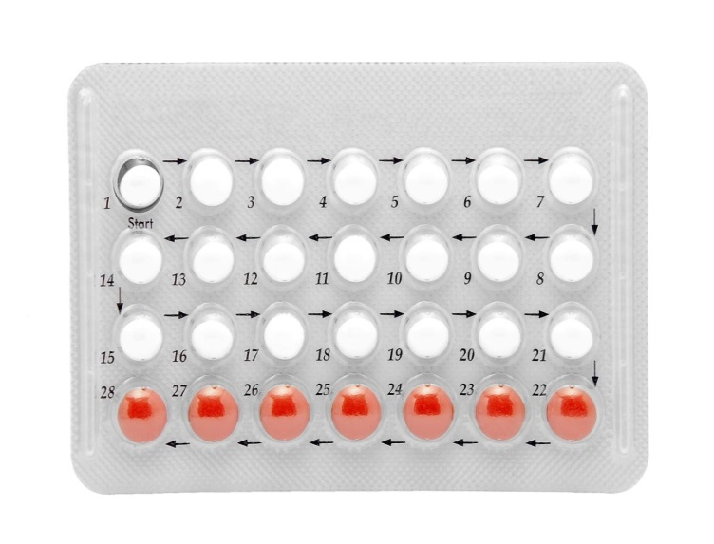
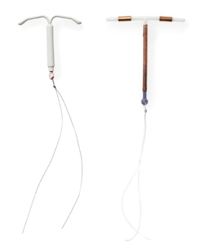
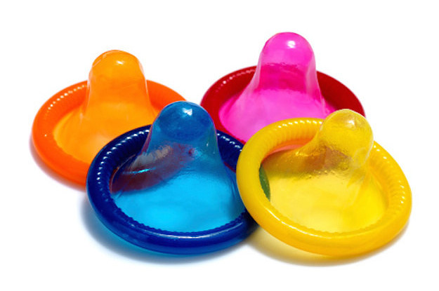
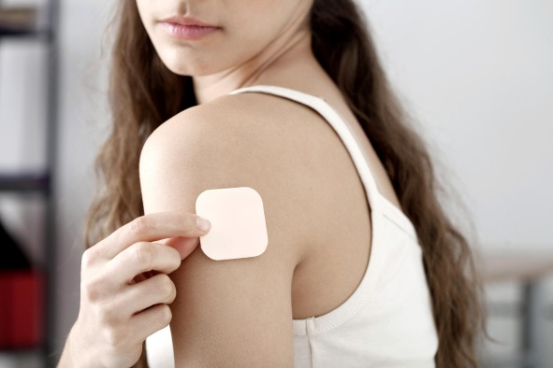
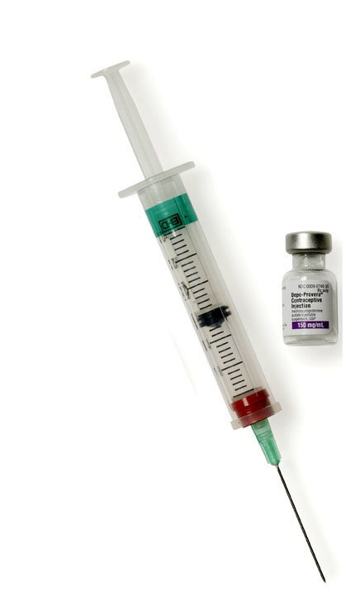
What is Contraception?
Notes:
Ask: What is contraception?
Answer: Methods to prevent pregnancy
At this point we will go through some of the most common and reliable methods of contraception. (click through next few slides)

Slide 6
Abstinence
Abstinence
100% effective
in preventing pregnancy and
sexually transmitted infections (STIs)
Notes:
What does Abstinence mean to you?
There are differing views on the definition of abstinence.
Discuss setting limits. Ask class to describe what this means.
People have to set limits for themselves, and communicate those limits to their partner.
This is the only 100% proven effective option for contraception. It is a great method for the beginning stage of a relationship to test understanding and feelings for each other.
There must not be any skin to skin contact in the genital area to be confident about pregnancy prevention and to prevent sexually transmitted infections.
When practicing oral sex, remember that mouth to genital contact can lead to sexually transmitted infections.
Also remember that sperm can travel and they have the ability to find their way into the vagina if ejaculation takes place at the entrance of the vagina. Be sure to keep a condom available, just in case you may need it.
NB : Abstinence is only 100% effective against pregnancy and STIs if there is NO sexual behaviour including skin to genital contact, genital to genital contact or exchange of bodily fluids.
Why is abstinence a good choice?
Effective protection from STIs and pregnancy.
Not ready for sex or not interested in the stress that is involved in having intercourse at an early age.
Wanting to spend time on other things; being focused on personal goals; sports, friends and to focus on personal growth
Religious beliefs, cultural beliefs; self-worth.

Slide 7
Barrier Contraceptive Methods
Notes:
Barrier methods of contraception work by creating a physical barrier between sperm and egg cells so that fertilization cannot occur. They also protect against STIs

Slide 8
Male/External Condoms
97% effective when used properly
Use before ANY genital contact
Protection against some STIs
Notes:
What is it?
The condom is a latex cover which fits over the erect penis and prevents direct contact between the penis and vagina.
How does this method work?
It is a barrier method - prevents sperm from getting into the vagina and fertilizing the egg.
Why would someone choose this method?
Easy to get, no prescription needed, not expensive.
Reversible method
Only method, besides abstinence, that offers contraception and STI prevention for oral sex and intercourse.
Comes in different sizes, colours, flavours
97% effective when used properly
Cost
Ask your school nurse how to access condoms for free!
IF YOU HAVE A LATEX ALLERGY: Polyurethane latex free condoms can also be provided for free. Ask your school nurse!

Slide 9
Notes:
https://www.youtube.com/watch?v=fbo9_0IgcFA
Although most people think using a condom is fairly straight forward, failure rates from condoms are often related to improper use.
If comfortable, you can do a condom use demonstration with Penis demonstrator. Otherwise show this video.

Slide 10
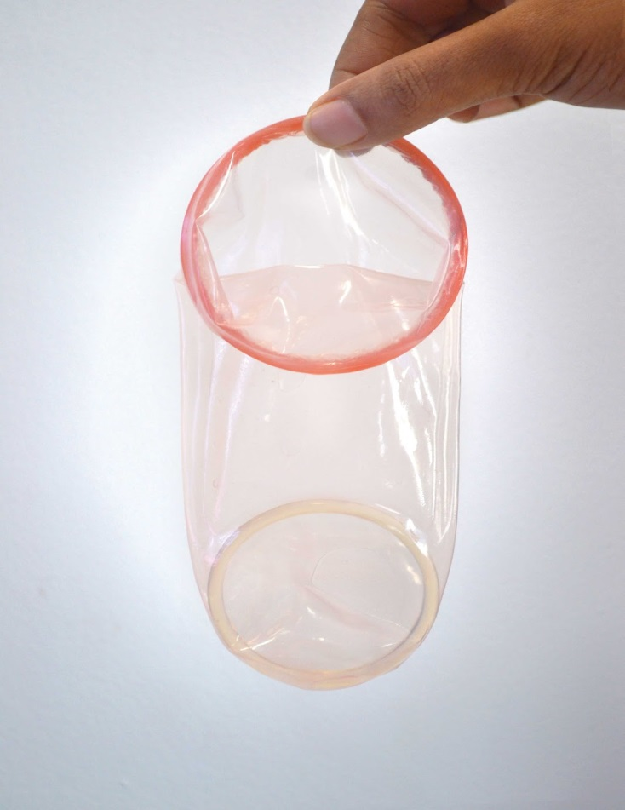
Female/Insertive Condoms
95% effective with proper use
use before ANY genital contact
protection against some STIs
Notes:
What is it?
A polyurethane cover that lines the inside of the vagina and covers the woman’s genitals.
How does this method work?
Placed in vagina prior to vaginal intercourse (up to 8 hours prior)
It is a barrier method – it prevent sperm from getting into the vagina and fertilizing the egg cell.
Why would someone choose this option?
Free from school nurse
Approximately $3.00 each when purchased at a pharmacy,.
Reversible method of contraception
95% effective when used perfectly every time
Most people do not use perfectly every time, so with average use, they are 79% effective
Protects against STIs
Cost
Ask your school nurse how to access condoms for free!

Slide 11
Hormonal Contraceptives
Notes:
Medications containing hormones such as estrogen and progesterone that females take to prevent pregnancy
Hormonal contraceptives are prescribed by a doctor or nurse practitioner who do a thorough health history and an assessment to determine the best option for the patient.
Mild side effects are possible with all hormonal methods: breast tenderness, spotting, etc.
In rare cases, a girl may experience a severe reaction to hormonal contraceptives.

Slide 12
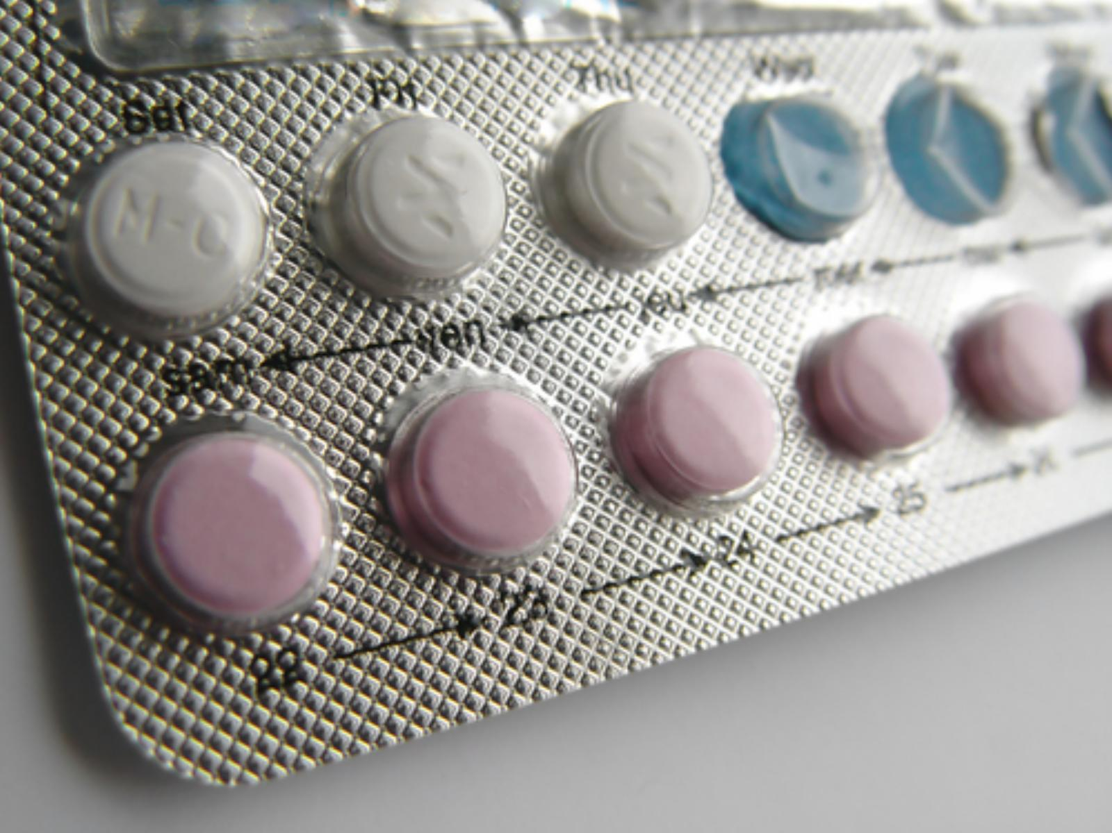
Oral Contraceptives
99% effective with perfect use
Take at the SAME TIME every day
No protection against STI
Notes:
What is it?
Oral contraceptives are hormone pills that prevent pregnancy when taken correctly. There are many different types of pills. The right one will be chosen for you by a doctor or nurse practitioner.
What you need to know?
Contains hormones that stop ovulation (monthly egg release).
Changes cervical mucous, making it difficult for sperm to travel
Must be taken every day at the same time.
Why would someone choose this option?
99.9 % effective if taken properly ( Describe proper / perfect use means taking every day at the same time , as prescribed by a doctor or nurse practitioner. Usual use effectiveness is 92-97% - i.e. errors made by forgetting pills, not taking at the same time every day etc.)
Can help regulate periods and help with cramps
Can also improve acne
Cost
Ask your school nurse how to access for free or reduced cost.
The pill does not offer any protection against STIs so it is important to use a condom with all sexual activity.

Slide 13
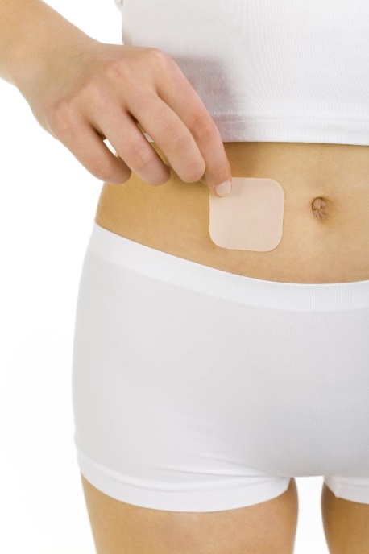
EVRA Patch
99% effective with perfect use
Change weekly for 3 weeks
No protection against STI
Notes:
What is it?
Evra is a patch that is placed on the skin and releases hormones through the skin
How does this method work?
Evra works like the Birth Control Pill except the hormones are absorbed through the skin instead of the stomach
Each box of Evra contains 3 patches. A patch is applied once a week for three weeks on the SAME DAY of the week. The fourth week is a patch free week and this is when a girl’s period would start. After the fourth week, a new patch is applied. It is important to remember to apply the patch on the same day at the same time every week. For example, someone may choose to change their patch every Sunday at 5pm.
The patch is placed on the buttocks, upper outer arms, lower stomach or shoulder blade (not breasts).
Why would someone choose this option?
Don’t have to take daily – only change once a week
99 % effective if taken properly
Can help regulate periods and help with cramps
Can also improve acne
Cost
Ask your school nurse how to access for free or reduced cost.
The patch does not offer any protection against STIs so it is important to use a condom with all sexual activity.

Slide 14
Nuvaring
99% effective with perfect use
Inserted into vagina for 21 days
No protection against STI
Notes:
What is it?
The Nuvaring is a soft, flexible plastic ring that is self-inserted into the vagina for 21 days
How do they work?
2 hormones to prevent ovulation are absorbed by the body through the walls of the vagina.
The ring sits inside the vagina for 3 weeks, followed by one week that the ring is out. A girl will get her period during this week, and insert another ring at the same time and day the next week.
Why would someone choose this option?
Only need to insert once a month
99 % effective if taken properly
Can help regulate periods and help with cramps
Can also improve acne
Cost
Ask your school nurse how to access for free or reduced cost.
The ring does not offer any protection against STIs so it is important to use a condom with all sexual activity.

Slide 15
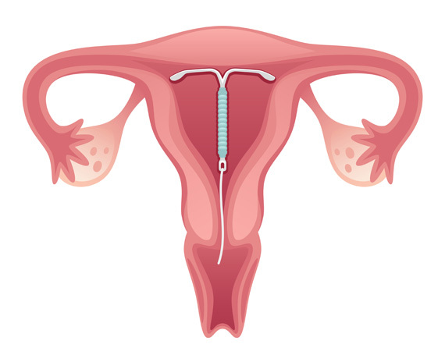
Hormonal Intrauterine System (IUS)
99.9% effective
Inserted by doctor – good for 3 to 5 years
No protection against STIs
Notes:
What is it?
A T-shaped device inserted into the uterus by a doctor or specially trained nurse practitioner
Lasts 3-5 years depending on the type
Contains the hormone progestin, which changes the lining of the uterus to stop a fertilized egg from growing inside the uterus, thickens the mucous in the cervix so it’s harder for the sperm to get to the egg, slows the sperm movement. May stop the ovaries from releasing an egg
Why would someone choose this option?
Long-acting and you only need to think about it when the 3 - 5 years is up
99% effective
Can reduce bleeding and cramping
Cost?
Ask your school nurse how to access for free or reduced cost.
The IUS does not offer any protection against STIs so it is important to use a condom with all sexual activity.

Slide 16
Depo - Provera
99. 7 % effective
Given by needle every 12 to 13 weeks
No protection against STI
Notes:
What is it?
Depo-Provera™ is a hormonal birth control method that contains only a progestin. (no estrogen) It is given by injection every 12 -13 weeks.
What you need to know?
Contains hormones that stop ovulation (monthly egg release)
Changes cervical mucous, making it difficult for sperm to travel
Injections are given by a health care provider (can not be given at school) A prescription is required.
The first injection should be given during the first 5 days of the menstrual cycle.
It becomes fully effective 24 hours after the first injection
Injections must be given every 12-13 weeks
If late for an injection, a pregnancy test should be done before another injection is given. A non-hormonal method of birth control ( i.e. condoms) should be used until next injection is given and for 3 weeks after that injection
Why would someone choose this option?
99.7 % effective if taken properly
Do not have to think about birth control every day – only 4 times a year!
Many women stop having periods within the first year of taking depo-provera (this is not unhealthy – may be a positive side effect for women with painful periods)
Can be used by breastfeeding mothers – no effect on breast milk production
Side Effects
The most common side effects are irregular bleeding and weight gain, although they do not happen to every user.
Irregular bleeding is common in the first few months of use. Some women have no bleeding; some women have spotting, and some women experience heavier bleeding. The bleeding usually decreases with time. By one year, 50% of women will stop having periods altogether.
Women may gain weight with the average gain in the first year being approximately 5-10 pounds. This may be due to increased appetite and an increased food intake. Not all women gain weight and healthy diet and exercise are important for all women.
There may be a small decrease in bone density in women who use the injection especially teens. There is no evidence that this will lead to osteoporosis. Bone density appears to return to normal when the injections are stopped, but there is no guarantee. Studies are ongoing. It is always important for a woman to have a calcium-rich healthy diet and active lifestyle.
A woman's return to fertility with this method can be longer than with the oral contraceptive pill. It takes an average of 9 months after your last injection to return to your regular menstrual cycle pattern. In some women, this can take longer, but Depo Provera does not cause infertility.
Cost
Ask your school nurse.
Depo-Provera does not offer any protection against STIs so it is important to use a condom with all sexual activity.

Slide 17
Other Forms of Contraception

Slide 18
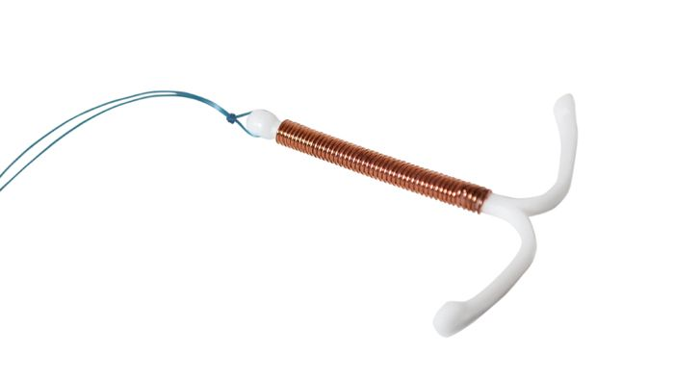
Copper Intrauterine Device (IUD)
99% effective
Inserted by doctor – good for 3 to 5 years
No protection against STIs
Notes:
What is it?
A T-shaped piece of plastic and copper inserted into the uterus by a doctor or specially trained nurse practitioner
Inserted every 3, 5 or 10 years depending on the type
The copper changes the chemistry of the uterus and stops sperm from fertilizing an egg
Why would someone choose this option?
Is a non-hormonal method. A good alternative for women who can’t use hormonal contraceptive methods. (i.e. migraines with aura)
Long-acting and you only need to think about it when the 3+ years is up
99% effective
Can be used up to 7 days after unprotected sex for emergency contraception
Cost?
Ask your school nurse how to access for free or reduced cost.
The IUD does not offer any protection against STIs so it is important to use a condom with all sexual activity.
The IUD may be more expensive than other methods initially, but will save you money in the long run

Slide 19
Emergency Contraceptive
Used after unprotected sex to prevent pregnancy
Can be taken up to 120 hours (5 days) after sexual encounter
Not to be used as regular birth control
Notes:
What is it?
A hormone pill that can lower the risk of pregnancy after there has been unprotected sex, a condom breaks or another method of contraception has not been used properly / as prescribed. Women should not rely on EC as your primary method of birth control.
How do they work?
It functions by delaying or inhibiting the release of an egg (ovulation)
ECPs do not cause abortion of an existing pregnancy.
Is most effective the sooner it is taken to the time of unprotected intercourse: 95% when taken within 24 hours, 85 % when taken within 25-48 hours, 58% when taken between 49-72 hour, less than 58% when taken between 73-120 hours)
A woman may experience spotting (light vaginal bleeding) a few days after taking Plan B and her next period may be heavier than normal
There is still a risk of pregnancy – if a woman doesn’t get a period within 3 weeks they need to have a pregnancy test.
Cost at SHC / School Nurse
Ask your school nurse how to access for free.
Why would someone choose this option?
A simple and safe way to prevent pregnancy
ECPs have no known medically serious complications
ECPs do not appear to be harmful if inadvertently taken in pregnancy.
Available without a prescription at pharmacies
You can obtain the product in advance and store it for use in case of an emergency.

Slide 20
Contraception Myths
FACT?
FICTION?

Slide 21
Contraception Myths
TRUE
You can get pregnant if it’s your first time having sex
FALSE
You need your parent’s permission to get birth control
FALSE
The pill is effective as soon as you start taking it
FALSE
The pill makes you gain weight
TRUE
A guy can get a girl pregnant even if he doesn’t have an orgasm/ ejaculate
Notes:
Withdrawal (Pulling Out In Time)
Once the penis becomes erect, it gives off a small amount of semen which contains many sperm. It only takes 1 sperm + 1 ovum (egg) = baby.
Not always able to pull out before ejaculation occurs as this method requires a lot of self-control.
Ejaculation near vaginal opening is risky as sperm can travel into the vagina.
FOR REFERENCE ONLY:
If students require more information regarding the rhythm method:
Period lasts approximately the first 5 to 7 days of a cycle.
Ovulation occurs approximately 14 days before the next menstrual period.
As an example: Ovulation occurs on approximately the 16th day of a 30 day cycle. One should add a day or two on either side to allow for individual variations (e.g. 14th to 18th day).
The egg lives for 24 to 48 hours after ovulation and the sperm can live as long as 5 days after ejaculation. Therefore, add 2 days on after ovulation and 5 days before. This gives you a rough estimate of the fertile time if the body worked in the way it technically should (e.g. 9th to 20th).
BUT:
Periods do not always come as expected.
Important to have an idea of how the cycle works but calculations could be wrong.
Pregnancy could occur. No time is 100% safe.
Anytime a man and woman have intercourse, they risk pregnancy.

Slide 22
Love,
Sperm
#babies

Slide 23
Skills for Saying NO
Set the scene
Body language
Say something positive
Believe in yourself
Speak personally
Be clear
Stay with your statement
Try to see the situation from their point of view
Notes:
As a reminder, the only 100% way to prevent pregnancy is abstinence. With all of the pressures teens are facing, sometimes they find it difficult to say ‘no’. Here are a few tips that may be helpful:
Set the Scene:
Decide what you want beforehand, if possible. This helps you feel in control of the situation
Body Language:
Stand tall, keep your head up and keep eye contact. Feel strong and equal. Believe in yourself.
Say something positive:
Begin by saying something positive to the other person, for example, I really like you, and I enjoy spending time with you, and I don’t want to
Believe in Yourself:
Avoid: I should, I ought, I must Replace with: I could, I want to, I can if I choose
In extreme situations where you are not being heard and your safety is under threat, you may need to walk away.
Speak personally:
No, I don’t want to because… No, I have a problem with that No, I don’t feel ready
Be clear:
You don’t need to give a reason. Use short clear statements, for example: I feel uncomfortable about… I am unhappy with… It scares me when…
Stay with your statement:
Avoid being manipulated into giving further explanations. Avoid being side-tracked.
Try to see the situation from their point of view:
Don’t accuse them or blame them for anything, simply state your views and wishes. Acknowledge that you have heard what the other person has said, for example: Yes, I hear what you are saying and I don’t want to…

Slide 24
Where to Access Sexual Health Services
School Nurse
Sexual Health Centres
St. Catharines, Niagara Falls,
Welland, Fort Erie
Family doctor or nurse practitioner
Walk-in clinic
Completely confidential and parental permission not required

Slide 25
Sexual Health Centres
Sexual Health Centres
Four sexual health centres in Niagara
Provide free, non-judgmental, and confidential services
Aim to enhance the sexual health of our community
St. Catharines Sexual Health Centre
277 Welland Avenue, St. Catharines
Welland Sexual Health Centre
200 Division Street, Welland
Niagara Falls Sexual Health Centre
5710 Kitchener Street, Niagara Falls
Fort Erie Sexual Health Centre
1264 Garrison Road, Unit 12, Fort Erie
905-688-3817
1-800-263-5757
For current hours call or visit: www.niagararegion.ca/health
Notes:
Free, confidential walk in and telephone counselling services for males and females of all ages.
No health card needed
Parental consent not needed
Free condoms
Information, counselling and access to birth control and Plan B at a reduced cost
Pregnancy and STI testing in a clinic setting.
STI treatment and follow up
Clean needle supply
Positive space for gay, lesbian, bisexual, transgendered and questioning individuals
Referrals to other health care providers, as needed

Slide 26
QUESTIONS?

